Slide 1
Header
Lymphoma
Paul Harker-Murray, MD PhD
Subhead

Slide 2
Overview
Review Pediatric Hodgkin and Non-Hodgkin lymphoma
Epidemiology, Etiology, Pathology & Biology
Presentation, Diagnosis and Staging
Principles of therapy, Outcomes, & Late Effects
Highlight differences between the various lymphomas
Emphasis on the ABP content outline for the Pediatric Hematology-Oncology Subspecialty Examination
(indexed at the end of the of the presentation)
!
!
The ABP content has not changed since 2007

Slide 3
Organization of slides
Hodgkin lymphoma
Non-Hodgkin lymphoma
Epidemiology
Subtypes
Histology
Phenotype
Genetics
Subsets
Presentation
Emergencies
Evaluation
Staging
Risk stratification
Treatment
Late effects
Epidemiology
HL etiology
Genetics
Infection
Immune dysregulation
EBV
Histology
HRS & L&H
HL subsets
NLPHL vs cHL
Presentation
DDX
Evaluation
Staging
Prognostic Factors
Risk Stratification
Treatment
Radiation
Late effects
Relapse
Summarize Major Differences

Slide 4
Pediatric Lymphoma: Many Subtypes
Hodgkin Lymphoma
Classic Hodgkin Lymphoma
Nodular sclerosing
Mixed cellularity
Lymphocyte predominant
Lymphocyte depleted
Nodular Lymphocyte Predominant
Non-Hodgkin Lymphoma
Burkitt
Lymphoblastic
Diffuse Large B Cell
Primary Mediastinal B cell
Anaplastic Large Cell
Others

Slide 5
Pediatric Lymphoma: Subtypes Simplified
 | T cell derived | B cell derived
Immature
Mature

Slide 6
Pediatric Lymphoma: Subtypes Simplified
 | T cell derived | B cell derived
Immature | T-lymphoblastic
Mature

Slide 7
Pediatric Lymphoma: Subtypes Simplified
 | T cell derived | B cell derived
Immature | T-lymphoblastic | B-lymphoblastic
Mature

Slide 8
Pediatric Lymphoma: Subtypes Simplified
 | T cell derived | B cell derived
Immature | T-lymphoblastic | B-lymphoblastic
Mature | Anaplastic Large Cell

Slide 9
Pediatric Lymphoma: Subtypes Simplified
 | T cell derived | B cell derived
Immature | T-lymphoblastic | B-lymphoblastic
Mature | Anaplastic Large Cell | Burkitt Diffuse Large B cell Primary Mediastinal B cell Hodgkin

Slide 10
Pediatric Lymphoma: Subtypes Simplified
 | T cell derived | B cell derived
Immature | T-lymphoblastic | B-lymphoblastic
Mature | Anaplastic Large Cell | Burkitt Diffuse Large B cell Primary Mediastinal B cell Hodgkin
Differentiated by morphology, immunophenotype, cytogenetics

Slide 11
Most Common Pediatric Cancers
Age 0-14
Age 15-19
Leukemia 30%
CNS 21
Lymphoma 9
Neuroblastoma 7
Rhabdo/STS 7
Wilms 5
Osteo/Ewing 4
Germ cell 3.5
Retinoblastoma 3
Hepatoblastoma 1
Thyroid 1
Melanoma 1
Lymphoma 24%
Germ cell 14
Leukemia 12
CNS 10
Rhabdo/STS 8
Thyroid 9
Melanoma 7
Osteo/Ewing 6
SEER, 1973-2010

Slide 12
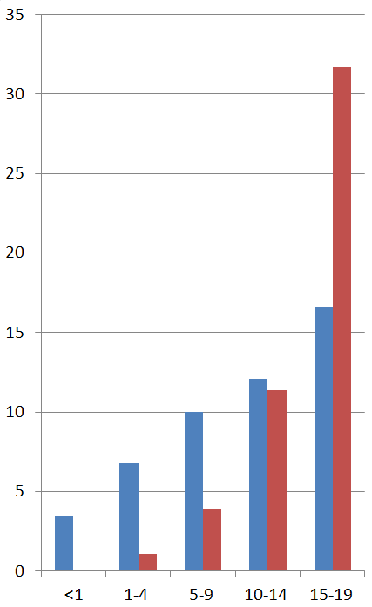
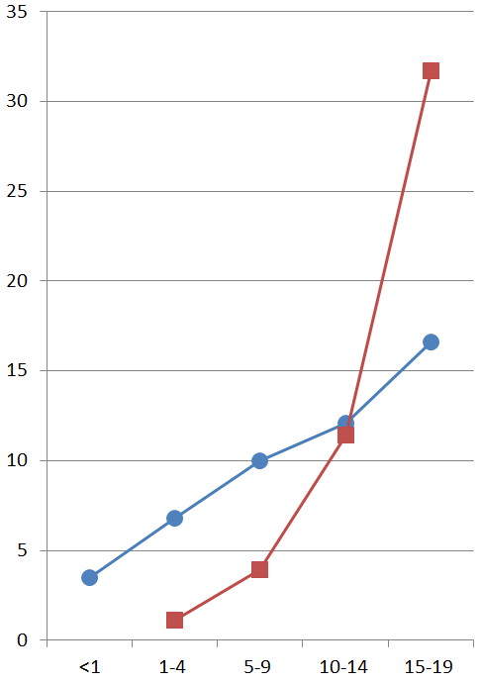
Hodgkin Lymphoma: #1 cancer in 15-19 year olds
NHL: more common
in young children
NHL = HL at age 10
Annual Rate Per Million
Annual Rate Per Million
Age at diagnosis
Age at diagnosis
Incidence of Hodgkin Lymphoma is bimodal with peaks after age 20 and 50
U.S. Cancer Statistics Working Group. United States Cancer Statistics: 1999–2013 Incidence and Mortality Web-based Report. Atlanta: U.S. Department of Health and Human Services, Centers for Disease Control and Prevention and National Cancer Institute; 2016. Available at: www.cdc.gov/uscs
Notes:
U.S. Cancer Statistics Working Group. United States Cancer Statistics: 1999–2013 Incidence and Mortality Web-based Report. Atlanta: U.S. Department of Health and Human Services, Centers for Disease Control and Prevention and National Cancer Institute; 2016. Available at: www.cdc.gov/uscs.

Slide 13
Hodgkin Lymphoma: may be multiple diseases mediated by genetics, infection and immune function
Genetics Family member with HL Increased risk
Parent 3 x ↑
Sibling 5 x ↑
Brothers 8 x ↑
Sisters 11 x ↑
Monozygotic twin 99 x ↑
Immune
function
Infection
Can be seen in:
Sarcoid
ALPS (51x↑risk)
Ataxia telangiectasia
HIV
Can present with:
ITP, AIHA
autoimmune neutropenia
nephrotic syndrome
Childhood form (age 0-14)
Lower socioeconomic status
Larger family
Early, intense exposure to infections
Young Adult form (age 15-35)
Higher socioeconomic status
Single family house
Small family, Less siblings / playmates
Late exposure to infections
(more older siblings and pre-school
infections are protective)
SEER, 1975-1995
Notes:
cHL: is probably multiple diseases mediated by
Genetic susceptibilities - Immune dysregulation
Infectious disease: - Autoimmunity
CONTENT OBJECTIVE: Hodgkin dx can occur in families
Childhood form (Age 0-14): associated with ↓ socioeconomic status, larger family, early exposure to pathogens (EBV)
Young Adult form (Age 35-34): Higher socioeconomic status, late exposure to pathogens. (Protective: More older siblings, More pre-school infections)
Note: Gender concordance in sibling pairs could be explained by a pseudoautosomal region of the sex chromosomes, potential recessive susceptibility gene on chromosome 4
Infectious disease: HIV, EBV → cHL EBV+ (clonal), increased risk in younger children, africans, asians, south americans. Time 4.1 years
Autoimmune or Immunodeficiency: sarcoid, ALPS (51x↑risk) , Ataxia telangiectasia
Genetic susceptibilities: Twin studies, HLA associateions
Aspirin → ↓NF-kB, → ↓Hodgkin →↑HRS apoptosis

Slide 14
Hodgkin Lymphoma: may be multiple diseases mediated by genetics, infection and immune function
Genetics Family member with HL Increased risk
Parent 3 x ↑
Sibling 6 x ↑
Brothers 8 x ↑
Sisters 11 x ↑
Monozygotic twin 99 x ↑
Immune
function
Infection
Can be seen in:
Sarcoid
ALPS (51x↑risk)
Ataxia telangiectasia
HIV
Can present with:
ITP, AIHA
autoimmune neutropenia
nephrotic syndrome
Childhood form (age 0-14)
Lower socioeconomic status
Larger family
Early, intense exposure to infections
Young Adult form (age 15-35)
Higher socioeconomic status
Single family house
Small family, Less siblings / playmates
Late exposure to infections
(more older siblings and pre-school
infections are protective)
SEER, 1975-1995
Notes:
cHL: is probably multiple diseases mediated by
Genetic susceptibilities - Immune dysregulation
Infectious disease: - Autoimmunity
CONTENT OBJECTIVE: Hodgkin dx can occur in families
Childhood form (Age 0-14): associated with ↓ socioeconomic status, larger family, early exposure to pathogens (EBV)
Young Adult form (Age 35-34): Higher socioeconomic status, late exposure to pathogens. (Protective: More older siblings, More pre-school infections)
Note: Gender concordance in sibling pairs could be explained by a pseudoautosomal region of the sex chromosomes, potential recessive susceptibility gene on chromosome 4
Infectious disease: HIV, EBV → cHL EBV+ (clonal), increased risk in younger children, africans, asians, south americans. Time 4.1 years
Autoimmune or Immunodeficiency: sarcoid, ALPS (51x↑risk) , Ataxia telangiectasia
Genetic susceptibilities: Twin studies, HLA associateions
Aspirin → ↓NF-kB, → ↓Hodgkin →↑HRS apoptosis

Slide 15
Hodgkin Lymphoma: may be multiple diseases mediated by genetics, infection and immune function
Genetics Family member with HL Increased risk
Parent 3 x ↑
Sibling 6 x ↑
Brothers 8 x ↑
Sisters 11 x ↑
Monozygotic twin 99 x ↑
Immune
function
Infection
Can be seen in:
Sarcoid
ALPS (51x↑risk)
Ataxia telangiectasia
HIV
Can present with:
ITP, AIHA
autoimmune neutropenia
nephrotic syndrome
Childhood form (age 0-14)
Low socioeconomic status
Larger family
Early, intense exposure to infections (?)
Young Adult form (age 15-35)
Higher socioeconomic status
Single family house
Small family, Less siblings / playmates
Late exposure to infections
(more older siblings and pre-school
infections are protective)
Notes:
cHL: is probably multiple diseases mediated by
Genetic susceptibilities - Immune dysregulation
Infectious disease: - Autoimmunity
CONTENT OBJECTIVE: Hodgkin dx can occur in families
Childhood form (Age 0-14): associated with ↓ socioeconomic status, larger family, early exposure to pathogens (EBV)
Young Adult form (Age 35-34): Higher socioeconomic status, late exposure to pathogens. (Protective: More older siblings, More pre-school infections)
Note: Gender concordance in sibling pairs could be explained by a pseudoautosomal region of the sex chromosomes, potential recessive susceptibility gene on chromosome 4
Infectious disease: HIV, EBV → cHL EBV+ (clonal), increased risk in younger children, africans, asians, south americans. Time 4.1 years
Autoimmune or Immunodeficiency: sarcoid, ALPS (51x↑risk) , Ataxia telangiectasia
Genetic susceptibilities: Twin studies, HLA associateions
Aspirin → ↓NF-kB, → ↓Hodgkin →↑HRS apoptosis

Slide 16
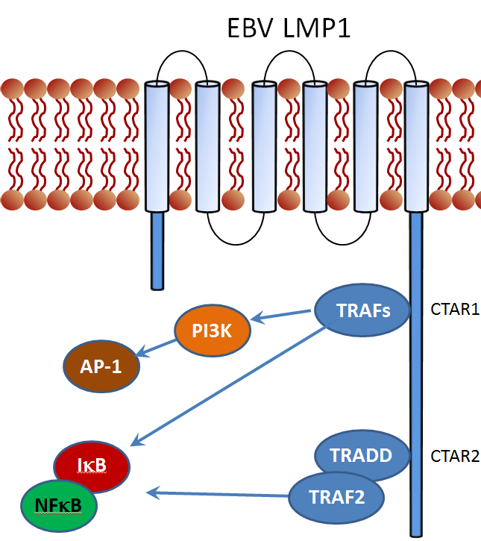
EBV may cause some cases of Hodgkin Lymphoma
Many patients have high antibody titers against EBV
EBV genome is found in and localized to Reed-Sternberg cells:
Epstein-Barr Early Ribonucleoprotein 1 & 2
Latent membrane proteins 1 & 2A
Nuclear antigen 1
“Latency type II pattern of EBV infection”
LMP1
Resembles activated TNFR superfamily member
Signaling pathways include NFκB
NFκB is constitutively active in HRS cells
EBV expression varies by
Subtype: LD > LR > MC > NS > NLP
Ethnicity: Asian > Hispanic > White > African American
Population: younger age, lower socioeconomic status
Notes:
Children with serologically confirmed EBV have a 4 x increased risk of HL
EBV-negative HL may have IkB inactivating mutations
EBV is not prognostic in HL

Slide 17
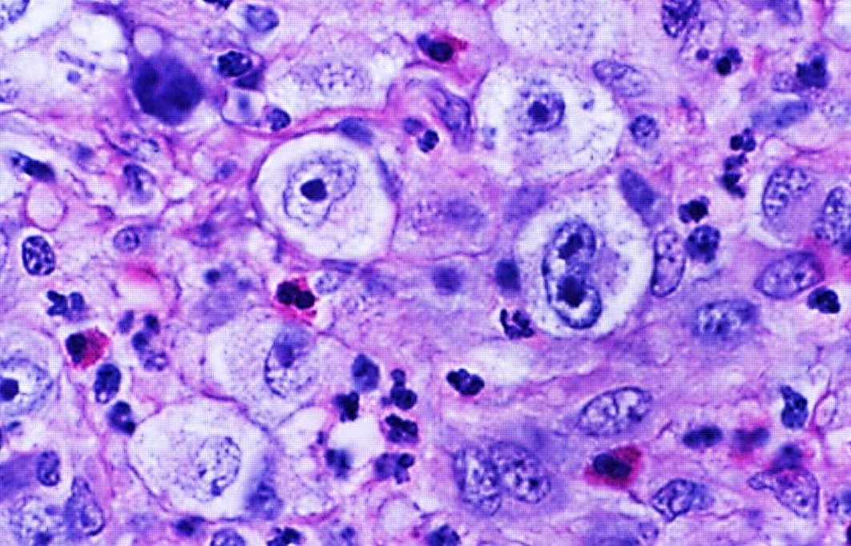
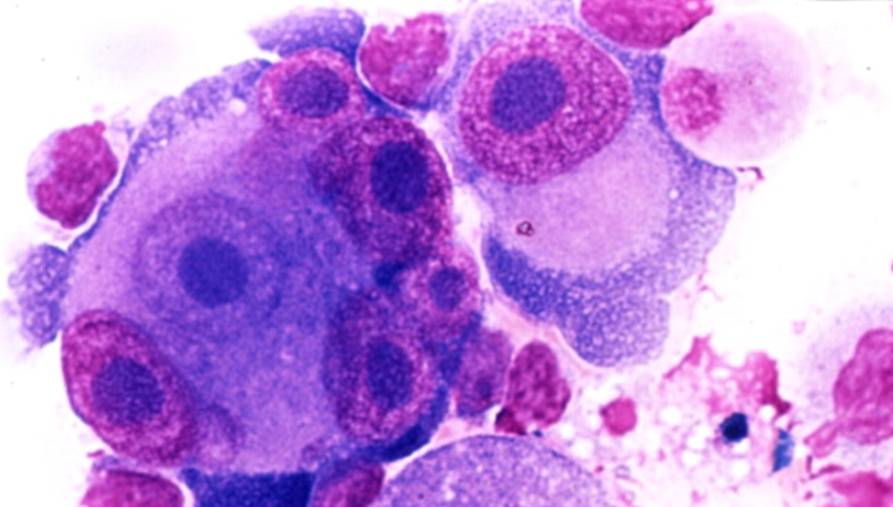
The Hodgkin Reed-Sternberg Cell and Variations
Classic HRS cell: binucleate, “owl’s eye”
Hodgkin cell (mononuclear variant of HRS)
Multinucleate variant
Lacunar cells: artifact of formalin fixation
Republished with permission of The American Society of Hematology, from ASH Image Bank, Kadin, M. Image 2-4 2002;2002:100484 & 100525 Copyright ©2002; permission conveyed through Copyright Clearance Center, Inc.
Notes:
OBJ: Recognize the morphologic and immunophenotypic HRS cells and HRS cell variants.
HRS cell obtained from non-copywrited site (http://www.geocities.ws/jcprolla/case_01A_2002.html)
Permission to use ASH Image Bank Slides obtained from Patrick Baggott 11/10/2016 for the 2017 ASPHO board review course
Patrick Baggott
Sr. Manager, Publications, American Society of Hematology
2021 L Street, NW, Suite 900, Washington, DC 20036
202-292-0027
pbaggott@hematology.org

Slide 18
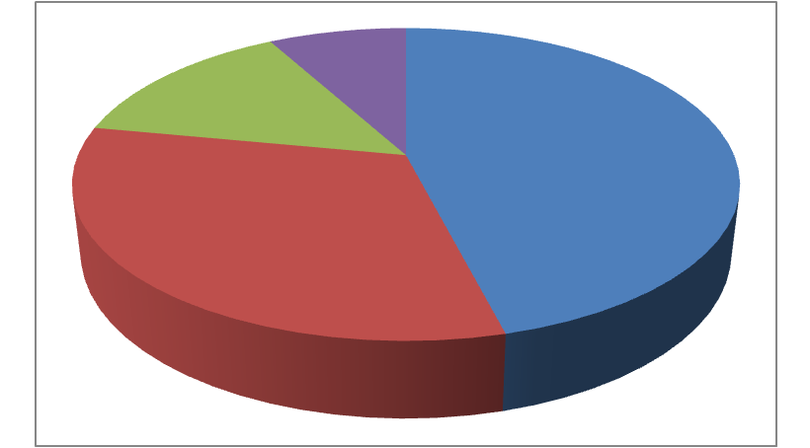
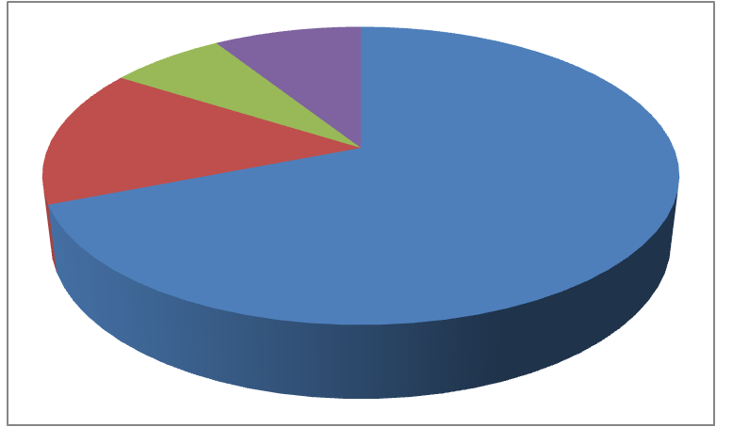
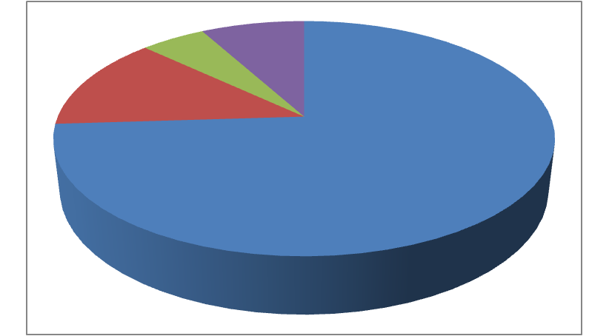
Nodular Sclerosing is the most common histology
<10 years
10-14 years
15-19 years
7%
5%
14%
13%
46%
15%
69%
74%
32%
Subtype Buzz Words EBV
Nodular sclerosing Young adults 25%
Lymphocyte-rich <10 years 42%
Mixed cellularity <10 years, advanced 75%
Lymphocyte depleted Adults with HIV 100%
Nodular lymphocyte predominant Young, male, localized rarely
cHL
Histologic subtypes of cHL are based on tissue architecture, fibrosis, and inflammatory infiltrate. They are not used in risk stratification (yet)
SEER, 1975-1995
Notes:
18
Purple is non-classical NLPHL
Lymphocyte depleted: Adults, HIV (<2% of Pediatric HL)
CD45: LCA = leukocyte common antigen,
CD30: AKA Ki-1 because identified by antibody Ki-1
Eotaxis → eosinophils
TGF b → fibrosis
Germinal Center is where B cells encounter antigen + T cell help
→ B cell activation & proliferation (dark zone)
Somatic hypermutation & class switch recombination (light zone)
Differentiation plasma cells or memory B cells
Dysregulation can result in B cell malignancies (Hodgkin)

Slide 19
Nodular Sclerosing Hodgkin Lymphoma
Thick capsule with thick, sclerotic collagenous bands (can be visualized grossly)
Notes:
Pathology courtesy of Dr Gabriela Gheorghe, MD.
Department of Pathology, Medical College of Wisconsin

Slide 20
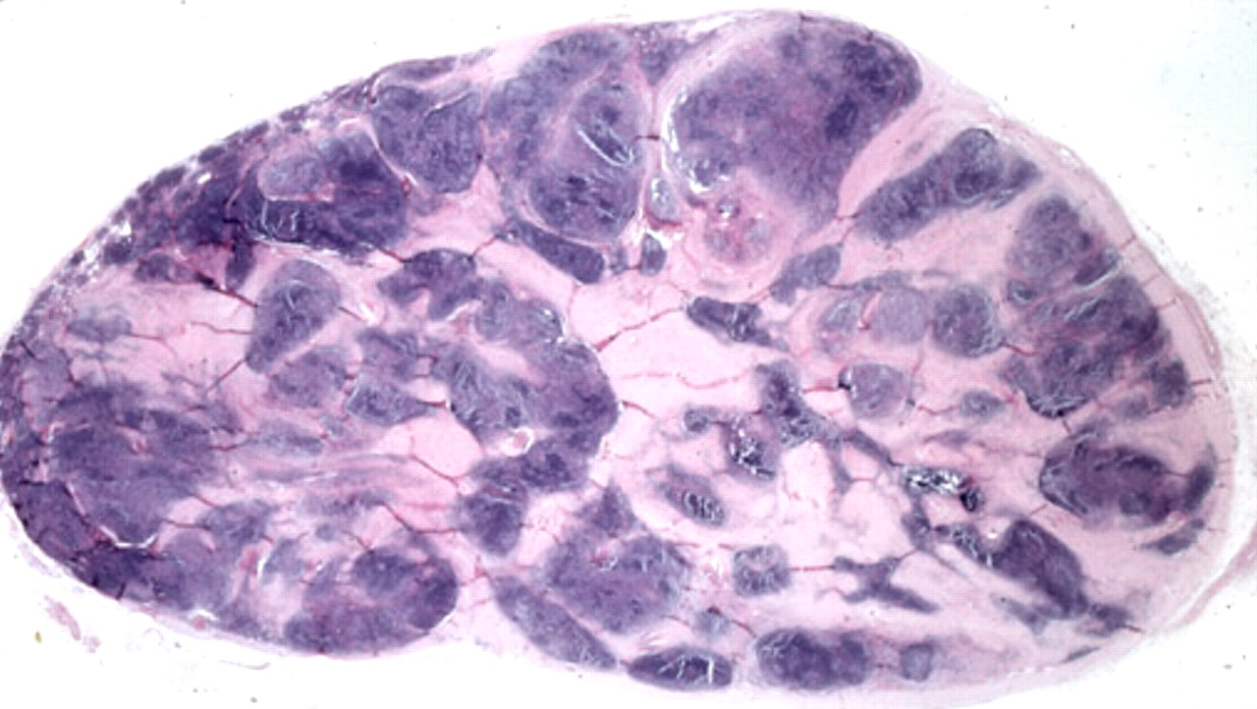
Nodular Sclerosing Hodgkin Lymphoma
Thick capsule with thick, sclerotic collagenous bands
Most common cHL histology, often involves neck and mediastinum
Republished with permission of The American Society of Hematology, from ASH Image Bank, Kadin, M. 2002;2002:100484 Copyright ©2002; permission conveyed through Copyright Clearance Center, Inc.
Notes:
Nodular growth can often be visualized grossly. Collagenous bands surround at least one nodule
Permission to use ASH Image Bank Slides obtained from Patrick Baggott 11/10/2016 for the 2017 ASPHO board review course
Patrick Baggott
Sr. Manager, Publications, American Society of Hematology
2021 L Street, NW, Suite 900, Washington, DC 20036
202-292-0027
pbaggott@hematology.org

Slide 21
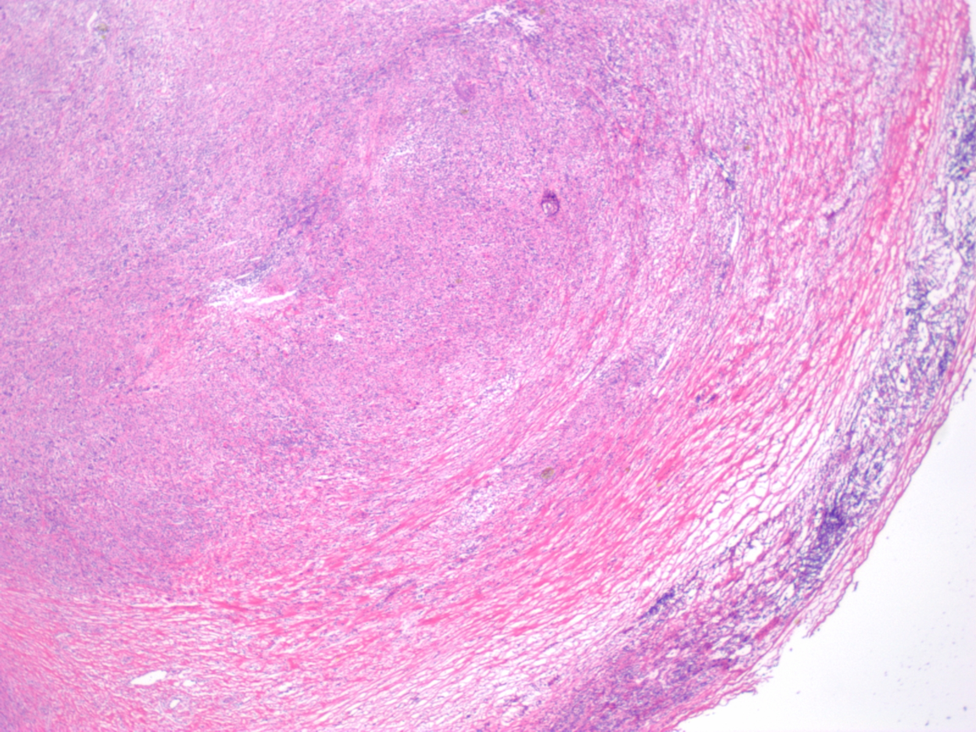
Nodular Sclerosing Hodgkin Lymphoma
Thick capsule with thick, sclerotic collagenous bands
Notes:
Pathology courtesy of Dr Gabriela Gheorghe, MD.
Department of Pathology, Medical College of Wisconsin

Slide 22
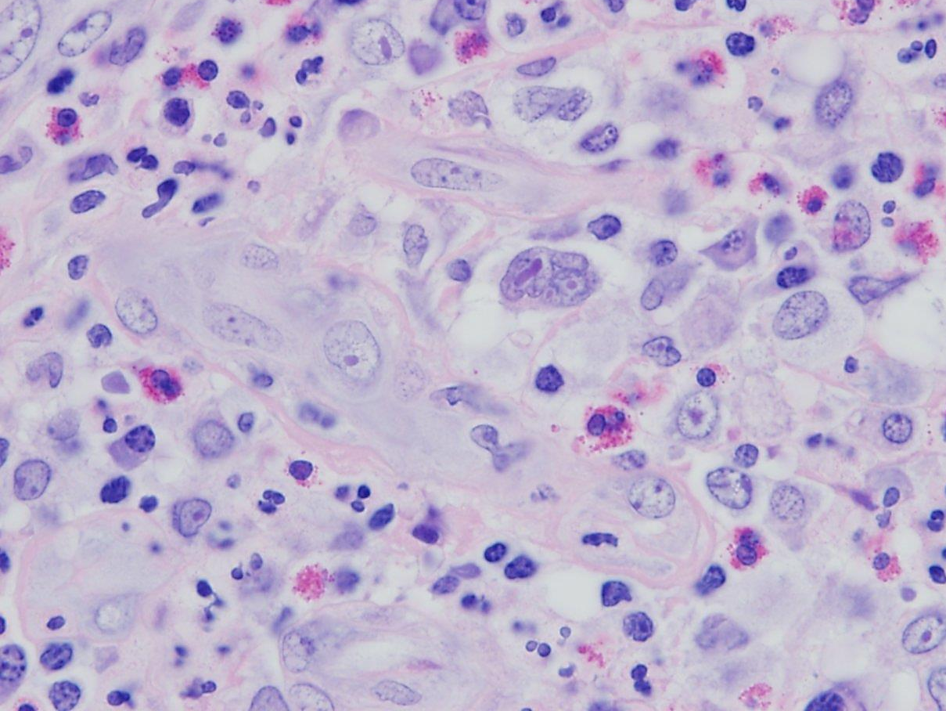
Nodular Sclerosing Hodgkin Lymphoma
HRS cell in a background containing lymphocytes, macropahges, eosinophils & rare plasma cells
Notes:
Pathology courtesy of Dr Gabriela Gheorghe, MD.
Department of Pathology, Medical College of Wisconsin

Slide 23
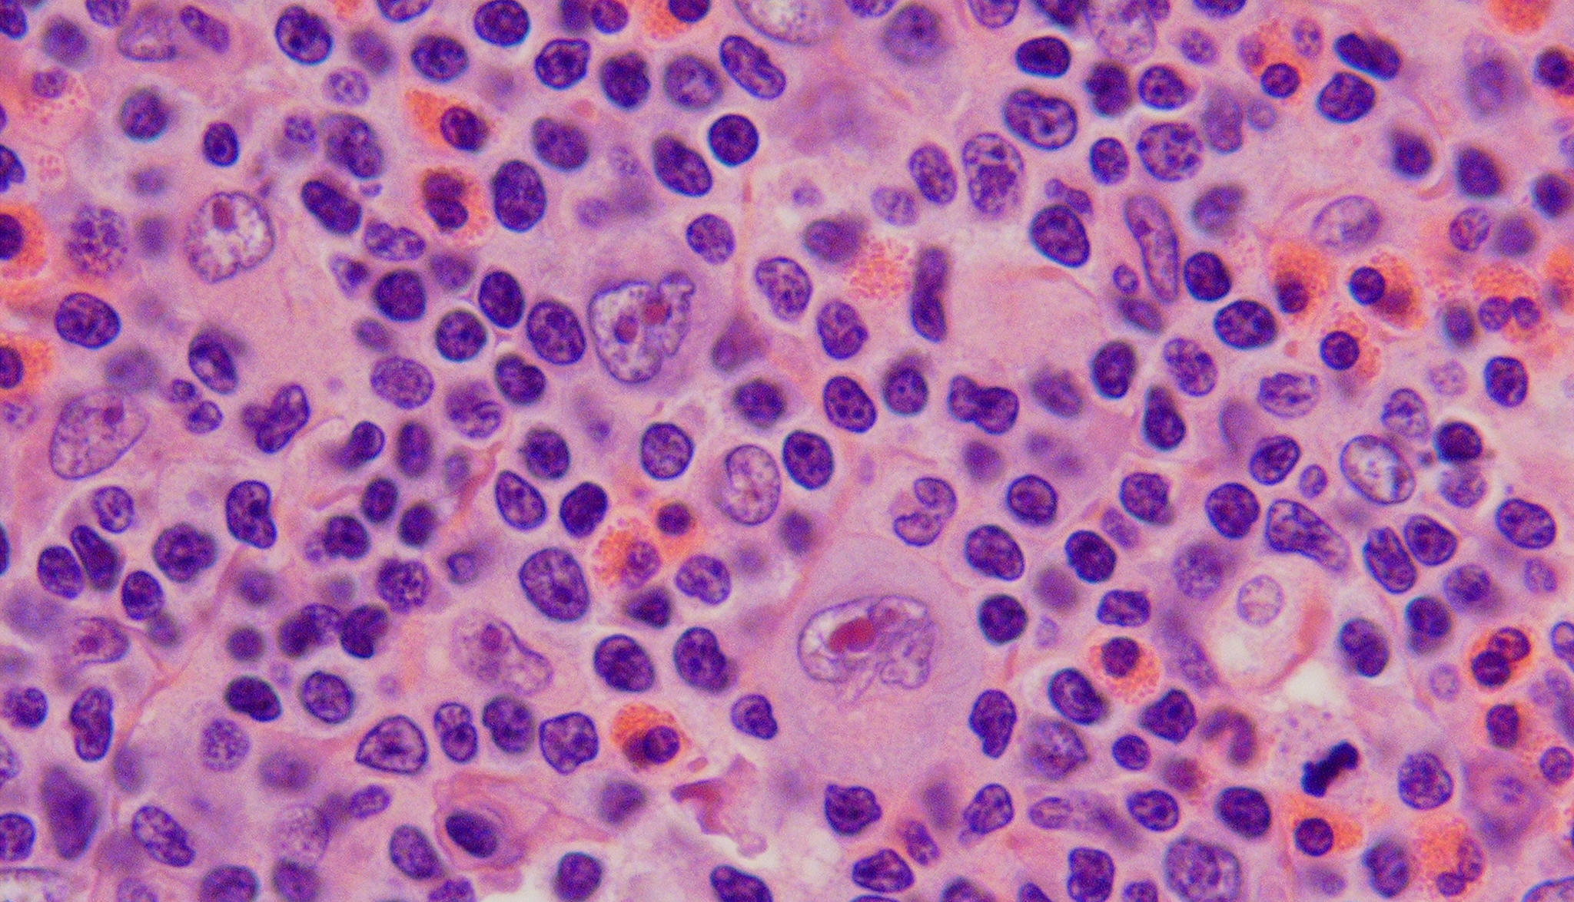
Mixed Cellularity Hodgkin Lymphoma
Many HRS cells, multiple others (lymphocytes, eosinophils, plasma cells, histiocytes)
2nd most common cHL, patients <10 years old, EBV frequently involved
Often advanced disease at presentation
Notes:
Histology Images courtesy of Dinesh Rakheja, M.B.B.S., M.D., Assistant Professor, Department of Pathology, University of Texas, Southwestern Medical School.
- Can be diffuse or vaguely nodular, but no sclerosis

Slide 24
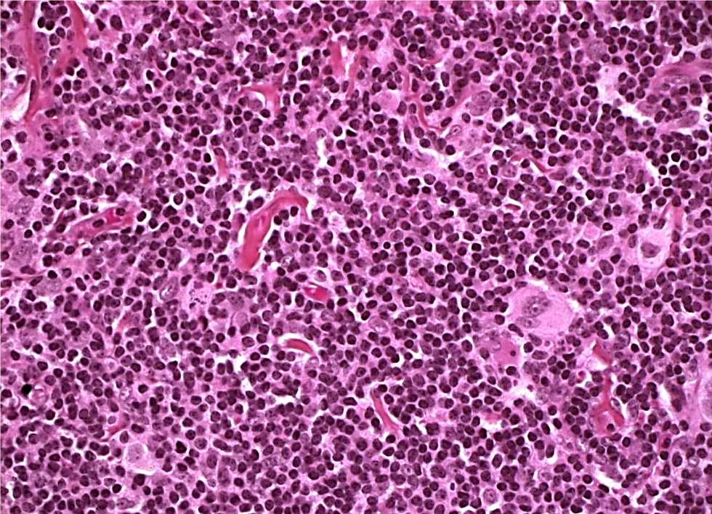
Lymphocyte Rich Hodgkin Lymphoma
~5% of cHL, background of small B lymphocytes, may be nodular or diffuse
Notes:
Non-copywrited material: http://www.humpath.com/spip.php?article1271

Slide 25
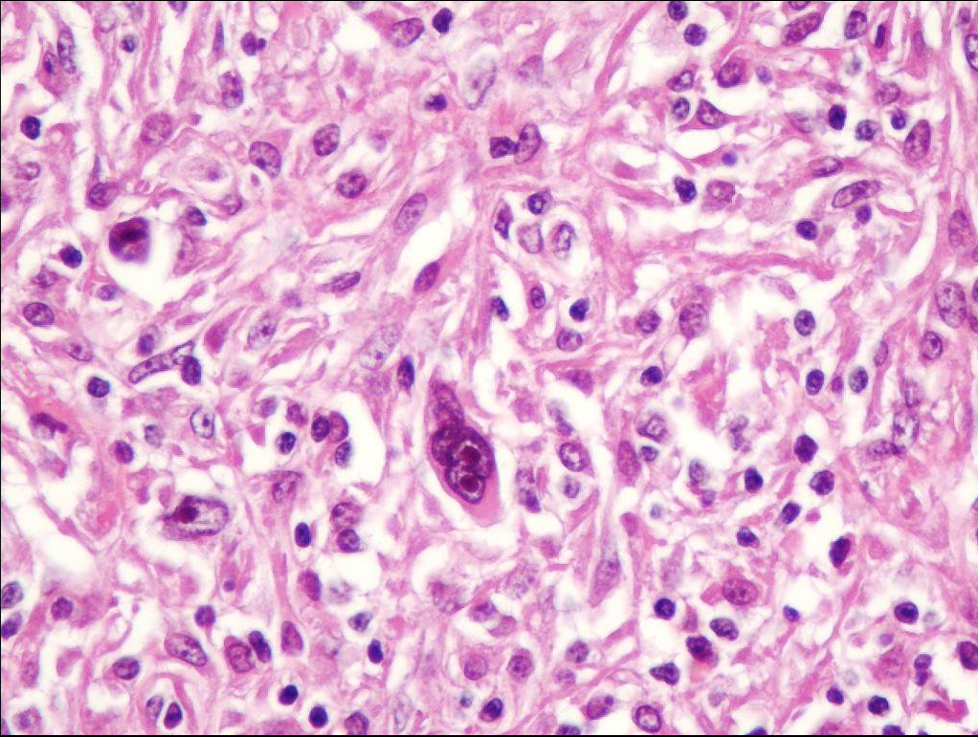
Lymphocyte Depleted Hodgkin Lymphoma
Large, bizarre malignant cells. Few lymphocytes, disorganized fibrosis.
Very rare in children, common in adults with HIV+, nearly always associated with EBV
Notes:
Not copywrited material Amjad Khan - https://twitter.com/amjadalikhan52/status/532261653329772544

Slide 26
The Malignant Cells of cHL and NLPHL
Hodgkin Reed Sternberg (HRS)
Malignant cell of classic HL
Binuclear
Thick nuclear membrane
Pale chromatin
Large eosinophilic nucleoli
LP Cell
Formerly Lymphocytic & Histiocytic (L&H)
Malignant Cell of NLPHD
Mononuclear variant of HRS cell,
Convoluted irregular nucleus (“popcorn”)
May have several small nucleoli
Notes:
26
HRS cell obtained from non-copywrited site (http://www.geocities.ws/jcprolla/case_01A_2002.html)
NLPHL – Pathology courtesy of Dr Gabriela Gheorghe, MD.
Department of Pathology, Medical College of Wisconsin

Slide 27
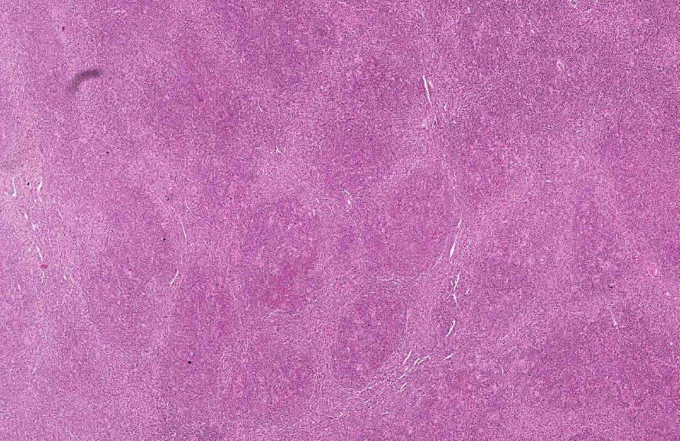
Nodular Lymphocyte Predominant HL
Notes:
http://app.parisdescartes.fr/cgi-bin/WebObjects/TRIBVNClientWS.woa/wa/lectureflash?jeton=9994_6258_20110922_16h18&WfmlZoomifyRoi=/ts/18/9994_6258/p/0000270a/sw/00006258.ndpi.apr

Slide 28
Nodular Lymphocyte Predominant HL
Notes:
Pathology courtesy of Dr Gabriela Gheorghe, MD.
Department of Pathology, Medical College of Wisconsin

Slide 29
Classic Hodgkin Nodular Lymphocyte
Lymphoma Predominant HL
CD30
CD30
CD15⁺, CD30⁺, CD45⁻
CD15⁻, CD30⁻, CD45⁺
Spoiler: PMBCL: CD15⁻, CD30⁺, CD45⁺
Notes:
Pathology courtesy of Dr Gabriela Gheorghe, MD.
Department of Pathology, Medical College of Wisconsin

Slide 30
Nodular Lymphocyte Predominant HL
Presentation
5-8% of HL
10-20% of HL in pre-pubertal
75% of NLPHL are males
Localized disease
No “B” symptoms
Not bulky
Not systemic
EBV negative
Good:
Surgery only may be appropriate for stage IA
Bad:
10-14% transform to DLBCL
Buzzwords:
Young
Male
Contained (localized)
Asymptomatic
Y
M
C
A
Notes:
HRS CELL: 25% have crippling rearrangements that destroy the function of the Ig gene – the cell should undergo apoptosis it resists due to constiuitive NF-KB activation
Phenotype: 70% CD15+, 100% CD30+ (also in ALCL, PTCL), 45-neg, B cell marker neg
PATHWAYS:
CD30 / CD40 / EBV LMP-1 (TNF-R superfamily) → NF-kB active → survival
NLPHL – Monoclonal B cell neoplasm
18% of HL in <10years
8% of HL if >10 yrs
80% of NLPHL are males
Presents with localized disease: No “B”, not bulky, not systemic
Nodular or nodular & diffuse infiltrate of small lymphocytes
difficult to differentiate from lymphocyte rich classic HL
EBV negative
t(3q27) → BCL-6 mutation in ~50%
(oncogene: zinc finger transcription prepressor, needed for GC formation)
BCL-6 may down regulate tP53 which senses DNA damage.

Slide 31
Classic Hodgkin Nodular Lymphocyte
Lymphoma Predominant HL
Malignant Hodgkin Reed-Sternberg LP cell (formerly L&H)
Cell (“Owl’s eyes”) (“Popcorn”)
Origin pre-apoptotic GC B cell GC/post-GC B cell
(Clonal Ig rearrangements, but Antigen selected, IgV genes intact
mutated & unable to code IgV) (transit to memory B cell)
Phenotype CD15⁺, CD30⁺, CD45⁻ CD15⁻, CD30⁻, CD45⁺, CD20⁺
B cell markers downregulated + for CD19, 20, 79a, J chain, PAX5
Pathways NFκB →↑BCL-2, IL-10, TGFβ t(3q27) → BCL-6 mutation in ~50%
(anti-apoptotic) may downregulate P53
which senses DNA damage
EBV+ LMP1
Like activated TNFR superfamily
EBV- Mutations inactivate IκB
IκB negative regulator of NFκB
all CD30 (TNFR superfamily)
Signals through NFκB & AP-1
↑CD30 associated with ↑stage and B sx
Neoplastic cells comprise <10% of the tumor, the cytokines they produce determine the signs, symptoms and histology
Notes:
HRS CELL: 25% have crippling rearrangements that destroy the function of the Ig gene – the cell should undergo apoptosis it resists due to constiuitive NF-KB activation
Phenotype: 70% CD15+, 100% CD30+ (also in ALCL, PTCL), 45-neg, B cell marker neg
PATHWAYS: CD30 / CD40 / EBV LMP-1 (TNF-R superfamily) → NF-kB active → survival
Nodular or nodular & diffuse infiltrate of small lymphocytes
difficult to differentiate from lymphocyte rich classic HL
EBV negative
t(3q27) → BCL-6 mutation in ~50%
(oncogene: zinc finger transcription prepressor, needed for GC formation)
BCL-6 may down regulate tP53 which senses DNA damage.

Slide 32
CD30
EBV LMP1
TRAF2
TRAFs
CTAR1
PI3K
AP-1
IκB
TRADD
CTAR2
NFκB
TRAF2

Slide 33
MCH I
PD-L1 on Reed Sternberg cells
TCR
PD-1 on T cells
9p24.1 alterations →↑PD-L1, PD-L2
PD-1 ligation results in
T cell anergy
Growth inhibition
Inhibition of effector function
ZAP70
SHP2
PLC-γ
AP-1
NFAT
NFκB
T cell activation
Cell growth
Effector function
Survival

Slide 34
MCH I
PD-L1 on Reed Sternberg cells
TCR
PD-1 on T cells
Checkpoint inhibitors
Blocking antibodies against PD-L1 and PD-1
Restores anti-tumor immunity
Active in Hodgkin lymphoma
ZAP70
SHP2
PLC-γ
AP-1
NFAT
NFκB
T cell activation
Cell growth
Effector function
Survival

Slide 35
Clinical Presentation of Hodgkin Lymphoma
Painless cervical or supraclavicular lymphadenopathy
Mediastinal mass (~2/3)
Constitutional symptoms
Evidence of inflammation and RES activation
↑CRP, ESR, ferritin, copper
Anemia of chronic inflammation
Immune dysregulation (uncommon)
autoimmune neutropenia, AIHA, ITP, nephrotic syndrome
B symptoms are prognostic
Weight loss of 10% in 6 months
Drenching night sweats
Unexplained fevers >38ºC
for 3 consecutive days
Other symptoms are not prognostic
Fatigue, anorexia, mild weight loss
Pain immediately following alcohol
Pruritus: generalized, can be severe, more often in advanced disease
Notes:
35
Some mediastinal involvement in 2/3 of patients.
Present in 75% of adolescents
present in 35% of young children
Bulk disease in 20% of patients
Markers of inflammation and RES activation (CRP, ESR, ferritin, copper)
Anemia of chronic inflammation
Immune dysregulation: autoimmune neutropenia, AIHA, ITP, nephrotic syndrome
Autoimmune or Immunodeficiency:
sarcoid, ALPS (51x↑risk) , Ataxia telangiectasia
Impaired immune function at diagnosis which may persist after therapy.
PMN chemotaxis Mitogen proliferation
DTH skin testing CD4:CD8 ratio

Slide 36
15 year old female with 2 months of cervical adenopathy
Stage IIA Classic Hodgkin lymphoma (nodular sclerosing)
Notes:
36
Original Images made into a power point slide by Paul Harker-Murray

Slide 37
Differential diagnosis?
Saturday night transfer: 90 kg 13 year old male with orthopnea, shortness of breath and an anterior mediastinal mass
Notes:
Original Images made into a power point slide by Paul Harker-Murray

Slide 38
Differential diagnosis:
Non-Malignant
Malignant
Normal thymus (child)
Infection
EBV
Atypical Mycobacterium
Histoplasmosis
Toxoplasmosis
Lymphoproliferative disorders
Progressive transformation of germinal centers (PTGC)
Hodgkin Lymphoma
Lymphoblastic lymphoma
Diffuse large B cell lymphoma
Primary mediastinal B cell lymphoma
Anaplastic Large cell lymphoma
Germ Cell Tumor
Soft Tissue Sarcoma
Lymph node metastases from other sites
Notes:
38
But the content objective is to know that the differential diagnosis of HL includes both malignant and non-malignant conditions

Slide 39
Evaluation of Hodgkin Lymphoma
History and physical examination
B symptoms / Lymphadenopathy
Superior vena cava syndrome / Superior mediastinal syndrome
CBC, biochemistry profile, inflammatory markers
CXR (“bulky” if >33% of maximum intrathoracic cavity)
CT neck and chest
CT or MRI of abdomen and pelvis
FDG-PET (metabolic activity study of choice)
Excisional LN biopsy – for histology and architecture (vs core)
2007: Bilateral bone marrow biopsy if B symptoms or Stage III/IV
2017: FDG-PET imaging to assess marrow involvement
Notes:
Excisional biopsy is best for diagnosis.
histology, LN architecture
Immunochistochemistry.
In patients with symptomatic masses where anesthesia poses a risk, tissue must be obtained in the least invasive way possible:
- consider a core biopsy (better than FNA)
Note: flow cytometry does not contribute to the diagnosis of HL

Slide 40
FDG-PET: Metabolic study of choice
FDG is a radioactive glucose analogue & correlates with proliferation in tumors undergoing anaerobic glycolysis
Drawbacks:
False positives: inflammation, thymic rebound, brown fat
Used for
Staging at diagnosis
Response to therapy - complete metabolic response is considered complete remission (Especially useful when only partial response by CT)
More sensitive and specific than bone marrow biopsy
Not appropriate for off therapy surveillance for recurrence
Most relapses are detected clinically <12 months of completing therapy.
Early detection of relapse does not affect overall survival
Surveillance imaging is expensive and results in unnecessary radiation
*Cheson et al, 2014. J Clin Oncol 32:3059-3067
Notes:
40
Treated with chemo alone: PET 3 wks after completion
Treated with radiation: PET 8-12 weeks post radiation

Slide 41
PET-CT is used for anatomic localization and staging at diagnosis
FDG-PET is more sensitive
than bone marrow biopsy for
Hodgkin Lymphoma

Slide 42
PET-CT is used to monitor response to therapy
5 point scale
no uptake above background
uptake < mediastinum
uptake > mediastinum
but < liver
uptake moderately > liver
uptake markedly > liver
and/or new lesions
Interpretation
1,2: complete metabolic response
3: context dependent
4,5: active disease
J Clin Oncol (2014) 32:3059-3067
The interpretation of a 3 depends on the time, context, treatment
“3” at interim analysis often considered cMR
“3” in de-escalation trial may be inadequate to avoid undertreatment

Slide 43
Non-malignant FDG-PET avid nodes
18 year old male with glomerulonephritis and diffuse, PET-AVID, submandibular, cervical, axillary and inguinal lymphadenopathy
Notes:
Patient was HIV-positive.
This point is not specific to hodgkin lymphoma: but HIV is always on the differential regardless of the history obtained from the patient.
Original Images made into a power point slide by Paul Harker-Murray

Slide 44
The Ann Arbor Staging Classification
Useful for risk stratification because Hodgkin lymphoma spreads predictably along contiguous lymph nodes until it is very advanced
Stage I: single node region (I) or single extra-lymphatic organ or site (I_{E}).
Stage II: two or more node regions on the same side of the diaphragm (II) or one node region and localized lymphatic site on the same side of the diaphragm (II_{E}).
Stage III: node regions are involved on both sides of the diaphragm (III), may include a localized extranodal site (III_{E}) the spleen (III_{S}) or both (III_{SE}).
Stage IV: Diffuse / disseminated involvement of >1 extranodal site or tissue
Substage classifications: A Asymptomatic
B B symptoms are present
E involvement of extra-lymphatic organ
S Splenic involvement
X Bulky mediastinal disease
Bulk: Mediastinal mass: tumor >1/3 thoracic diameter on PA CXR
Nodal aggregate >6 cm in the longest transverse diameter
Macroscopic splenic nodules: focal defects on CT, PET or MRI
Notes:
44
Carbone PP, Kaplan HS, Musshoff K, et al. Report of the Committee on Hodgkin's Disease Staging Classification. Cancer Res 1971;31(11):1860–1861

Slide 45
Unfavorable Prognostic factors in Hodgkin Lymphoma
At Diagnosis: Advanced disease
B symptoms
Bulk disease
Extranodal extension
During therapy: Slow / incomplete response (CT/PET)
Notes:
Different groups have also reported
Male sex
Histology
Elevated WBC count >11.5
Hb <11
Cytokins: sTNF, sCD30, b2m, transferrin, IL-10, Caspase 3 in HRS cells
As therapies change, prognostic factors change
CR usually defined as 70-80% reduction (varies)

Slide 46
Risk Stratification for Hodgkin Lymphoma
Children’s Oncology Hodgkin Lymphoma German Multicenter/
Group Consortium Euronet
Low Risk
I/IIA, no bulk
I/IIA +bulk
I/IIA_{E}
IIIA
IB, IIB no bulk
IVA
IIB+Bulk
IIIB, IVB
I/IIA, no bulk
(<3 sites of dx)
I/IIA +bulk
I/IIA_{E}
IIIA, IVA
IB
IVA
IIB
IIIB, IVB
I/IIA, IB
I/IIA_{E}
IIIA
IB_{E}, IIB
IIIA_{E} IVA
IIB_{E},
IIIB, IVB
Intermediate
Risk
High Risk
HL consortium: Stanford Cancer Center, St Jude, Dana Farber Cancer institute, Massachusetts General Hospital Cancer Center, Maine Medical center
Notes:
Usually time for relapse is within 1st 3 years.
Relpase within 1st year is worse.
Table made by Paul Harker-Murray
The Hodgkin consortium is based at St Jude and led by Monika Metzger, MD. It includes the following institutions: Dana Farber Cancer Institute, Stanford Comprehensive Cancer Center, Massachusetts General Hospital Cancer Center and Maine Medical Center. Collaborators work together to develop improved treatment strategies for Hodkgin lymphoma patients

Slide 47
Risk Stratification for Hodgkin Lymphoma
Children’s Oncology Hodgkin Lymphoma German Multicenter/
Group Consortium Euronet
Low Risk
I/IIA, no bulk
I/IIA +bulk
I/IIA_{E}
IIIA
IB, IIB no bulk
IVA
IIB+Bulk
IIIB, IVB
I/IIA, no bulk
(<3 sites of dx)
I/IIA +bulk
I/IIA_{E}
IIIA, IVA
IB
IVA
IIB
IIIB, IVB
I/IIA, IB
I/IIA_{E}
IIIA
IB_{E}, IIB
IIIA_{E} IVA
IIB_{E},
IIIB, IVB
Intermediate
Risk
High Risk
HL consortium: Stanford Cancer Center, St Jude, Dana Farber Cancer institute, Massachusetts General Hospital Cancer Center, Maine Medical center
Notes:
Usually time for relapse is within 1st 3 years.
Relpase within 1st year is worse.
Table made by Paul Harker-Murray
The Hodgkin consortium is based at St Jude and led by Monika Metzger, MD. It includes the following institutions: Dana Farber Cancer Institute, Stanford Comprehensive Cancer Center, Massachusetts General Hospital Cancer Center and Maine Medical Center. Collaborators work together to develop improved treatment strategies for Hodkgin lymphoma patients

Slide 48
Risk Stratification for Hodgkin Lymphoma
Common between groups
I/IIA, no bulk
(<3 sites of dx)
I/IIA_{E}
IIIA
IB
IIIB
IV
Low Risk
Intermediate
Risk
High Risk
Notes:
Usually time for relapse is within 1st 3 years.
Relpase within 1st year is worse.
Table made by Paul Harker-Murray
The Hodgkin consortium is based at St Jude and led by Monika Metzger, MD. It includes the following institutions: Dana Farber Cancer Institute, Stanford Comprehensive Cancer Center, Massachusetts General Hospital Cancer Center and Maine Medical Center. Collaborators work together to develop improved treatment strategies for Hodkgin lymphoma patients

Slide 49
Principles of Therapy for Hodgkin Lymphoma
Multimodal:
Multi-agent chemotherapy + radiation
Survival is >90%, even for advanced disease
Risk-adapted:
Disease severity determines intensity of therapy
Stage / prognostic factors at diagnosis
Objective response to therapy (CT / PET)
Modifications include ↑, ↓, or omission of a modality
Design trials to minimize late effects:
Chemotherapy: ↓ cumulative dose, substitute less toxic agents
Radiation: ↓ radiation fields, more precise delivery
Notes:
Multimodal: chemotherapy and radiation are standard for most patients
(NLPHL: stage I may be treated with surgery alone
Multi-agent: Chemotherapeutic agents should be
- individually active, have different mechanisms and toxicities
- so that multiple agents can be administered simultaneously at the single agent full dose
Modifications:
- Increase or decrease the number of cycles
- add agents
- limit or omit a modality (such as radiation)
Design trials to minimize late effects
↓cumulative alkylating agents to ↓ secondary cancer (MOPP → ABVD)
substitution (use cyclo vs mechlorethamine or etoposide vs procarbazine)
MOPP → ABVD → COPP/ABV, OPPA/OEPA VAMP

Slide 50
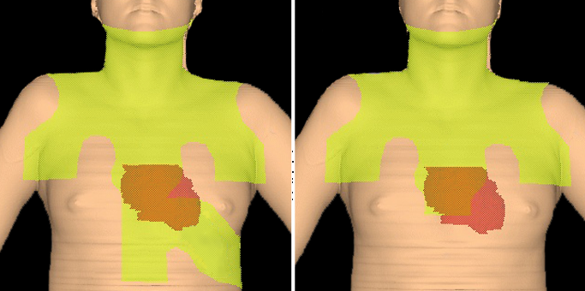
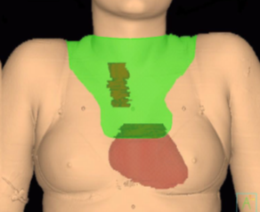
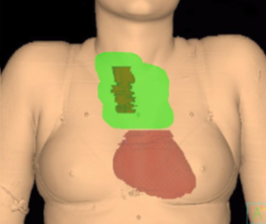
Tailor radiation fields to protect normal tissues
Mantle Field Radiation Therapy
Involved Field Radiation Therapy (IFRT)
Involved Node radiation therapy (INRT)
Mantle
Treats adjacent uninvolved nodal chains
Treats only involved nodes
Radiation fields and dose are based on initial stage, bulk disease, chemotherapy backbone and response to therapy
(Radiation dose: ~20-25.5 Gy in 1.5-1.8 Gy fractions over 6-8 weeks)
Courtesy of David Hodgson MD, MPH, FRCPC
University of Toronto
Notes:
Compares Mantle and Involved node radiation fields.
For Pediatric HL: use strategies to minimize damage to abnormal tissues
low dose IFRT (15-25 Gy)
Shield breast tissue (HL involving axillary LN)
Relocate ovaries laterally along iliac wings or centrally behind uterus for abdominal HL
STANDARD: IFRT
UNDER INVESTIGATION:
Radiation for area of initial bulk disease
Radiation for post-chemotherapy residual disease
Image Courtesy of Dr Sheena Jain, MD. Original Images made into a power point slide by Paul Harker-Murray

Slide 51
Data support elimination of radiation based on initial staging, response to therapy, and specific chemotherapy backbone.
Trial Risk Group Chemotherapy Radiation not beneficial
DAL GPOH-95¹ Low (TG1) OEPA or OPPA CR after 2 cycles
DAL GPOH-2002² Low (TG1) OE*PA or OPPA CR after 2 cycles
NCT00145600 ³ Low risk VAMP CR after 2 cycles
AHOD0031⁴ Intermediate ABVE-PC RER after 2, CR after 4 cycles
Currently, there is no consensus regarding who should be treated with chemotherapy alone
Dorffel et al., J Clin Oncol. 2013 Apr 20;31(12):1562-8
Mauz-Korholz et al., J Clin Oncol 2010, 28:3680-3686.
Metzger et al., JAMA, 2012, Vol 307, No. 24 2609
Friedmen et al., J Clin Oncol. 2014 Nov 10;32(32):3651-8
Notes:
Compares Mantle and Involved node radiation fields.
For Pediatric HL: use strategies to minimize damage to abnormal tissues
low dose IFRT (15-25 Gy)
Shield breast tissue (HL involving axillary LN)
Relocate ovaries laterally along iliac wings or centrally behind uterus for abdominal HL
STANDARD: IFRT
UNDER INVESTIGATION:
Radiation for area of initial bulk disease
Radiation for post-chemotherapy residual disease
Image Courtesy of Dr Sheena Jain, MD. Original Images made into a power point slide by Paul Harker-Murray

Slide 52
Late Effects of Hodgkin Lymphoma Therapies
Skeletal ↓ Bone Growth, AVN Radiation (high dose), Steroids
Cardiac: Cardiomyopathy, Radiation, Alkylating agents, Anthracyclines
effusion, pericarditis,
CHF, CAD, AMI
Pulmonary: Pneumonitis, fibrosis Radiation, Bleomycin
Anthracyclines (radiation recall)
Endocrine: Hypothyroidism Radiation
Female infertility Radiation, Alkylating agents
Male infertility Alkylating agents
Malignancy: Solid tumors Radiation, Alkylating agents
AML/MDS Alkylating agents,
Epipodophyllotoxins
Infection: Encapsulated pathogens Radiation (>40Gy), splenectomy (historical risk)
Because Hodgkin lymphoma is highly curable, clinical trials aim
to reduce long term toxicities and secondary malignancies
Notes:
85-95% EFS – current goal is to limit late effects
Some protocols omit radiation for subsets of patients.
In general, even if event free survival for patients who do and do not receive radiation therapy, overall survival is often similar.
Decision to use radiation may depend on the intensity of the salvage therapy.
Doxorubicin can cause radiation recall pneumonitis.
Pulmonary VOD is rare, but occurs.
Cyclophosphamide may exacerbate anthracycline or radiation induced cardiac injury.
Mechlorethamine > cyclophosphamide

Slide 53
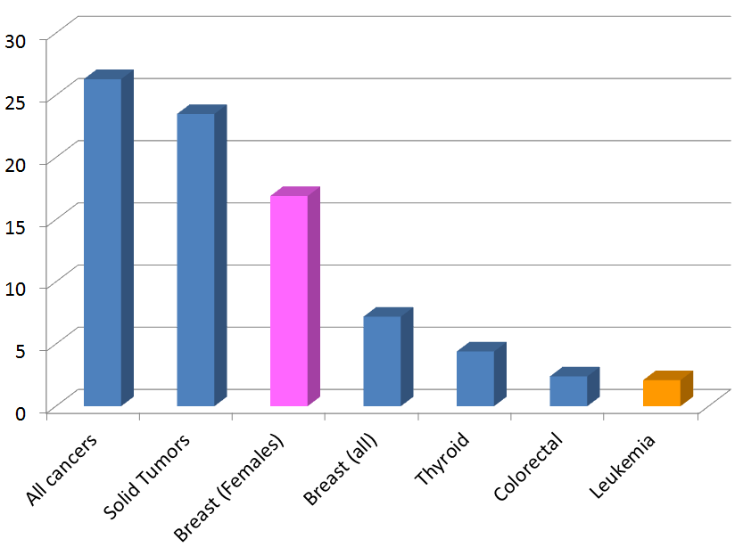
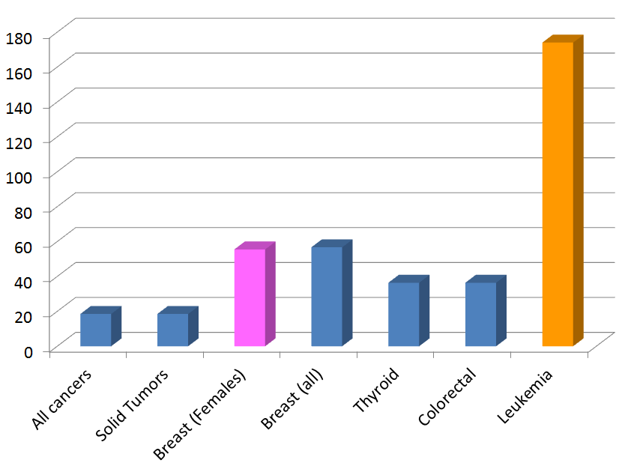
Treatment of Hodgkin Lymphoma increases the incidence of secondary malignancies
30 year cumulative incidence of cancer
Standardized incidence ratio
Breast cancer in women is the most common secondary malignancy
Highest for females receiving radiation at age >10 or older
Decreases with age; no excess risk in women aged 30 or older
The greatest relative increase is for leukemia
Adapted from et al. J Clin Oncol 2003;21(23):4386–4394
Notes:
Overall:
Nearly 20 fold increased risk of 2nd cancer
11% at 20 years
26% at 30 years
From Bhatia S, Yasui Y, Robison L, et al. High risk of subsequent neoplasms continues with extended follow-up of childhood Hodgkin disease: report from the Late Effects Study Group. J Clin Oncol 2003;21(23):4386–4394

Slide 54
Designing a Retrieval Trial
CR
Novel Therapy
HDCT+ Autologous
Stem Cell Transplant
No
CR
Response (CR/PR)
CD34 Mobilization
Toxicity
Response (CR/PR)
CD34 Mobilization
Toxicity
Response (CR/PR)
CD34 Mobilization
Toxicity
Response (CR/PR)
CD34 Mobilization
Toxicity
Response (CR/PR)
CD34 Mobilization
Toxicity
Response (CR/PR)
CD34 Mobilization
Toxicity
Response (CR/PR)
CD34 Mobilization
Toxicity

Slide 55
Adult relapse trials use this model
CR
Standard Dose
Chemotherapy
HDCT+ Autologous
Stem Cell Transplant
No
CR

Slide 56
Pediatric trials are also predicated on this model
CR
Standard Dose
Chemotherapy
HDCT+ Autologous
Stem Cell Transplant
No
CR
POG8827
Ara-C
Cisplatin
Etoposide
AHOD00P1
Ifosfamide
Vinorelbine
AHOD0321
Gemcitabine
Vinorelbine
AHOD0321
Bortezomib
Ifosfamide
Vinorelbine
AHOD1221
Bretuximab
Gemcitabine
Late relapse (>12m) of low stage disease (IA, IIA) don’t need ASCT
Refractory disease (<3m) don’t do well even with ASCT

Slide 57
Designing a Retrieval Question
Target for immunotherapy CD30 (classic HL)
(antibody or T cell) EBV (EBV⁺ classic HL)
CD20 (NLPHL)
CD79a (NLPHL)
Tumor microenvironment Block HL inactivation of anti-tumor T cells
Intracellular pathways Inactivate NFκB
Block degradation of IκB
Block mTOR pathway
Epigenetic modification Block histone deacetylation
Standard chemotherapy alkylator / purine analogue
Notes:
Brentuximab
EBV-CTL
Rituximab
Polatuzumab
Nivolumab, pembrolizumab
Bortezomib
HDAC inhibitor
Bendamustine

Slide 58
Pediatric Lymphoma: Subtypes Simplified
 | T cell derived | B cell derived
Immature | T-lymphoblastic | B-lymphoblastic
Mature | Anaplastic Large Cell | Burkitt Diffuse Large B cell Primary Mediastinal B cell
Others: Marginal zone, Follicular, Peripheral T cell, NK cell, γδ T cell
Differentiated by morphology, immunophenotype, cytogenetics

Slide 59
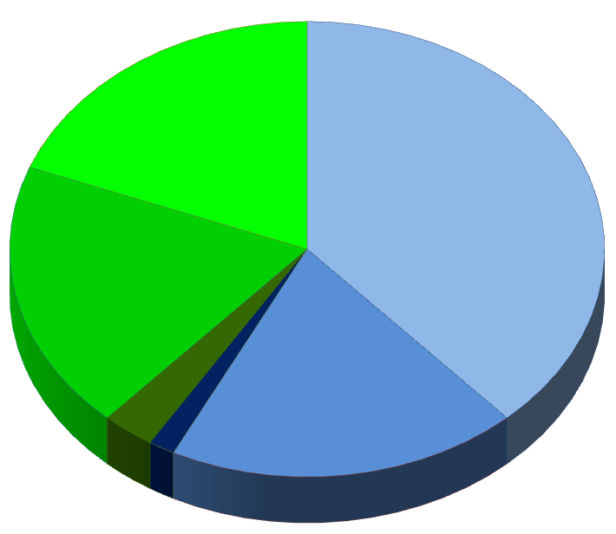
NHL in children are highly aggressive, disseminated diseases
60% are stage III-IV
at diagnosis
<1% are secondary
malignancies
ALCL 20%
Burkitt 40%
T-LLy 20%
DLBCL 20%
3%
1.5%
Numbers are approximate
Notes:
<1% are secondary malignancies
SEER, 1977-1995
Pediatric NHL ~70% are very aggressive, ~30% aggressive.
Adults: ~6% are very aggressive, 40% indolent, most are mature phenotype, 80% are B lineage

Slide 60
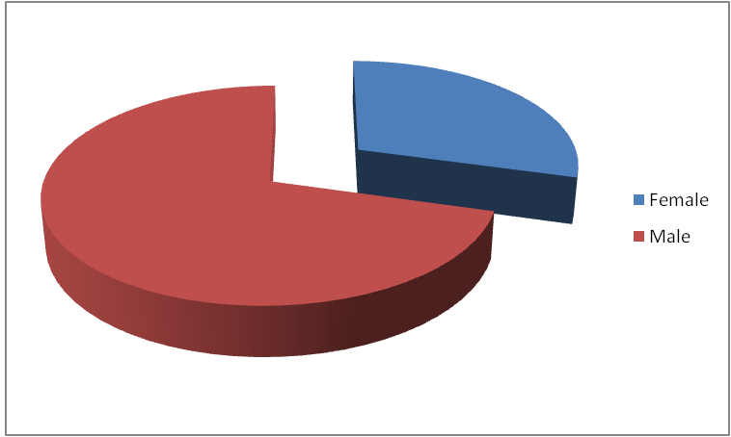
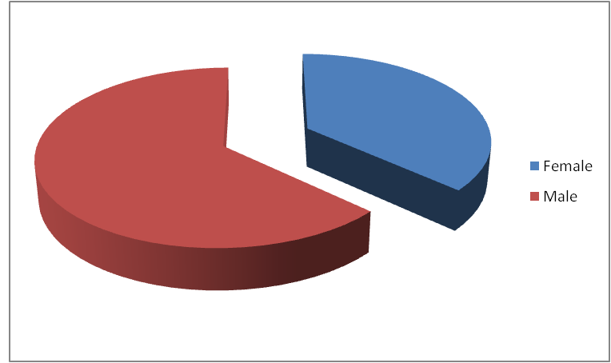
Pediatric Non-Hodgkin Lymphomas are more common in younger children, males, and Caucasians
HL
♀
African-American
♂
NHL
Caucasian
Incidence of ~4 per million (age <20), ~800 cases/year in the US
Burkitt lymphoma is ~5x more common in males than females
Incidence increases with age (except for Lymphoblastic Lymphoma)
<3% of cancer if <5y, ~9% of cancer if >10y
Etiology is unknown, risk factors include
EBV (Burkitt)
Immunodeficiency / immunosuppression
Pesticides
Notes:
Percy, CL, Smith, MA, Linet, M, Ries, LAG, Friedman, DL. “Lymphomas and reticuloendothelial neoplasms.” From Cancer Incidence and Survival among Children and Adolescents: United States SEER Program 1975-1995, Ries LAG, Smith MA, Gurney JG, Linet M, Tamra T, Young JL, Bunin GR (eds). National Cancer Institute, SEER Program. NIH Pub. No. 99-4649. Bethesda, MD, 1999. [All material in this report is in the public domain and may be reproduced or copied without permission.]

Slide 61
Immunodeficiencies increase the risk of NHL
Primary Immunodeficiency
Chediak-Higashi
Common variable immunodeficiency
Hyper-IgM syndrome
IgA deficiency
Severe combined immunodeficiency
X-linked agammaglobulinemia
Wiscott-Aldrich syndrome
Acquired Immunodeficiency
Human Immunodeficiency Virus
Immunosuppression (SOT/HCT)
Following chemotherapy (HL)
Associations
T cell deficiency
B cell lymphoma
Extranodal
EBV+
Immunodeficiency from chromosome instability
Ataxia telangiectasia
Bloom Syndrome
Nijegen breakage syndrome
Werner syndrome
Notes:
~100 cases per year of NHL or LPD associated with primary or secondary immunodeficiency
Suspect immunodeficiency in any child with NHL who is <3 years of age
Immunodeficiency can be inherited or acquired
Usually T cell deficiency (not B cell or PMN)
Lymphoma phenotype is usually B cell
- DLBCL > Burkitt (Not LL or ALCL)
Lymphoma usually associated with EBV
Extra-nodal disease is common (primary CNS lymphoma)

Slide 62
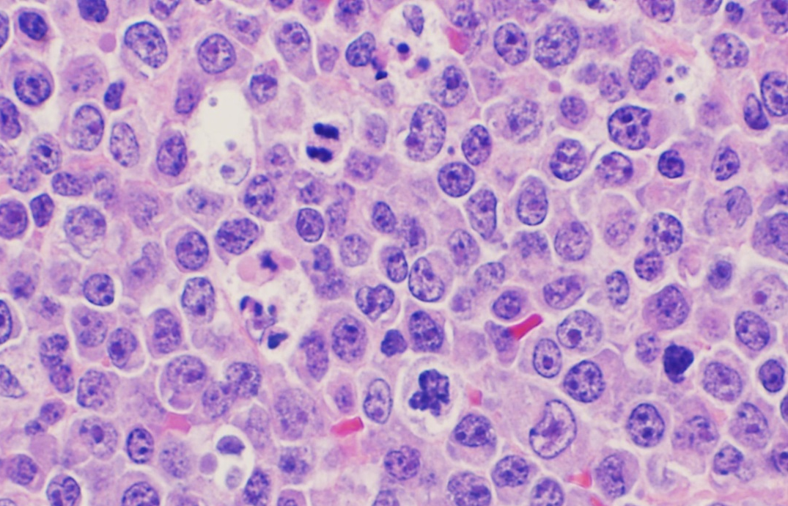
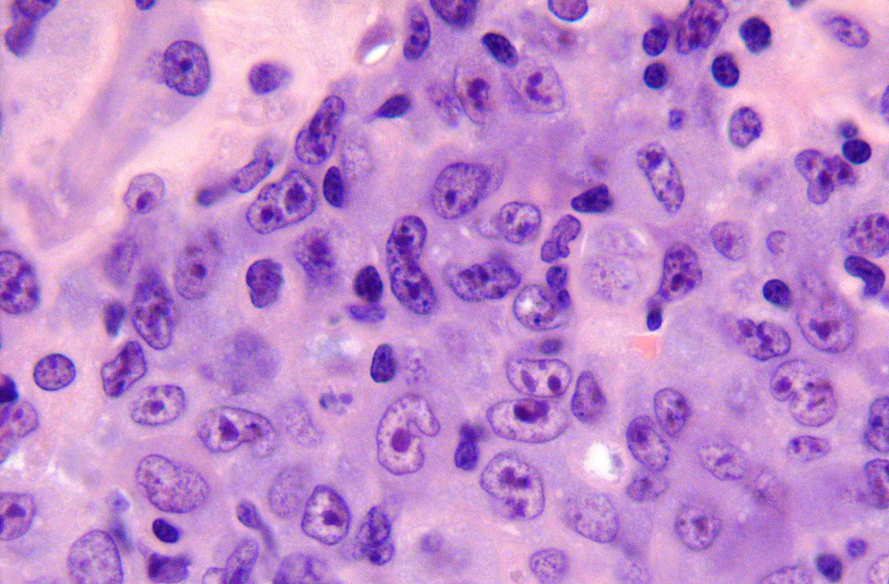
Histology of Pediatric NHL
Burkitt
Diffuse Large B cell
Lymphoblastic Lymphoma
Anaplastic Large Cell
Lymphoblastic
Although NHL subtypes can have distinct histologic appearances, diagnosis cannot be made by histology alone
Notes:
62
Pathology courtesy of Dr Gabriela Gheorghe, MD.
Department of Pathology, Medical College of Wisconsin

Slide 63
Burkitt Lymphoma
Homogeneous, medium sized cells, high mitotic index, “Starry Sky”
Notes:
63
Pathology courtesy of Dr Gabriela Gheorghe, MD.
Department of Pathology, Medical College of Wisconsin

Slide 64
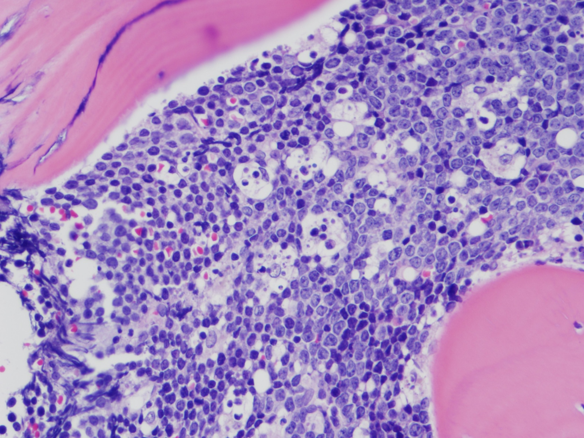
Burkitt Lymphoma in the bone marrow
Homogeneous, medium sized cells, high mitotic index, “Starry Sky”
Notes:
64
Pathology courtesy of Dr Gabriela Gheorghe, MD.
Department of Pathology, Medical College of Wisconsin

Slide 65
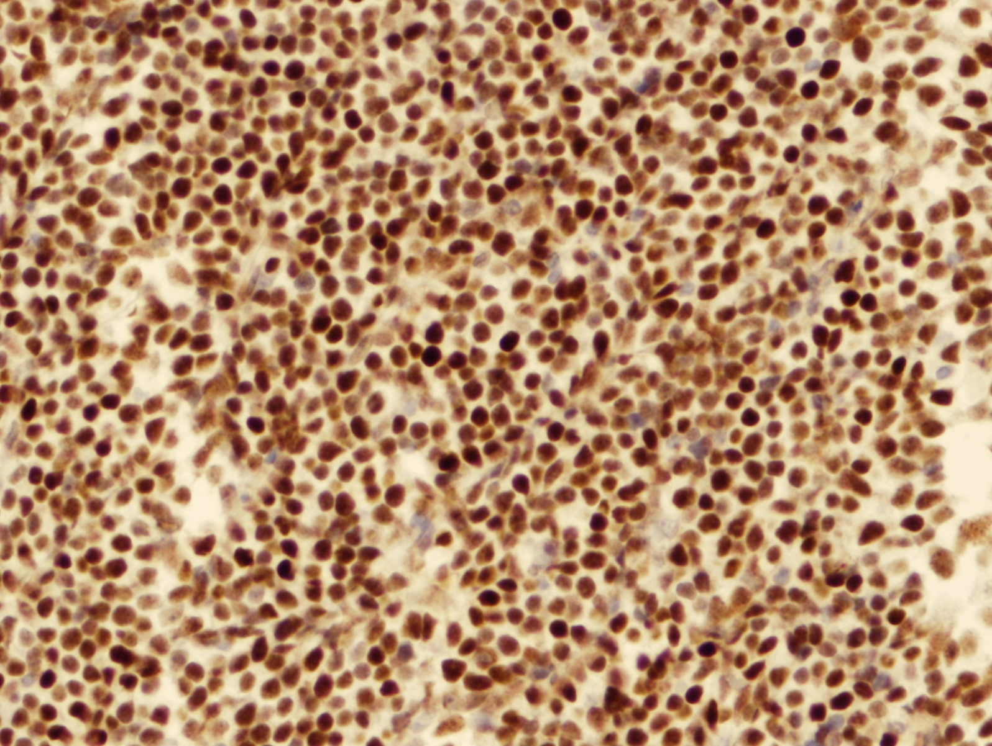
Burkitt Lymphoma is highly proliferative
KI67/MIB1: >99% of cells are positive
Notes:
65
Pathology courtesy of Dr Gabriela Gheorghe, MD.
Department of Pathology, Medical College of Wisconsin

Slide 66
Burkitt Lymphoma: highly aggressive Germinal center mature B cell lymphoma
Epidemiology ♂>♀, ~5-10yrs, sporadic & endemic forms
Immunophenotype CD10,19,20,22, sIg+ (>90% IgM)
low BCL-2 (anti-apoptotic)
Highly Proliferative 99% cells Ki-67+
Translocations ~80% IgH-cMYC t(8;14)(q24;q32)
15% Igκ-cMYC t(2,8)(p11;q24)
5% Igλ-cMYC t(8;22)(q24;q11)
Other changes occur in >50% (-13q, +1q, -6q)
First human tumor: associated with a virus (EBV)
with recurrent translocations
associated with HIV
Burkitt leukemia should be treated like lymphoma (not ALL)

Slide 67
Differences between Sporadic and Endemic Burkitt Lymphoma
Sporadic Endemic (“malaria belt”)
Geography North America, Equatorial Africa, Brazil
Europe Turkey, New Guinea
Incidence 0.2/100,000 10/100,000
Age 6-12y 4-7y
EBV 15% 95%
Location Abdomen, LN Jaw, orbit, mesentery, Marrow, CNS, CSF CNS in 1/3
Ch8 break near / within cMYC upstream of cMYC
Burkitt: type 1 latency & expresses EBNA-1 protein & EBER-1 & 2 RNA

Slide 68
Diagnosis of NHL is challenging because histology, immunophenotpye and cytogenetics can overlap
Burkitt Lymphoma
Lymphoblastic Lymphoma
Reactive macrophages engulf apoptotic debris from rapidly dividing cells – any NHL can have “starry sky” appearance
Also: C-MYC and B cell markers can occur in DLBCL
Notes:
68
Burkitt is post GC-B cell lymphoma, LL is usually an immature T cell lymphoma, but histology can be similar
Pathology courtesy of Dr Gabriela Gheorghe, MD. Department of Pathology, Medical College of Wisconsin

Slide 69
Diffuse Large B cell Lymphoma
Large cells, abundant cytoplasm (multiple histologic subtypes exist)
Notes:
69
Pathology courtesy of Dr Gabriela Gheorghe, MD.
Department of Pathology, Medical College of Wisconsin

Slide 70
Diffuse Large B cell Lymphoma: aggressive germinal / post-GC mature B cell lymphoma
DLBCL Phenotype sIg+, usually light chain restricted
B markers: CD19, 20, 22, 79a, PAX-5,
occasional CD30+ (nonspecific activation)
Cytogenetics ~2/3 express BCL-6, 1/3 express cMYC (not specific)
Proliferative <90% cells Ki-67+, low BCL-2 (anti-apoptotic)
Subsets ~90% “Germinal center B cell-like” (GCL DLBCL) ~10% “Activated B cell like” (ABC DLBCL) t(14;18)
PMBCL Primary Mediastinal B cell lymphoma
20% of DLBCL, 1% NHL
negative for surface Ig
B markers: CD19, 20, 22, 79a, PAX-5, frequent CD30
Gains in 9p → amplification of c-Rel gene
Gene profile overlaps with cHL
Worse prognosis in pediatrics (vs DLBCL)
Notes:
May express CD10
C-MYC expression may be worse
Pediatric: Germinal center like
Adults: Activated B cell like. May have t(14;18) IgH+BCL2
subtypes of DLBCL (centroblastic, immunoblastic, anaplastic, and T-cell/histiocyte-rich)
Can look very similar to Burkitt lymphoma: Need histology, immunophenotype and cytogenetics for diagnosis.
GCB express CD10, BCL-6, A-myb and have favorable outcome, ABC: BCL-2, IRF4, Cyclin D2. Type 3 may also exist

Slide 71
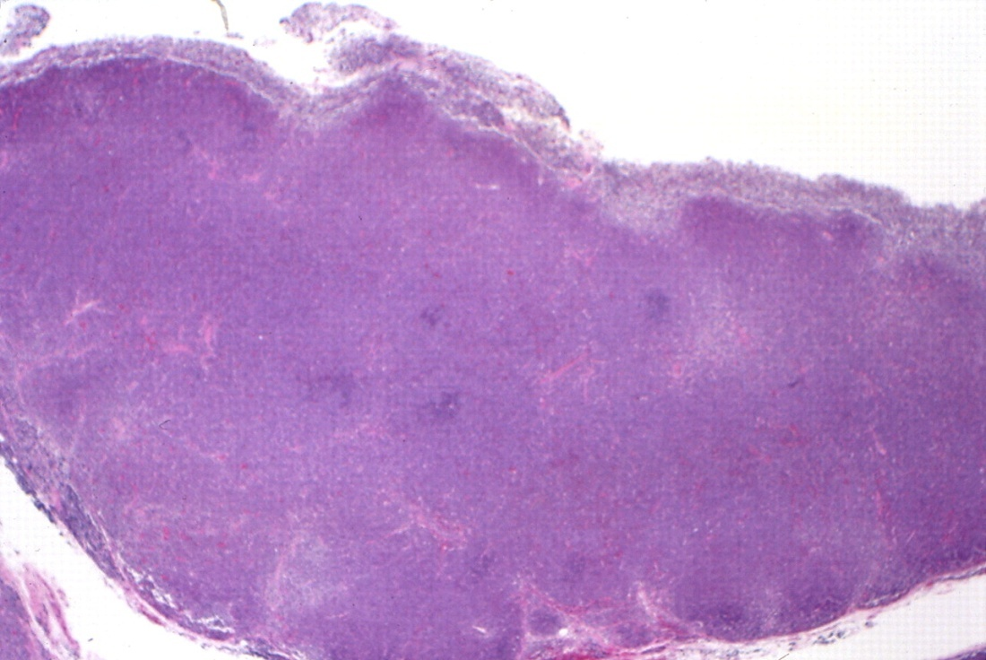
Lymphoblastic Leukemia/Lymphoma
Lymph node architecture completely effaced
Republished with permission of The American Society of Hematology, from ASH Image Bank, Kadin, M.2004:101244 Copyright ©2004; permission conveyed through Copyright Clearance Center, Inc.
Notes:
71
ASH Image Bank (2004);doi: 10.1182/ashimagebank-2004-101255. Used with permission.

Slide 72
Lymphoblastic Leukemia/Lymphoma
Lymph node architecture is effaced by small to medium sized cells with open chromatin, minute nucleoli. Lymphoblasts of LL & ALL are cytologically identical
Notes:
72
Pathology courtesy of Dr Gabriela Gheorghe, MD.
Department of Pathology, Medical College of Wisconsin

Slide 73
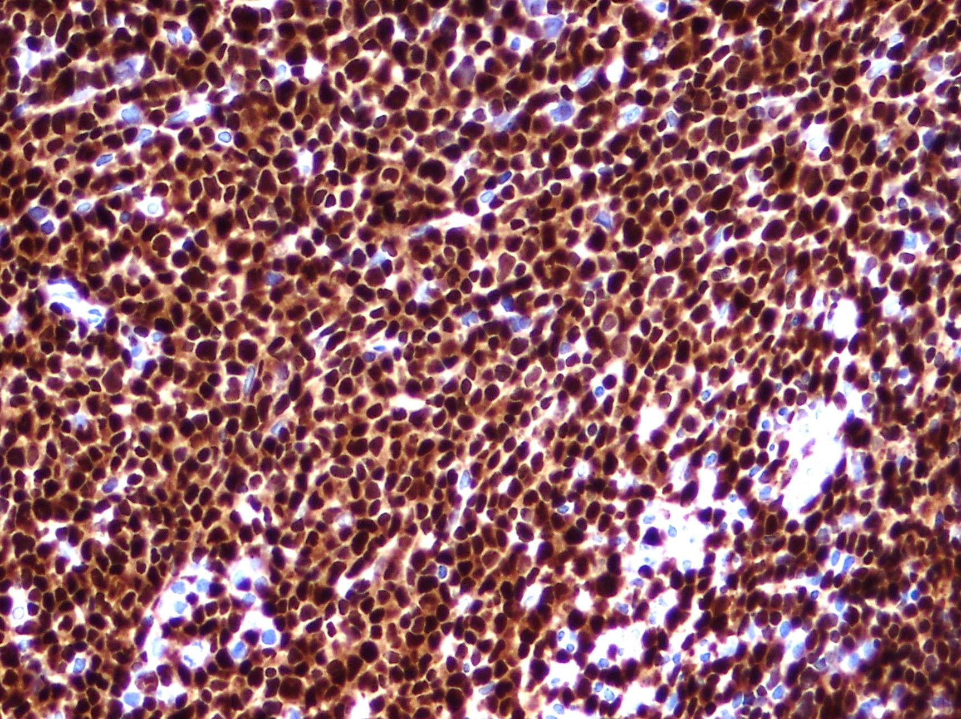
Lymphoblastic Leukemia/Lymphoma
Sheets of TdT+ immature lymphoblasts
Notes:
73
Pathology courtesy of Dr Gabriela Gheorghe, MD.
Department of Pathology, Medical College of Wisconsin

Slide 74
Lymphoblastic Leukemia/Lymphoma are a spectrum of malignant lymphoid precursors
Lymphoblastic lymphoma: <25% blasts in marrow (ALL has >25% blasts)
T lineage LL B lineage LL
Frequency 75% of LL 25% of LL
Stage >90% are stage III-IV 10% are stage III-IV
Site Mediastinum (75%) Isolated nodes
Marrow (25%) Bone, skin
CNS rare (<5%)
Antigens TdT, CD1a,2,3,5,7 +4,8 TdT, CD10,19,22,79a, HLA-DR
Translocations TCR + Transcription factors less characterized
Translocations involve TCR gene promoter/enhancer regions onto transcription factors.
Look for TCRαδ (14q11), TCRβ (7q32-36), TCRγ (7p15), and TF genes TAL1, HOX11, LYL1
2017: NOTCH WT with PTEN or LOH6q do worse (<50% EFS)
Notes:
75% present with anterior medistinal mass, pleural effusions
Treat like you would ALL
T cell LL antigens: 1a,2,4,5,7,8, B cell antigens: 10,19,20,22,HLA-DR
Many translocations exist - most involve TCR promotor or enhancer regions onto TF genes such as HOX11, TAL1, LYL1
TCRad (14q11) TCRb (7q32-36) TCRg (7p15)

Slide 75
Anaplastic Large Cell Lymphoma
Large, pleomorphic cells. Nucleus may be horseshoe like “hallmark” or may be multinucleated
Notes:
75
Images courtesy of Dinesh Rakheja, M.B.B.S., M.D., Assistant Professor, Department of Pathology, University of Texas, Southwestern Medical School.

Slide 76
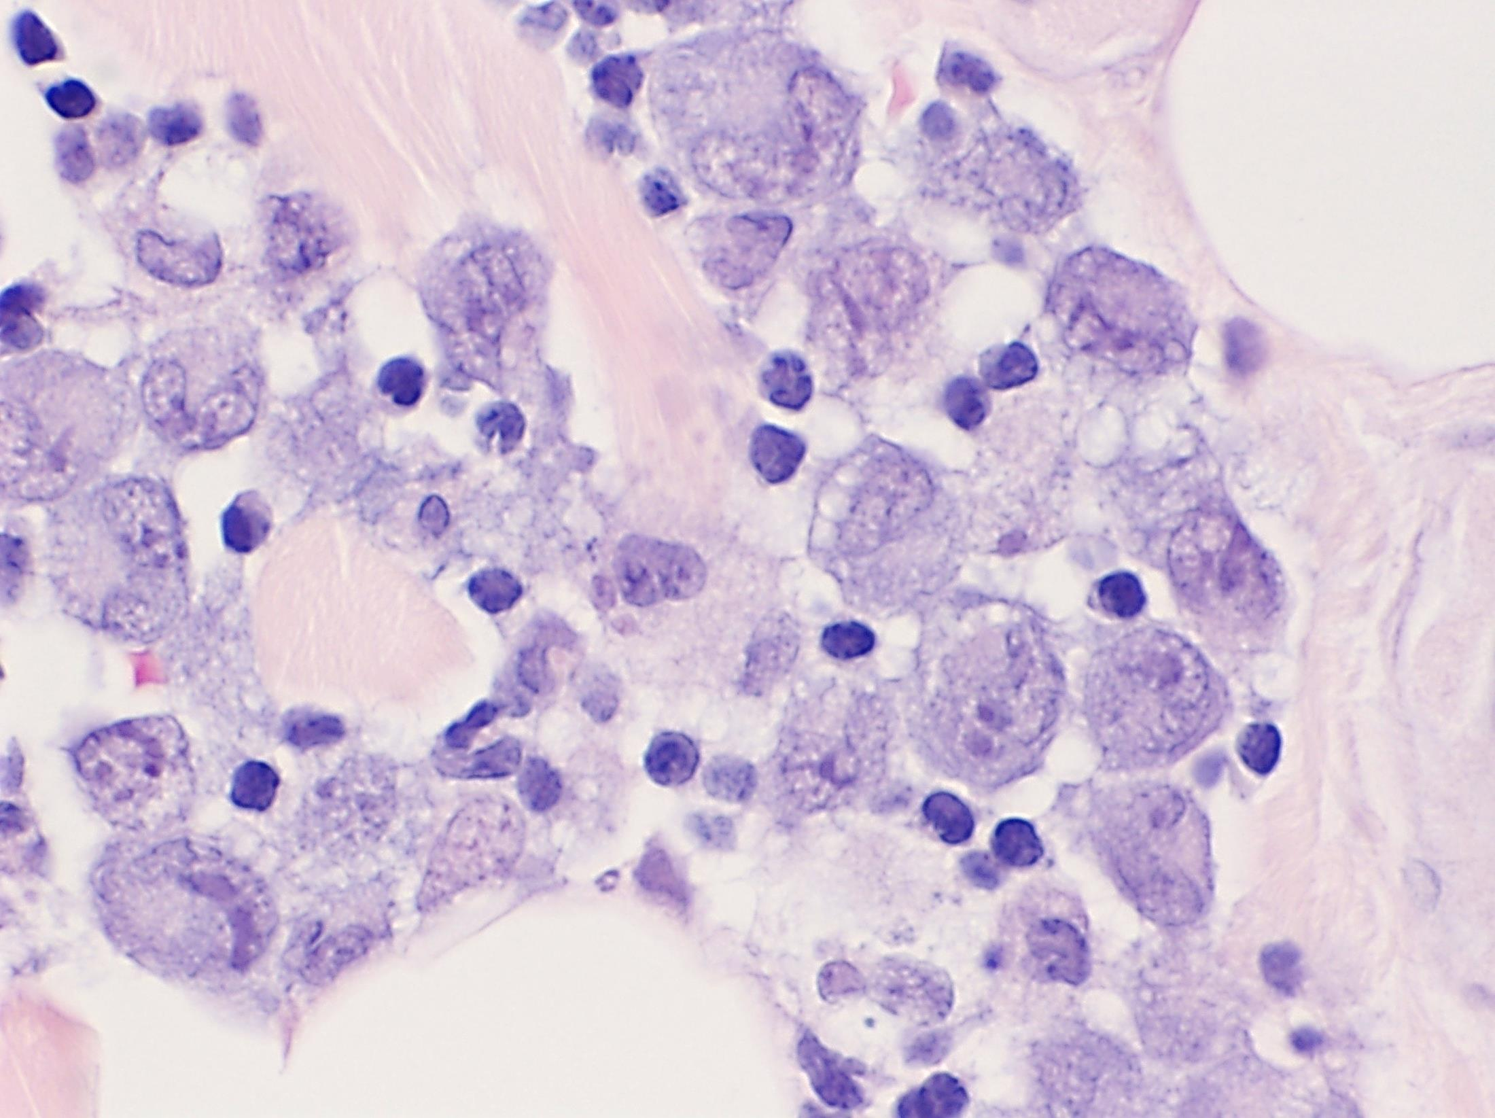
Anaplastic Large Cell Lymphoma
Large, pleomorphic hallmakr cells with horseshoe like nucleus and perinuclear hof (clearing)
Notes:
76
Pathology courtesy of Dr Gabriela Gheorghe, MD.
Department of Pathology, Medical College of Wisconsin
Hof = focal perinuclear clearing seen at the nuclear concavity in plasma cells and in other cells—e.g., lymphoblasts, Reed-Sternberg cells, or osteoblasts—that have eccentrically placed nuclei

Slide 77
Anaplastic Large Cell Lymphoma
Phenotype: CD15-, CD30+, CD45+
T cell markers in 60% (CD3, CD43, CD45RO)
TCR genes rearranged
Translocations Overexpression of ALK kinase
~75% have t(2;5)(p23:35) → NPM-ALK fusion
NPM: nucleophosmin gene
ALK: insulin receptor tyrosine kinase
Pathway NPM-ALK → PI-3K, AKT
cALCL Cutaneous ALCL (CD30+, ALK negative)
Separate entity
Notes:
TCR genes rearranged even if surface T cell markers absent.
NMP-ALK = N terminus of Nucleophosmin gene – catalytic portion of ALK insulin receptor tyrosine kinase
Myc, RAS, MAPK, ad Stat3/5 pathways

Slide 78
Clinical presentation of pediatric NHL
Endemic Burkitt Jaw swelling, abdominal / orbital swelling,
Paraspinal mass, CNS, marrow, intussusception
Sporadic Burkitt Rapidly expanding abd mass / spontaneous tumor lysis
Marrow, CNS, Non-specific GI symptoms, intussusception
DLBCL More diverse (LN, liver, spleen, marrow, mediastinum)
Extranodal abdominal (bowel, mesentery, retroperitoneum)
Often advanced stage
Lymphoblastic: Mediastinal mass, pleural / pericardial effusions
Pain, dysphagia, dyspnea
ALCL Slowly progressive, systemic symptoms, organs and skin, nodal, extranodal
Advanced disease in 2/3, but CNS and marrow are rare
Although excisional biopsy is best, this can be dangerous in some patients,
and the diagnosis can also be made from pleural or ascitic fluid
*Intussuseption is almost exclusively abdominal Burkitt or DLBCL
Notes:
78
Clinical presentation can give clues to the diagnosis, but is not diagnostic per se

Slide 79
Emergency presentations of NHL
A Airway Compression - superior mediastinal syndrome
B Breathing Pulmonary effusions
C Circulation SVC syndrome, tamponade, arrhythmia
D Disability Paraspinal / epidural → pain, paralysis
E Electrolytes Tumor lysis syndrome (↑K, ↑uric acid, ↑PO4 ↓Ca)
(spontaneous TLS in Burkitt, treat empirically)
F Failing organ Kidneys (ureter compression, ↑uric acid)
G GI Obstruction, intussusception, bleeding, perforation, jaundice, pancreatitis
H Hematologic Cytopenias from marrow infiltration
Treatment involves treating the underlying cause.
(steroids, chemotherapy, radiation)
Notes:
79
Lymphomas can cause nearly any of the oncologic emergencies
Teaching table made into a power point slide by Paul Harker-Murray

Slide 80
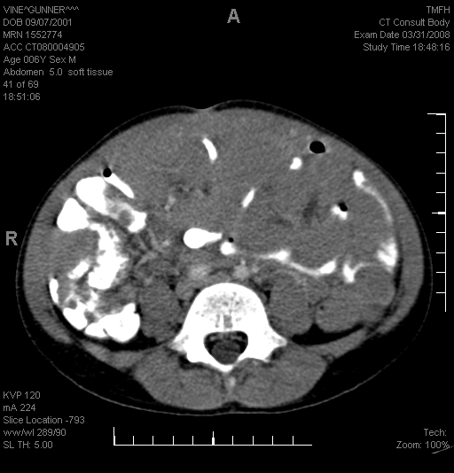
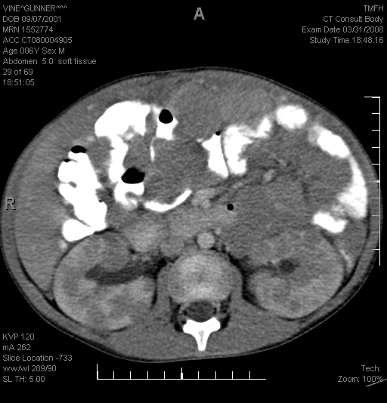
4 year old male with abdominal mass,
uric acid of 11, creatinine of 1.1
Burkitt Lymphoma with spontaneous tumor lysis
(Stage III, FAB/LMB group B)
Notes:
80
DLBCL – RIGHT AXILLA, SPLEEN. Original Images made into a power point slide by Paul Harker-Murray

Slide 81
13 year old female with fevers, fatigue and symptoms of urinary tract infection
DLBCL diagnosed from pleural effusion
(Stage III, FAB/LMB Group B)
Notes:
81
DLBCL – throughout abdomen, thorax. Pericardiophrenic mass, malignant effusion.
Original Images made into a power point slide by Paul Harker-Murray

Slide 82
13 year old male with 10% weight loss, supraclavicular and axillary lymphadenopathy x 4 months
DLBCL of the right axilla and spleen (Stage III, FAB/LMB Group B)
Notes:
82
DLBCL – RIGHT AXILLA, SPLEEN. Original Images made into a power point slide by Paul Harker-Murray

Slide 83
14 year old female with fatigue, tachypnea, palpitations.
(Normal physical examination 5 days prior)
Anterior mediastinal mass with pleural and pericardial effusions – T cell LL diagnosed from pericardial fluid (Stage III)
Notes:
83
ALCL – presenting with anterior mediastinal mass. Original Images made into a power point slide by Paul Harker-Murray

Slide 84
12 year old male with neck pain and facial swelling
SVC syndrome. ALK+ ALCL diagnosed from needle biopsy
(Stage III)
Notes:
84
ALCL – presenting with anterior mediastinal mass. Original Images made into a power point slide by Paul Harker-Murray

Slide 85
12 year old male with dry cough for 2 months
Superior Mediastinal Syndrome: Airway compression from paratracheal and mediastinal lymphadenopathy. Stage III classic Hodgkin lymphoma diagnosed from core needle biopsy of axillary node
Notes:
85
Original Images made into a power point slide by Paul Harker-Murray

Slide 86
Intubation for Airway Protection?
ET tube stops here
Airway obstruction
begins here

Slide 87
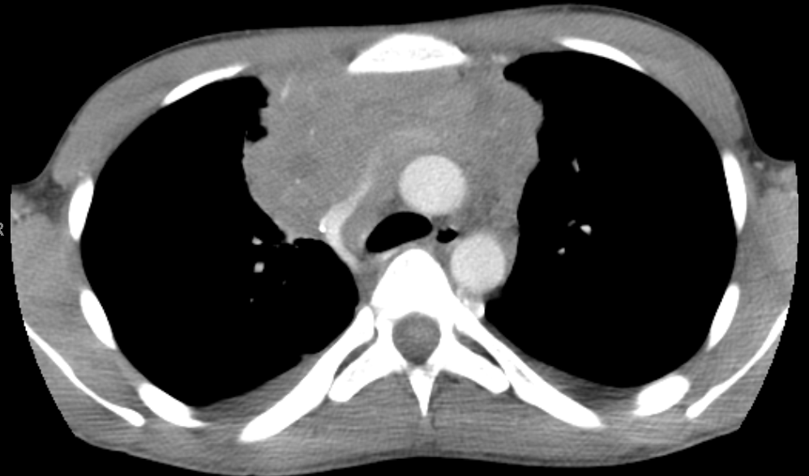
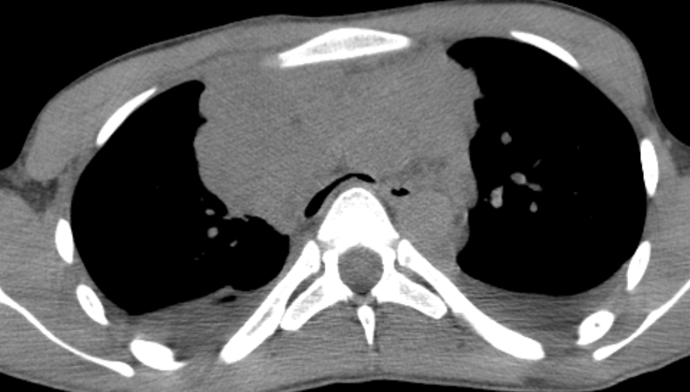
Sedation can precipitate airway obstruction
Patent airway in an alert 17 year old
(stage III PMBCL)
During sedation for needle biopsy
Notes:
87
Sedation or anesthesia may reduce respiratory muscle tone
Slide by Paul Harker-Murray

Slide 88
SVC / SMS syndrome are Medical Emergencies
Proceed with caution:
Small tumors can be symptomatic (location dependent)
Sedation can cause fatal respiratory failure
Anesthesia can aggravate SVC / airway compression
Difficult to intubate past obstruction
Obtain tissue by the least invasive means possible
Emergency management may include steroids or radiation
Biopsy may become uninterpretable in as little as 48 hrs
Selected reviews listed at the end of the talk
Notes:
88
Tracheal compression on CT may predict perioperative obstruction
Steroids: Methylprednisolone 50 mg/m²/day divided QID, Prednisone 40–60 mg/m²/day divided QID
Radiation: 200-400 cGy/dose x 3 doses recommended by COG

Slide 89
Evaluation for Non-Hodgkin lymphoma
Primary Care
History: respiratory and constitutional “B symptoms”
Physical: lymphadenopathy, signs of infection, airway compromise
Labs: CBC/diff, inflammatory markers, biochemistry profile
Tumor lysis labs: electrolytes, BUN, Cr, Ca, PO4
Chest X-ray (always), consider CT neck/chest/abdomen
DO NOT give empiric steroids
Tertiary Care
CT neck and chest, CT or MRI of abdomen and pelvis
- FDG-PET may add sensitivity but CT is standard for staging
Excisional or incisional LN biopsy
histology, flow cytometry, cytogenetics and molecular studies
Bilateral bone marrow biopsy and aspirate
Cerebral spinal fluid cytology
Notes:
NO STEROIDS
Excisional biopsy is best for diagnosis.
histology, LN architecture
Immunochistochemistry.
In patients with symptomatic masses where anesthesia poses a risk, tissue must be obtained in the least invasive way possible:
- consider a core biopsy (better than FNA)
Note: flow cytometry does not contribute to the diagnosis of HL

Slide 90
The St Jude (Murphy) Classification for pediatric NHL
Stage I: Single nodal or extranodal tumor excluding the mediastinum and abdomen.
Stage II: a) Single extranodal tumor with regional node involvement, or
b) Two or more nodal areas on the same side of the diaphragm, or
c) Two extranodal tumors on the same side of the diaphragm
(with or without regional node involvement)
d) Primary gastrointestinal tract tumor that is resectable (w/o ascites)
(usually ileocecal, with/without regional mesenteric node involvement)
Stage III: a) Two extranodal tumors on opposite sides of the diaphragm
b) Two or more nodal areas above and below the diaphragm, or
c) Any intrathoracic disease (lung, pleura, mediastinum, and thymic) or
d) All extensive, primary intraabdominal disease, or
e) All paraspinal or epidural disease (regardless of other tumor sites)
Stage IV: Bone marrow involvement >5%
CNS involvement (other than facial nerve palsy or paraspinal disease)
CSF blasts, CNS mass, CN palsy, cord compression, parameningeal disease
Pediatric NHL progression is not orderly & predictable (like HL), and
the Ann Arbor system does not adequately predict prognosis
Adapted from Murphy SB. Semin Oncol 1980;7:332–339.
Notes:
90
Ann Arbor Staging system does not adequately reflect NHL prognosis. Childhood NHL does not progress in the orderly and predictable lymphatic pattern that Hodgkin lymphoma (HL) does and extensive extranodal disease is common Adapted from Murphy SB. Classification, staging and end results of treatment of childhood non-Hodgkin lymphomas: dissimilarities from lymphomas in adults. Semin Oncol 1980;7:332–339.

Slide 91
The St Jude (Murphy) Classification for pediatric NHL
Stage I: Single nodal or extranodal tumor excluding the mediastinum and abdomen.
Stage II: a) Single extranodal tumor with regional node involvement, or
b) Two or more nodal areas on the same side of the diaphragm, or
c) Two extranodal tumors on the same side of the diaphragm
(with or without regional node involvement)
d) Primary gastrointestinal tract tumor that is resectable (w/o ascites)
(usually ileocecal, with/without regional mesenteric node involvement)
Stage III: a) Two extranodal tumors on opposite sides of the diaphragm
b) Two or more nodal areas above and below the diaphragm, or
c) Any intrathoracic disease (lung, pleura, mediastinum, and thymic) or
d) All extensive, primary intraabdominal disease, or
e) All paraspinal or epidural disease (regardless of other tumor sites)
Stage IV: Bone marrow involvement >5%
CNS involvement (other than facial nerve palsy or paraspinal disease)
CSF blasts, CNS mass, CN palsy, cord compression, parameningeal disease
Pediatric NHL progression is not orderly & predictable (like HL), and
the Ann Arbor system does not adequately predict prognosis
Adapted from Murphy SB. Semin Oncol 1980;7:332–339.
Notes:
91
Ann Arbor Staging system does not adequately reflect NHL prognosis. Childhood NHL does not progress in the orderly and predictable lymphatic pattern that Hodgkin lymphoma (HL) does and extensive extranodal disease is common Adapted from Murphy SB. Classification, staging and end results of treatment of childhood non-Hodgkin lymphomas: dissimilarities from lymphomas in adults. Semin Oncol 1980;7:332–339.

Slide 92
Risk stratification for mature B cell lymphoma
French Society of Pediatric Oncology (FAB/LMB)
Stratum A: Completely resected stage I / abdominal stage II
Stratum B: Nonresected stage I-IV
Stratum C: CNS+ or >25% blasts in marrow
Berlin-Frankfurt-Munster (BFM)
Stratum R1 Completely resected stage I, Completely resected abdominal stage II
Stratum R2 Stage III with LDH <500 Nonresected stage I/II
Stratum R3 Stage III with LDH 500-999 Stage IV (marrow >25% blasts) & LDH<1,000
Stratum R4 Stage III with LDH ≥1,000 Stage IV (marrow >25% blasts) & LDH≥1,000
Stage IV with any CNS disease
Adapted from: Patte C et al J Clin Oncol 1986;4:1219–1226 and Reiter A, et al., J Clin Oncol 1995;13:359–372.
Notes:
92
Higher risk:
Stage,
Increased Marrow involvement
CNS disease
Patte C, Philip T, Rodary C, et al. Improved survival rate in children with stage III and IV B cell non-Hodgkin's lymphoma and leukemia using multi-agent chemotherapy: results of a study of 114 children from the French Pediatric Oncology Society. J Clin Oncol 1986;4:1219–1226.
Reiter A, Schrappe M, Parwaresch R, et al. Non-Hodgkin's lymphomas of childhood and adolescence: results of a treatment stratified for biologic subtypes and stage—a report of the Berlin-Frankfurt-Munster Group. J Clin Oncol 1995;13:359–372.

Slide 93
Principles of therapy for Pediatric NHL
Principle Exception
Chemotherapy Pediatric Follicular (completely resected) (also resected Stage I NLPHL)
CNS prophylaxis Resected abdominal Burkitt / DLBCL
Short duration / intense Lymphoblastic lymphoma
No radiation CNS+ Lymphoblastic lymphoma
Burkitt leukemia: Treat like Burkitt lymphoma
Lymphoblastic Induction, consolidation, & maintenance.
Lymphoma: Duration of therapy of at least 2 years
Survival is high: Burkitt/DLBCL ~95%
Lymphoblastic ~90%
ALCL ~85%
PMBCL ~66%
Notes:
93

Slide 94
Chemotherapy for pediatric NHL
Risk adapted:
Higher stage → more cycles and higher doses of chemotherapy
Example:
Completely resected abdominal Burkitt: 2 cycles of chemotherapy
Burkitt leukemia with CNS involvement: 6-8 cycles of chemotherapy
Response based:
Monitor response based on CT imaging.
(PET is often used, but PET-negative residual mass requires biopsy.)
Incomplete response by CT & biopsy → more cycles & higher doses
Example: Stage III Burkitt lymphoma of the abdomen
Usually in complete remission after 2 cycles of intensive chemotherapy
If not in remission, intensify therapy (8 cycles total)
Specific Treatments: http://www.cancer.gov/cancertopics/pdq/pediatrictreatment
Notes:
94
Specifics: www.cancer.gov/cancertopics/pdq

Slide 95
Google: NCI + PDQ
or Cancer + PDQ
Specific Treatments: http://www.cancer.gov/cancertopics/pdq/pediatrictreatment

Slide 96
Late Effects of NHL depend on the type of chemotherapy delivered
Skeletal ↓ Bone Growth, AVN Steroids
Cardiac: Cardiomyopathy, Anthracyclines, Alkylating agents
effusion, pericarditis,
CHF, CAD, AMI
Neuro: Neurocognitive Intrathecal medications,
High dose methotrexate
Endocrine: Infertility Alkylating agents
Malignancy: Solid tumors Alkylating agents
AML/MDS Alkylating agents, Epipodophyllotoxins
Notes:
85-95% EFS – current goal is to limit late effects
Some protocols omit radiation for subsets of patients.
In general, even if event free survival for patients who do and do not receive radiation therapy, overall survival is often similar.
Decision to use radiation may depend on the intensity of the salvage therapy.
Doxorubicin can cause radiation recall pneumonitis.
Pulmonary VOD is rare, but occurs.
Cyclophosphamide may exacerbate anthracycline or radiation induced cardiac injury.
Mechlorethamine > cyclophosphamide

Slide 97
Major differences in Pediatric HL vs NHL
Trait Hodgkin Lymphoma Non-Hodgkin Lymphoma
Age >10 years, bimodal <10 years
Spread Contiguous nodes Systemic disease
Staging Ann Arbor St Jude (Murphy)
B symptoms Prognostic Not prognostic
Bulk disease Prognostic Not prognostic
Radiation YES (esp high risk) NO (except CNS+ LL)
Marrow evaluation *YES (High stage) YES (all patients)
CSF evaluation NO YES
CNS prophylaxis NO YES
Flow cytometry NO YES
*Evaluation of marrow with FDG-PET is becoming standard
Notes:
Central nervous system (CNS) involvement by HL is rare, with a reported incidence of less than 0.02% [1]. In most cases, it occurs in the setting of relapsed systemic disease, but has been known to present in isolation or with systemic disease remission. 1. Re D, Fuchs M, Schober T, et al. CNS involvement in Hodgkin’s lymphoma. J Clin Oncol 2007;25:3182.

Slide 98
Staging is different between HL and NHL
Hodgkin Lymphoma Non-Hodgkin Lymphoma
Stage Ann Arbor St Jude (Murphy)
I Single node/site Single node/site
∅GI or intrathoracic
II >2 nodes/sites >2 nodes/sites
1º GI if >95% resected
III Crosses diaphragm Crosses diaphragm
GI (extensive), intrathoracic
paraspinal, epidural
IV Disseminated Marrow or CNS
(>1 extranodal site)
Other “B” symptoms -------------
Bulk disease
Intrathoracic: mediastinal, lung, pleura, thymus
Notes:
Original Chart by Paul Harker-Murray

Slide 99
 | Origin | Histology | Immunophenotype | Genes, translocations, paths
Classic Hodgkin | Mature B | Reed Sternberg | CD15+, CD30+, CD45- (↓ B cell markers) | CD30 → NFκB + AP-1 EBV+: LMP-1 → NFκB EBV-: mutated IκB → ↑NFκB 9p24.1 alterations → ↑PD-L1
NLPHD | Mature B | LP cell (L&H, popcorn cell) | CD15-, CD30-, CD45+ CD19, 20, 79a, J chain, PAX5 | BCL-6, p53
Burkitt | Mature B | Starry Sky | sIgM, CD10,19,20,22 | IgH, Igκ, Igλ – c-MYC t(8;14) > t(8;2), t(8;22)
DLBCL | Mature B | Large cells, ↑cytoplasm | sIg+, sIgM+ CD10,19,20,79a, PAX-5 | BCL-6, c-MYC
PMBCL | Mature B (thymic) | Large cells, sclerosis | sIg- (but cytoplasm+) CD10,19,20,79a, PAX-5 | Gain in 9p → ↑c-Rel
ALCL | Mature T | Horseshoe / hallmark cell | CD15-, CD30+, CD45+ T cell markers, TdT- | NPM-ALK: t(2;5)>t(1;2), t(2,3) PI-3K / AKT paths
T-LL | Immature T (thymic) | Sheets of small blue cells | TdT+, T cell markers | TCRαδ, TCRβ with (HOX11, LYL1, MYC, RHOMB1&2, TAL )
B-LL | Immature B (marrow) | Sheets of small blue cells | TdT+, B cell markers
Notes:
99

Slide 100
Agents to know in 2017
Agent Mechanism Potential use
Rituximab anti-CD20 Burkitt, DLBCL, NLPHL
Brentuximab vedotin anti-CD30 conjugated to MMAE cHL, ALCL
Nivolumab Checkpoint inhibitor; reverses cHL, NLPHL,
inactivation of anti-tumor T cells ALCL, PMBCL
T cell therapy CTL specific for EBV LMP EBV⁺ classic HL, PTLD
Crizotinib ALK inhibitor ALCL
Bendamustine alkylator / purine analogue cHL
Nelarabine Purine analogue T-LLy
Bortezomib Proteasome inhibitor; T-LL, cHL
blocks degradation of IκB
Notes:
Brentuximab
EBV-CTL
Rituximab
Polatuzumab
Nivolumab, pembrolizumab
Bortezomib
HDAC inhibitor
Bendamustine

Slide 101
Staging and Response Criteria in 2017
Hodgkin Lymphoma
Cheson et al., Recommendations for Initial Evaluation, Staging, and Response Assessment of Hodgkin and Non-Hodgkin Lymphoma: The Lugano Classification. 2014; J Clin Oncol 32:3059-3067.
Cheson et al., Refinement of the Lugano Classification lymphoma response criteria in the era of immunomodulatory therapy Blood 2016;128(21):2489-2496
Non-Hodgkin Lymphoma
Rosolen et al., Revised International Pediatric Non-Hodgkin Lymphoma Staging System. J Clin Oncol, 33, 2112–2118.
Sandlund et al., International Pediatric Non-Hodgkin Lymphoma Response Criteria. J Clin Oncol. 2015 Jun 20;33(18):2106-11.
Notes:
Brentuximab
EBV-CTL
Rituximab
Polatuzumab
Nivolumab, pembrolizumab
Bortezomib
HDAC inhibitor
Bendamustine

Slide 102
Reviews for Providers
Pediatric Non-Hodgkin Lymphoma
Special Issue on Non Hodgkin Lymphoma in the Younger and Paediatric Patient: British Journal of Hematology. May 2016 Volume 173, Issue 4, Pages 497-654
Management of Mediastinal Masses
Pediatric Anterior Mediastinal Mass: A Review Article. Pearson et al., Semin Cardiothorac Vasc Anesth. 2015 Sep;19(3):248-54.
Management of anterior mediastinal masses in children. Garery et al., Eur J Pediatr Surg. 2011 Oct;21(5):310-3.
Management of children and adolescents with a critical airway due to compression by an anterior mediastinal mass. Perger et al., J Pediatr Surg. 2008 Nov;43(11):1990-7.
Notes:
Brentuximab
EBV-CTL
Rituximab
Polatuzumab
Nivolumab, pembrolizumab
Bortezomib
HDAC inhibitor
Bendamustine

Slide 103
Special Thanks To:
Gabriella Gheorghe, MD, Department of Pathology, Medical College of Wisconsin for histology images
Dinesh Rakheja, MBBS, MD, Department of Pathology, University of Texas, Southwestern Medical School for histology images
David Hodgson, MD, MPH, FRCPC. University of Toronto, for radiation field images
Patrick Baggott, Sr. Manager, Publications, American Society of Hematology, for grantng permission to use images from the ASH Image bank http://imagebank.hematology.org
Hema Dave, MD: provided review of content

Slide 104
Image Attribution: slides (image)
Gabriella Gheorghe, MD: slides 19, 21, 22, 26, 28, 29, 58 (1-3), 59, 60, 61, 64, 65, 68, 69, 72, 98
Dinesh Rakheja, MBBS, MD: slides 23, 58 (4), 71
David Hodgson, MD, MPH, FRCPC. slide 46
ASH Image Bank: slides 17(2-4), 20, 67
http://imagebank.hematology.org

Slide 105
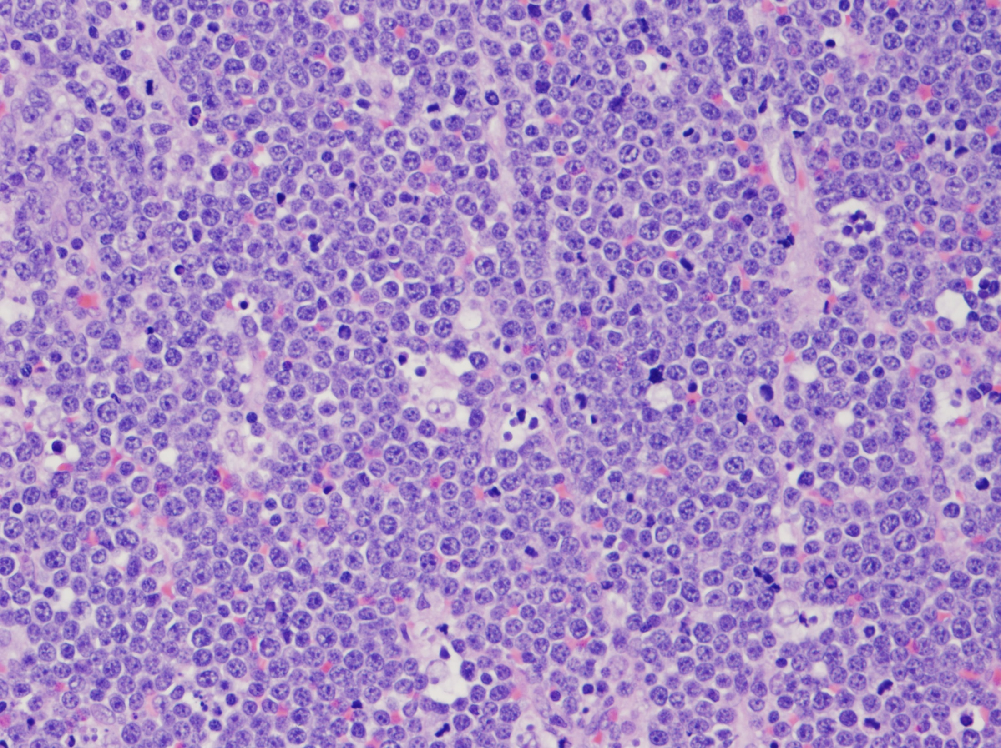
Questions?
)
,
Notes:
105
Pathology courtesy of Dr Gabriela Gheorghe, MD.
Department of Pathology, Medical College of Wisconsin

Slide 106
Lymphomas
1. Hodgkin disease
a. Epidemiology/predisposing factors/genetics
Know the epidemiologic features of Hodgkin disease in children (Slides 11,12)
Recognize that Hodgkin disease may occur in families (Slide 13)
b. Pathology
Recognize the pathologic subtypes of Hodgkin disease (Slides 4, 18-28)
Know the biologic characteristics of the Reed-Sternberg cell (Slide 26, 29, 31)
Know the incidence of each of the pathologic subtypes of Hodgkin disease in children (Slides 18)
Recognize the morphologic and immunophenotypic characteristics of Reed-Sternberg cells and of Reed-Sternberg cell variants (Slides 17, 26)
c. Clinical presentation
Recognize the presentation and pattern of spread of Hodgkin disease by anatomic site (Slides 30, 35)
Know the differential diagnosis of acute lymphadenopathy and chronic lymphadenopathy simulating malignant lymphoma (Slide 38)
Recognize impaired cellular immunity in a patient with Hodgkin disease (Slides 14, 15)
Know the most common clinical presentation of Hodgkin disease in children (Slides 30, 35)
Know the laboratory abnormalities that may be seen in children with Hodgkin disease at the time of diagnosis (Slide 35)

Slide 107
Hodgkin disease (continued)
d. Diagnosis and staging
Utilize imaging modalities appropriately to determine the extent of primary disease and metastatic spread of Hodgkin disease (Slides 39-42)
Know the criteria for Ann Arbor staging in patients with Hodgkin disease (Slides 44, 98)
Risk stratification (Slides 45, 48)
e. Treatment
Know the role of radiation therapy in the treatment of Hodgkin disease in children and adolescents (Slides 49-51)
Know the role of chemotherapy in the treatment of Hodgkin disease in children and adolescents (Slide 49)
Be able to monitor appropriately the response to treatment of Hodgkin disease (Slide 42)
Plan the treatment of a relapse in a patient with Hodgkin disease (Slides 54-57)
Know the principles of treatment for different stages of Hodgkin disease (Slide 49)
f. Prognosis
Know the prognostic features of Hodgkin disease. Know the prognosis of Hodgkin disease according to such variables as stage and histology (Slides 45-48)

Slide 108
Hodgkin disease (continued)
g. Complications/late effects
Evaluate and manage a febrile patient with Hodgkin disease who has previously undergone splenectomy (No Slide: we no longer perform splenectomy for staging. Draw blood cultures and immediately give empiric therapy to cover pneumococcus, meningococcus, hemophilus influenza type B.)
Recognize the radiologic, clinical, and laboratory manifestations of recurrent Hodgkin disease (Findings are the same at relapse as at initial diagnosis. Slides 30, 35)
Know the complications and late effects of treatment for Hodgkin disease (Slides 52, 53)
Recognize the significance of persistent abnormalities revealed by computed tomography after therapy for Hodgkin disease (Slides 42)
Know the increased risk for and kinds of second malignant neoplasms that are most likely after treatment for Hodgkin disease (Slide 53)

Slide 109
2. non-Hodgkin lymphoma (NHL)
a. Epidemiology/predisposing factors/genetics
Know the association of EBV and HIV with NHL (Slides 61, 66, 67)
Know the cytogenetic & molecular genetic abnormalities associated with NHL (Slides 66, 70, 74, 77, 99)
Know the chromosomal alterations associated with Burkitt lymphoma (Slides 66, 99, 67)
Know the gene rearrangement patterns which distinguish monoclonal and polyclonal lymphoproliferative processes
Understand the relationship of oncogenes to structural genes in chromosome t(8:14) (Slides 66, 67)
Recognize the clinical and epidemiologic characteristics that distinguish "endemic" from "sporadic" Burkitt lymphoma (Slide 67)
Know that the inherited and acquired immunodeficiency states predispose to the NHL (Slide 61)
b. Histopathology and immunophenotype
Recognize the pathologic subtypes of NHL in children and adolescents (Slides 58, 59, 62, 99)
Recognize the pathologic subtypes of NHL relative to primary site and pattern of spread (Slide 78)
Know the characteristic immunophenotype of Burkitt and Burkitt-like lymphomas (Slides 66, 70)
Know the relative importance of heavy and light chain immunoglobulin expression in the diagnosis of Burkitt or Burkitt-like lymphomas (Slide 66)
Know the characteristic immunophenotype of T-cell lymphoblastic NHL (Slide 74)
Know that immunophenotypically, Burkitt and Burkitt-like lymphomas are identical to MATURE B-cell ALL (not b lymphoblastic leukemia), and T-cell lymphoblastic lymphomas are identical to T-cell ALL (Slides 66, 74, 99)
Know the variety of immunophenotypes in large cell lymphomas in children (Slide 70)

Slide 110
2. non-Hodgkin lymphoma (NHL) Continued
c. Clinical presentation
Recognize the clinical presentation of NHL by anatomic site, such as superior vena cava syndrome (Slides 78-87)
Know the clinical presentation and laboratory findings of Burkitt lymphoma (Slides 78, 79)
Recognize when tumor lysis syndrome can be present in NHL (Slides 77, 78)
Recognize the large B-cell lymphomas that arise in the anterior mediastinum (Slide 78)
d. Diagnosis and staging
Utilize appropriate imaging modalities to determine the extent of NHL (Slide 89)
Utilize appropriate laboratory studies to determine the extent of NHL (Slide 89)
Know that diagnosis of NHL can sometimes be made on pleural effusion or ascitic fluid (Slides 81, 20, 88)
Recognize CNS involvement in a patient with NHL (Slides 89-93, 97)
Know how to use the degree of bone marrow involvement to distinguish stage IV NHL and acute leukemia of similar immunophenotype (Slides 90)
Recognize that advanced stage T-cell lymphoblastic lymphoma and T-cell acute lymphoblastic leukemia represent different stages of the same disease (Slides 71, 74)
Recognize that advanced stage Burkitt lymphoma or Burkitt-like NHL and B-cell acute lymphoblastic leukemia represent different stages of the same disease (Slides 63-67, 71-84, 93)

Slide 111
2. non-Hodgkin lymphoma (NHL) Continued
e. Treatment
Know the role of surgery in the treatment of NHL (Slide 93)
Know the role of radiation therapy in the treatment of NHL (Slide 93)
Know the role of chemotherapy in the treatment of specific types of NHL (Slide 93)
Know the emergency management of a large mediastinal mass in NHL (Slides 88, 102)
Know the emergency management of tumor lysis syndrome in NHL (Slides 88)
Know the emergency management of spinal cord compression in NHL (Slide 79)
Appropriately monitor the response to treatment of NHL (Slide 94)
Plan the treatment for a patient with advanced stage Burkitt lymphoma or Burkitt-like NHL (Slide 93-95)
Know the principles of treatment for different stages and histologies of NHL (Slides 94)
Plan the treatment for a patient with limited NHL (Slides 93-95)
f. Prognosis
Know the prognostic features of NHL (Slides 90-95)
Know the prognosis of NHL according to stage, histology, and immunophenotype (Slide 93)
g. Complications/late effects
Know the complications and late effects of the treatment of NHL (Slide 96)

