Slide 1
Header
Hemoglobinopathies
Charles Quinn, MD MS
Subhead

Slide 2
Disclosures
No conflicts of interest
Off-label discussion: hydroxyurea for children with sickle cell disease

Slide 3
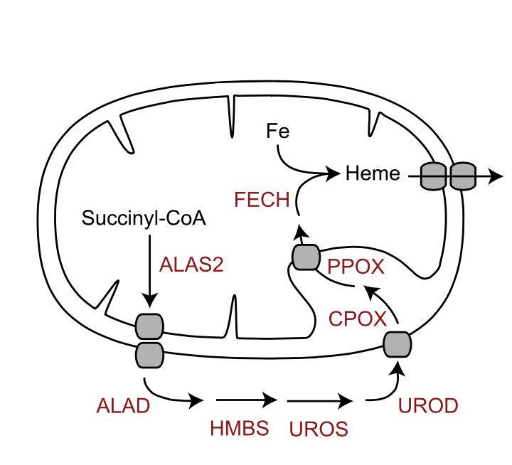
Overview of Hemoglobin Synthesis
Heme
Globin
chromosome 11
Hb A
8 genes
7 chromosomes
chromosome 16
Notes:
Chromosome 11 includes the beta-like globin genes, and chromosome 16 contains the alpha-like globin genes.
The tetramer of 2 alpha and 2 beta globins is called Hgb A…A for adult.

Slide 4
coding genes of the β-globin cluster
embryonic
fetal
adult
ε
^{G}γ
^{A}γ
δ
β
HBE
HBG2
HBG1
HBD
HBB
11p15
~50 kb
2: β/β
4: αα/αα
coding genes of the α-globin cluster
embryonic
fetal & adult
ζ
α2
α1
HBZ
HBA2
HBA1
16p13
~40 kb

Slide 5
Hemoglobins Throughout Development
fetal life
postnatal life
Hb F
Hb A
α
α
50
40
γ
β
% total hemoglobin
30
20
ζ,ε
β
10
γ
δ
Hb A₂
6
18
30
birth
12
24
36
48
gestational age
(weeks)
postnatal age
(weeks)
Notes:
This graph shows the expression of the different globin genes during development. Age is shown on the x-axis, and the percent of total hemoglobin is shown on the y-axis.
The embryonic epsilon and zeta chains are expressed only in very early life. Zeta glonbin synthesis is replaced by alpha globins that persists for the remainder of life.
The beta like chains are a bit more complex. The embryonic epsilon gene is also transiently expressed in very early life. It is replaced by gamma globin chain synthesis. The combination of two alpha and two gamma chains is called fetal hemoglobin (or Hgb F).
As gamma chain synthesis decreases around the time of birth, it is replaced by beta chain synthesis. The combination of two alpha and two beta chains is called adult hemoglobin (or Hgb A). A small amount of delta chain synthesis begins around the time of birth, and the combination of two alpha and two delta chains forms a minor adult Hgb called Hgb A2.
So, Hgb F is the predominant Hgb in fetal life, and it is replaced by Hgb A and to a lesser extent A2 after birth.

Slide 6
Be Familiar with These Names and Structures
Name Description Composition
Hb A Adult Hb α₂β₂
Hb A₂ Minor adult Hb α₂δ₂
Hb F Fetal Hb α₂γ₂
Hb Barts Abnormal Hb γ₄
Hb H Abnormal Hb β₄
Notes:
There are a number of named Hgbs that you need to know.
The names and formulas for the normal adult, fetal, and embryonic globins are shown. Memorize these.
You should also commit to memory two abnormal Hgbs: Hgb Bart’s and Hgb H, tetramers of gamma and beta, respectively. I’ll discuss their significance in a few minutes.

Slide 7
Disorders of Hemoglobin
Two broad categories:
Quantitative disorders
Thalassemia
Decreased (imbalanced) production of normal globin chains
Qualitative disorders
Structural variants or hemoglobinopathies*
Production of abnormal globin chains
*The usage of “hemoglobinopathies” varies. Technically, all disorders of Hb are hemoglobinopathies, but some use this term to refer particularly to structural or variants.
Notes:
The disorders of Hgb fall into two broad categories:
-The quantitative disorders, called the thalassemias, are those in which there is decreased production of a particular globin chain, which leads to an imbalance between the alpha and beta globin production.
-Second, there are qualitative disorders in which a structurally abnormal Hgb is made. These are called hemoglobinopthies.

Slide 8
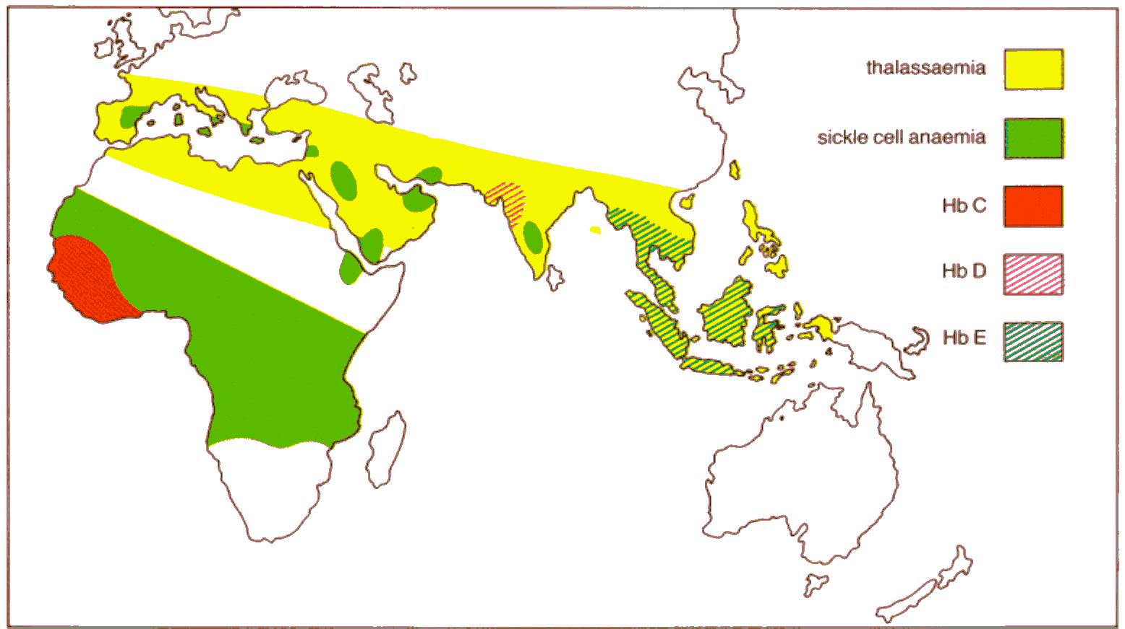
Geographical Distribution Common Disorders of Hemoglobin
thalassemia
Hgb S
Hgb C
Hgb D
Hgb E
Notes:
It’s important to know the geographic distribution of the common disorders of hemoglobin.
I will review each of these disorders,but know that thalassemia is common throughout the Mediterranean, the Middle East, India, and Southeast Asia. Hgb S and C occur commonly in subsaharan Africa, but Hgb S is also found in India and the Middle East. The distributions of Hgbs D and E are also shown.

Slide 9
Quantitative Disorders: Thalassemia
Notes:
We will start with the qualitative disorders of Hgb--the thalassemias.

Slide 10
Normal State
Fetus & Newborn
Child & Adult
γ
α
α
β
γ
α
α
β
γ
α
α
β
β
γ
γ
α
α
β
γ
α
β
β
γ
α
α
β
γ
γ
α = β + γ
γ
β
α
α
α
α
γ
β
Hb F
Hb A

Slide 11
Alpha Thalassemia
Fetus & Newborn
Child & Adult
γ
α
-
β
γ
α
-
β
γ
α
β
β
γ
γ
β
γ
α
α
β
β
γ
β
γ
γ
α < β + γ
γ
γ
β
β
γ
γ
α
α
α
α
β
β
γ
γ
β
β
Hb Bart’s
Hb F
Hb A
Hb H

Slide 12
Beta Thalassemia
Fetus & Newborn
Child & Adult
γ
α
α
β
γ
α
α
β⁰
γ
α
α
β
β
γ
γ
α
α
γ
α
β
γ
α
α
γ
γ
α > β + γ
γ
α
β
α
α
α
α
α
α
γ
α
β
Hb F
not stable
Hb A
no HbH equivalent

Slide 13
Pathophysiology of Thalassemia
Decreased production of α or β globins
Imbalance between α and β globins
Globins in excess precipitate and damage the RBC membrane
Ineffective erythropoiesis
Anemia
Bone marrow
expansion
Extramedullary
hematopoiesis
Increased intestinal iron absorption
Notes:
The basic pathophysiology is shown here. Genetic defects of the either the alpha or beta globin genes leads to the decreased production…
[Read slide]

Slide 14
Basic Nomenclature of Thalassemia
Complementary systems:
Genetic Defect
α-thalassemia: defect in α globins
β-thalassemia: defect in β globins
δβ-thalassemia: defect in both δ and β globins
Etc.
Clinical Severity
Minor / trait: mild anemia, asymptomatic
Intermedia / NTDT: moderate anemia, signs/symptoms, some transfusions
Major / TDT: severe anemia, transfusion-dependent
NTDT = non-transfusion-dependent thalassemia
TDT= transfusion-dependent thalassemia
Notes:
Thalassemias can be classified by the genetic defect and by clinical severity.
[Read slide]
The two classifications are complementary: one can have alpha thalassemia major, for example, or beta thalassemia intermedia.

Slide 15
Typical Thalassemia Mutations
Alpha thalassemia
Deletions
Segments of DNA containing α-globin genes absent
Beta thalassemia
Point mutations
Disrupt regulatory elements of gene expression
Decreased (β⁺) or absent (β⁰) production of β-globin
Notes:
Alpha thalassemias are typically caused by deletions that remove large segments of DNA.
Beta thalassemias are typically caused by point mutations that disrupt regulatory elements of gene expression. Beta thalassemia mutations are called beta-plus alleles if beta globin production is decreased, or beta-zero if beta-globin production is absent from that gene.
Although there are many exceptions, but it is important to know to this generalization.

Slide 16
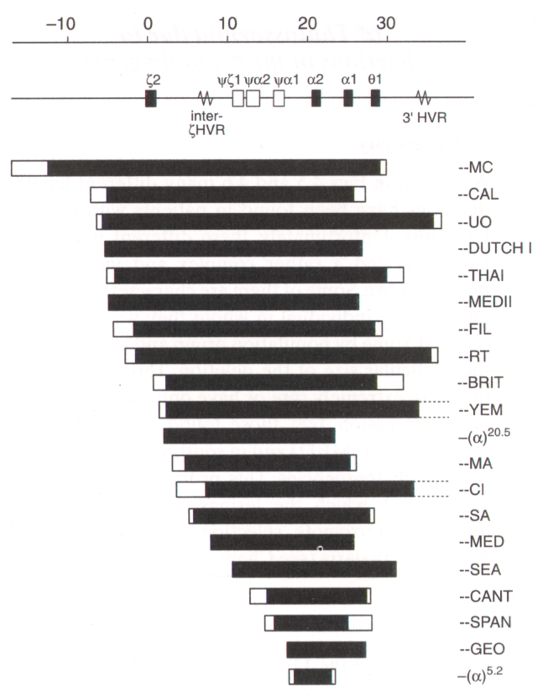
Common α-Thalassemia Mutations
Small DNA deletions
Remove one α-gene
α⁺ mutations
3.7 kb, rightward (-α^{3.7})
4.2 kb, leftward (-α^{4.2})
Large DNA deletions
Remove two α-genes
α⁰ mutations
Southeast Asian (SEA) variant
ααα^{anti 3.7}
−α^{3.7}
aberrant homologous
recombination
Notes:
Alpha thalassemia can be caused by small or large deletion of DNA.
Aberrant recombinational events in the alpha globin locus leads to the deletion of one of the alpha globin genes. The same event produces a triplicated allele. Two common examples of this are the leftward and rightward forms of the deletion. This produces the alpha-plus mutation, because and alpha globin genes remain.
Large DNA deletions tend to remove both alpha globin genes. This mutation is common among individuals of SEA ancestry. This produces the alpha-zero mutation, because the genes are removed entirely.

Slide 17
Overview of Alpha Thalassemia Common (Classical) Genotypes
Genotype | α genes | Name
αα / αα | 4 | Normal
αα / α– | 3 | Silent carrier
– – / αα | 2 2 | Thalassemia trait
α– / α–
– – / α– | 1 | Hgb H disease
– – / α^{CS}α | 1 | Hgb H-Constant Spring
– – / – – | 0 | Hydrops fetalis
Older terms:
α-thalassemia-2: α –
α-thalassemia-1: – –
minor
intermedia
NTDT
major
TDT
Notes:
Let’s review the main subtypes of the alpha thalassemias. Recall, we normally have 4 alpha globin genes, 2 on each chromosome.
[Read slide]
Let’s now review these classical forms of alpha thalassemia.

Slide 18
Alpha Thalassemia Trait
Genotypes | cis: – – / α α trans: α – / α –
Neonates | Excess γ → 3–8% Hb Barts (γ₄) Microcytosis (MCV 80–95 fL)
Children and Adults | Excess β → absent Hb H (β₄)—too unstable Mild anemia (Hb 10–11 g/dL) Hyphochromia and microcytosis (MCV 65–75 fL)
Significance | Common (Asian: cis and trans; African: trans but not cis) Frequently misdiagnosed and treated as iron deficiency anemia Risk of TI or TM in offspring, esp. of individuals with cis-deletions
TI = thalassemia intermedia
TM = thalassemia major

Slide 19
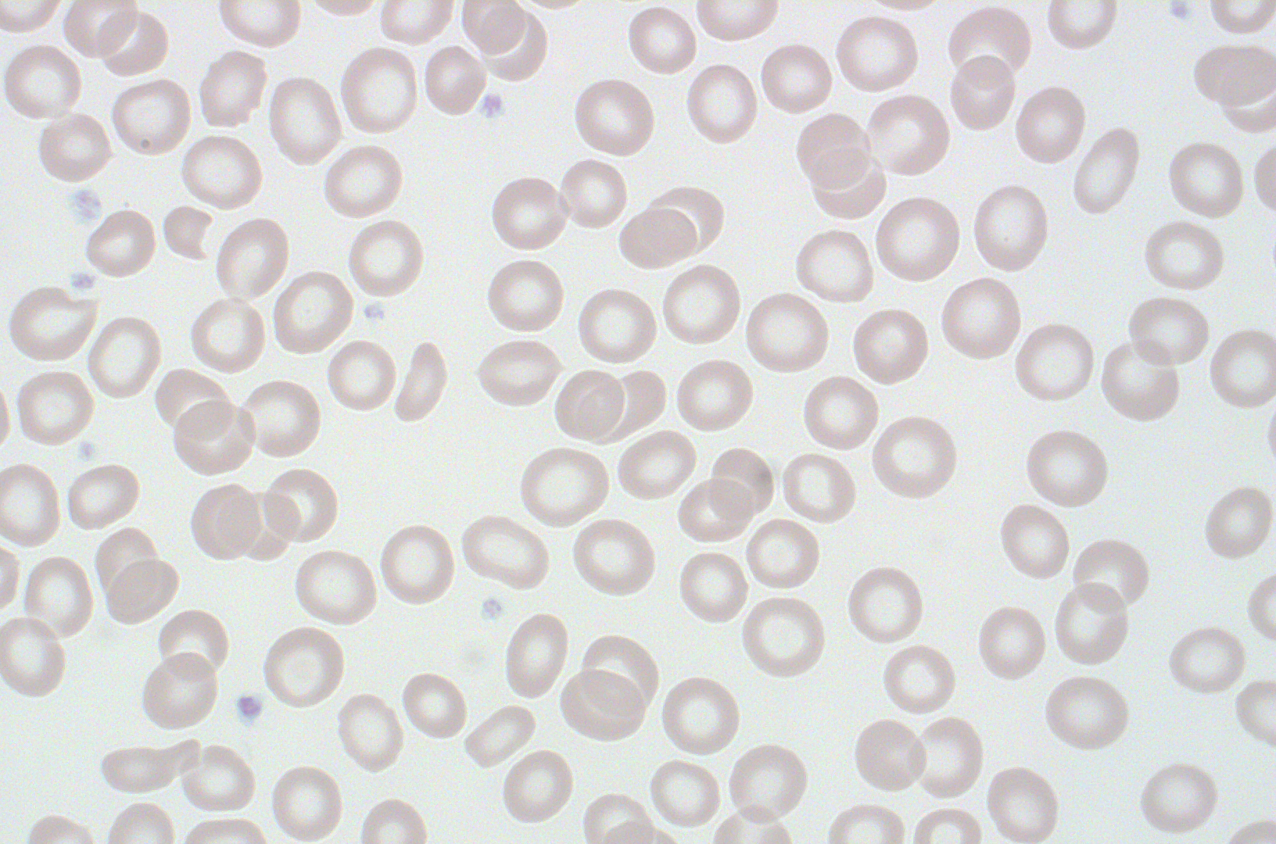
hypochromia, microcytosis, anisopoikilocytosis

Slide 20
Risk of Thalassemia Major in Offspring Depends on Trait Genotype
α-/α-
trans deletions
--/αα
cis deletions
 | α− | α−
α− | α−/α− | α−/α−
α− | α−/α− | α−/α−
 | −− | αα
−− | −−/−− | −−/αα
αα | αα/−− | αα/αα
No thalassemia major
25% thalassemia major

Slide 21
Hb H Disease
Genotypes | Classical: – – / α – Others: – – / α^{CS}α
Neonates | Excess γ → 25–50% Hb Barts (γ₄) Microcytosis (MCV <95 fL)
Children and Adults | Excess β → 5-10% Hb H (β₄) – fast band on IEF Moderate to severe anemia (Hb 6–9 g/dL) Hyphochromia and microcytosis (MCV 55–65 fL) Hepatosplenomegaly Hb H inclusions on brilliant cresyl blue (BCB) stain
Significance | Great phenotypic variability Hemochromatosis from increased iron absorption and transfusions
α^{CS} = Hb Constant Spring

Slide 22
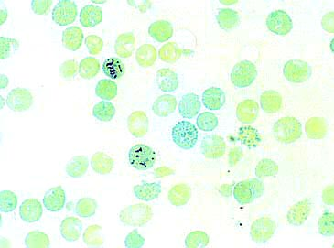
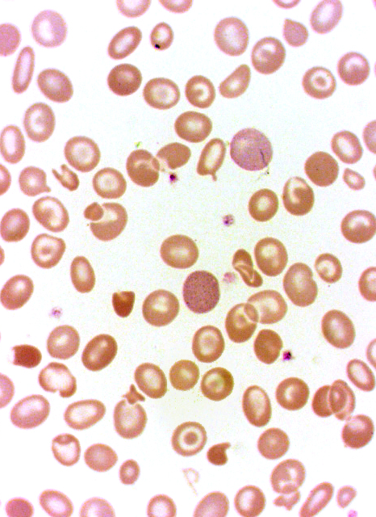
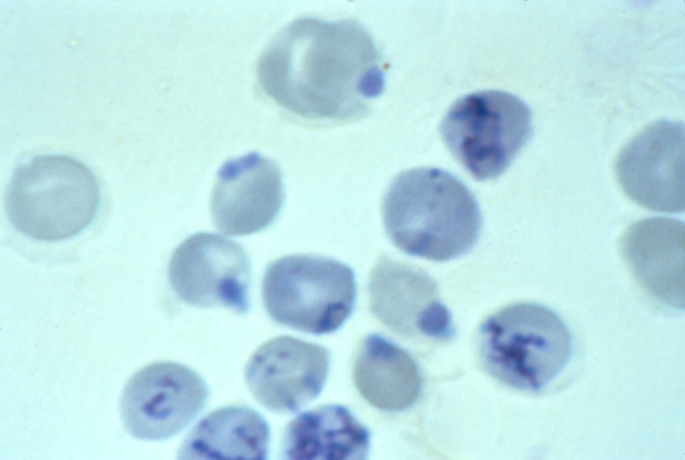
Hb H inclusions
(supravital stain)
Hb H inclusions after splenectomy
(supravital stain)

Slide 23
Hb Constant Spring (CS)
UAA
(stop)
α-globin
mRNA
α-globin
protein
CAA
(Gln)
31 extra a.a.
slow band on IEF
unstable (2-3% on IEF)
α^{CS}-globin
mRNA
α^{CS}-globin
protein
Hb H - Constant Spring
Genotype: – – / α^{CS}α
A form of Hb H disease (α-thalassemia intermedia)
Typically more severe than classical Hb H disease
Notes:
An alpha globin variant that you need to know is Hgb Constant Spring, named after the location in Jamaica where it was described.
It is produced by a mutation of the stop codon that adds an additional 31 amino acids. This appears as a slower band on Hgb electrophoresis (Hgb H and Barts are fast bands). Because it is unstable, it produces thalassemic phenotype.
When coinherited with two gene deletion thalassemia, it produces a form of thalassemia intermedia called Hgb H Constant Spring that is more severe than classical Hgb H disease.

Slide 24
Homozygous alpha thalassemia Hydrops Fetalis
HBZ (ζ)
Genotype | – – / – –
Embryo and Fetus | Nearly 100% Hb Barts and Hb H Possible embryonic Hb formation (if ζ not deleted) Non-immune fetal hydrops and demise
Potential Medical Support | In utero transfusions Post-natal chronic transfusions or SCT
SCT = stem cell transplantation

Slide 25
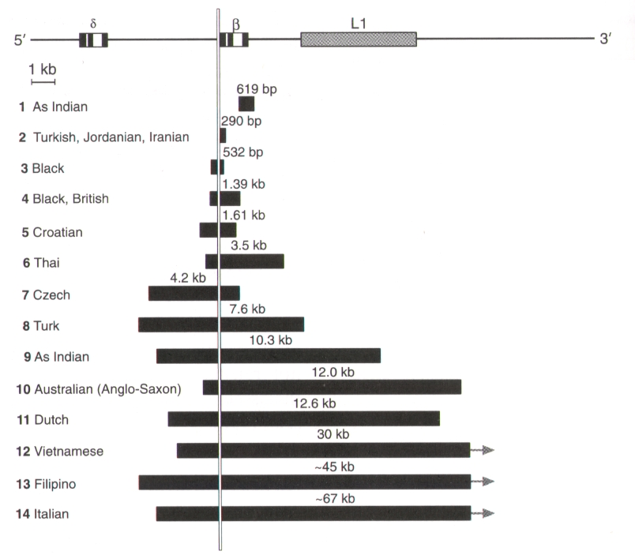
Typical β-Thalassemia Mutations
Point mutations
Most common
Disrupt regulatory sequences
β⁰ = no expression
β⁺ = partial expression
Deletions
Remove the β gene
Less common
Notes:
Switching now to beta thalassemias,
Beta thalassemia is typically caused by point mutations of regulatory elements that completely or partially disrupt the expression of the gene. Beta thalassemia can also be caused by deletions that remove the beta globin gene.

Slide 26
Overview of Beta Thalassemia Common (Classical) Genotypes
Genotype | Description
β / β | Normal
β / β⁰ | Beta thalassemia trait (minor)
β / β⁺
β⁺ / β⁺ | Beta thalassemia intermedia
β⁺ / β⁰
β^{E} / β⁺
β^{E} / β⁰
β⁰ / β⁰ | Beta thalassemia major (Cooley’s Anemia)
Production of β-globin:
β⁺ = decreased
β⁰ = absent
Notes:
Let’s review the main subtypes of the beta thalassemias. Recall, we normally have 2 beta globin genes.
Beta thalassemia trait or minor occurs when a single thalassemic allele is inherited…either beta plus or beta zero.
Beta thalassemia intermedia results from a variety of combinations, 4 classical examples are shown here.
Beta thalassemia major, or Cooley’s anemia, is the result of homozygosity for two null alleles.

Slide 27
Beta Thalassemia Trait
Genotypes | β/β⁺ β/β⁰
Neonates | Normal blood counts γ (not β) is the predominant β-like globin
Children and Adults | Mild to no anemia (Hb 10–12 g/dL) Hyphochromia and microcytsis (MCV 65–75 fL) Hb A₂ (and sometimes Hb F) increased
Significance | Common Frequently misdiagnosed and treated as iron deficiency anemia Risk to offspring
TI = thalassemia intermedia
TM = thalassemia major

Slide 28
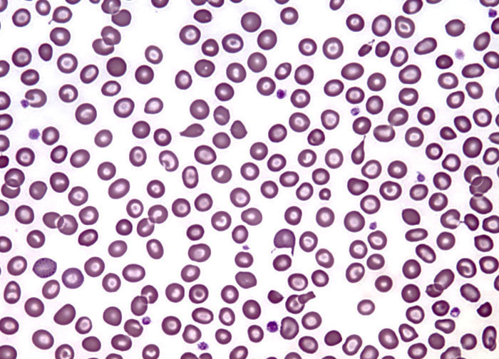
hypochromia, microcytosis, target cells, anisopoikilocytosis

Slide 29
Basics of Electrophoresis differentiation of thalassemia trait from mild iron deficiency anemia
Condition | Hgb F | Hgb A₂
Beta thalassemia trait | Normal or Increased (1 – 10%) | Increased (3 – 10%)
Alpha thalassemia trait | Normal (0 – 2%) | Normal or Decreased (0 – 2.5%)
Iron deficiency anemia | Normal (0 – 2%) | Normal or Decreased (0 – 2.5%)
Normal Hgb F: ≈ 0 – 2%* Normal Hgb A₂: ≈ 2 – 3%*
Key Points:
Beta thalassemia trait: diagnosis can be confirmed by electrophoresis.
Alpha thalassemia trait: diagnosis of exclusion (electrophoresis may be normal).
Iron deficiency anemia: mimics α-thalassemia trait, masks β-thalassemia trait.
Treat iron deficiency before performing electrophoresis.
*Normal range after 6 months of age. Range varies by technique and lab.

Slide 30
Beta Thalassemia Intermedia
Genotypes | β⁺/β⁺ β⁺/β⁰ β^{E}/β⁺ β^{E}/β⁰
Neonates | Normal blood counts γ (not β or β^{E}) is the predominant β-like globin
Children and Adults | Mild to moderately severe anemia Hyphochromia and microcytsis (MCV 50–65 fL) Hb A₂ and F increased Variable hepatosplenomegaly
Significance | Some require intermittent transfusions Hemochromatosis from increased iron absorption (and transfusions)
all β⁺ is not the same
phenotype can be modified by non-β genes: β/β⁰ + ααα/αα
TI = thalassemia intermedia
TM = thalassemia major

Slide 31
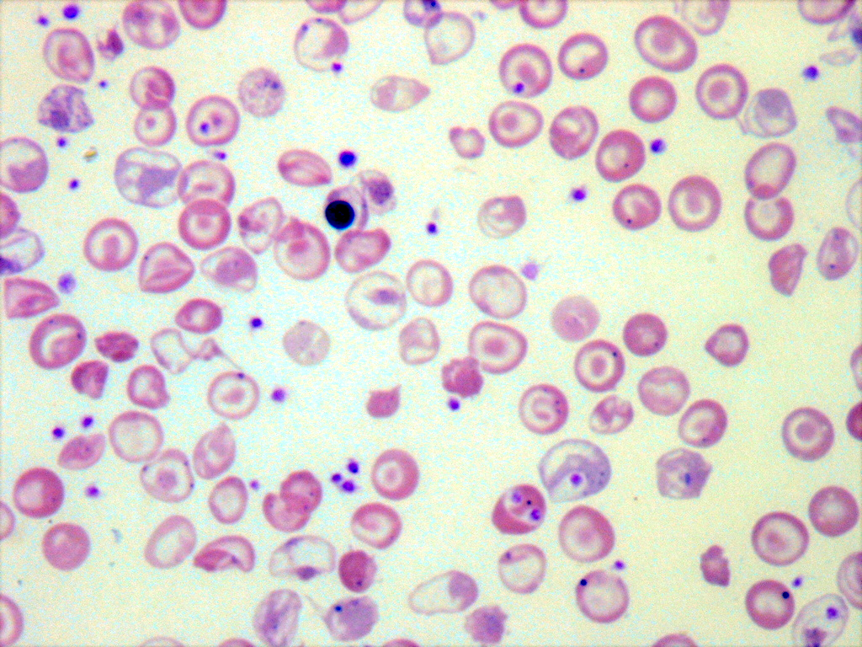

Slide 32
c.118C>T(p.Q40*)
β
c.118C>T(p.Q40*)
β
α α
β β
α α
ααα^{anti-3.7}
α α α
normal
β-thalassemia
minor
β-thalassemia
intermedia

Slide 33
Hemoglobin E
Very common Hb variant (Southeast Asia)
β^{26 glu→lys} [HBB.c.79G>A(p.E27K)]
Qualitative and quantitative defect (thalassemic hemoglobinopathy)
Interacts with β-thalassemia determinants
Clinical Spectrum of Hb E Disorders
Name | Main Hbs Present | Clinical features (generalization)
Hb E trait | A > E | Microcytosis, target cells
Hb E disease | E | Mild microcytic anemia, target cells
Hb E / β⁺ -thalassemia | E > A | β-thalassemia minor to intermedia
Hb E / β⁰ -thalassemia | E | β-thalassemia intermedia to major
Hb E/β-thalassemia syndromes are managed like other β-thalassemia syndromes of comparable severity.
Notes:
A word about Hgb E.
It is probably the most common abnormal Hgb in the world. The mutation is beta 26 glu - lys. This mutation produces both qualitative and quantitative abnormalities of Hgb.
E trait is a benign condition, like thal trait, characterized by microcytosis.
Homozygosity for Hgb E (Hgb E disease) produces a mild microcytic anemia.
Interestingly, when Hgb E is conherited with beta-thal genes, then more severe anemia or a thalassemia intermedia phenotype can be seen.

Slide 34
β^{E}-globin gene:
GAG→AAG
glu→lys
β^{E}-globin transcripts:
β-globin protein:
Properly spliced:
Hb E
(β^{26 glu→lys})
reduced normal splicing
reduces globin output = thalassemia
Improperly spliced:
Not translated
Notes:
This slide illustrates why Hgb E has qualitative and quantitative abnormalities…that is, it is a thalassemic hemoglobinopathy.
[Describe slide]

Slide 35
Beta Thalassemia Major
Genotypes | β⁰/β⁰
Neonates | Normal blood counts All Hb F (no Hb A) Newborn screen: F only pattern
Children and Adults | Progressively severe anemia during the first year of life Produce Hb F and A₂ only Severe hypochromic microcytic anemia Organomegaly and growth failure
Significance | Lifelong transfusions or transplantation needed Hemochromatosis from increased iron absorption and transfusions

Slide 36
Therapy for Thalassemia Intermedia or Major
Cure by stem cell transplantation (HLA-matched sibling donor)
Chronic transfusions (“hypertransfusion”)
Common indications: severe/symptomatic anemia, growth failure, problematic extramedullary hematopoiesis.
Frequency: every 2-4 weeks (nadir Hb ≈ 10 g/dL)
Therapeutic goals:
Alleviate symptomatic anemia
Greatly suppress ineffective erythropoiesis
Prevent bony complications and decrease organomegaly
Improve growth, development, quality of life
Chelation therapy for iron overload
Consider splenectomy for marked hypersplenism (e.g., increased transfusion requirements, discomfort)—try to avoid if possible
Terminology conundrum. By definition, a patient with thalassemia who is receiving chronic transfusions has thalassemia major, regardless of genotype. So, one’s medical assessment and practice often determines whether a patient has thalassemia intermedia or major. A specific genetic form of thalassemia is often associated with a particular clinical grouping (e.g., intermedia or major), but both biological factors and physicians’ practices make for inconsistent genotype-phenotype correlations.
Notes:
The treatement of thalassemia major is chronic transfusions or SCT.
Transfusions are given approximately monthly and lifelong not just to alleviate the anemia. Hypertransfusion regimens are given to turn off erythropoiesis to prevent bony complications and to improve growth and development.
Chelation therapy is needed for iron overload, both endogenous and transfusional.
Sometimes a splenectomy helps decrease transfusion requirements.

Slide 37
Recommended standard care for thalassemia intermedia and major
Assessment | Ages | Frequency | Comments
Bone mineral density | ≥ 10 | Yearly | DEXA scan or quantitative CT
Tanner Stage | 10 to 20 | Yearly | Perform yearly starting at age 10 and continuing until breast or gonadal Tanner stage V or age 20.
Liver Iron Content | all | Yearly | MRI (R2, T2*) or liver biopsy
Cardiac T2* | ≥ 10 | Yearly | To be performed when available for patients with biochemical evidence of iron overload or age 10 years or older
Cardiac Studies | ≥ 10 | Yearly | Echocardiography and/or cardiac function by MRI; indicate the need to assess for pulmonary hypertension when ordering an echocardiogram
CBC plus differential | all | Yearly (minimum) | If transfused, preceding each transfusion
Blood chemistries | all | Yearly | BUN, creatinine, calcium, magnesium, phosphorus, and zinc
LFTs | all | Yearly | ALT, AST, total bilirubin, albumin
Ferritin | all | Yearly (minimum) | If transfused, preceding each transfusion
HIV | all | Yearly | Only for transfused participants starting at the first transfusion
Hepatitis serology | all | Yearly | Only for transfused participants starting at the first transfusion.
Fasting plasma ascorbate | all | Yearly | 12 hour fast
Fasting glucose | ≥ 10 | Yearly | 12 hour fast
Endocrine panel I | ≥ 6 | Yearly | TSH, free T4, parathyroid hormone, 25-hydroxy vitamin D, and 1,25 dihydroxy vitamin D levels
Endocrine panel II | ≥ 10 | Yearly | Testosterone (males only), FSH and LH (males and females), and estradiol (females only)

Slide 38
Transfusional Iron Overload not specific to thalassemia
Iron loss is fixed
1 mg/day
Sloughed mucosa; menses
No mechanism to “excrete” iron
PRBCs provide iron
1 mL of pure RBCs ≈ 1 mg Fe
1 unit PRBC/month = 3-4 g Fe/yr
Limitation of iron loading
Erythrocytapheresis
Phlebotomy prior to transfusion
Increased intestinal iron absorption
Ineffective erythropoiesis
Low hepcidin
Modified by co-inherited mutations/polymorphisms (e.g., HFE)
Adverse effects
Hepatic fibrosis and cirrhosis
Endocrinopathies (hypothyroidism, growth failure, diabetes mellitus)
Cardiomyopathy and conduction disturbances (sudden death)
Notes:
The problem with transfusions is that iron loss from the body is fixed at about 1 mg/day from sloughed mucosa. The body has no mechanism to excrete iron.
Every time you give a transfusion you give iron. I ml of pure RBCs contains about 1 mg of Fe. One unit of PRBCs per month will provide about 3-4 g Fe/year.
There is also increased intestinal absorbtion of Fe because of the ineffective erythropoiesis, and this can be modified by the coinheritance of HFE mutations.
Iron overload affects mainly the liver, the endocrine glands, and the heart.
Iron burden can be monitored and measured in different ways. Ferritin is the easiest but least accurate. Fe can be measured in tissue biopsies, or using MRI or magnetic susceptometry.
The treatement of iron overload is chelation. Commonly used agents in this country are deferasirox, the newer orally active chelator, and deferrioxamine.

Slide 39
Accumulation of Iron: Hemochromatosis
transfusions
intestinal absorption
iron stores increase
capacity of transferrin exceeded
unbound iron accumulates
iron accumulates in organs
free radicals and
reactive oxygen species
cardiac, endocrine, hepatic and joint toxicity
peroxidation of membrane
lipids and cellular injury
Notes:
I’ve mentioned iron overload several times.
You should know that as iron stores increase, the capacity of transferrin will be exceeded ,and unbound iron will accumulated.
This free iron accumulates in organs, forms free radicals and ROS, and damages membrane lipids and cellular contents leading to organ toxicity.

Slide 40
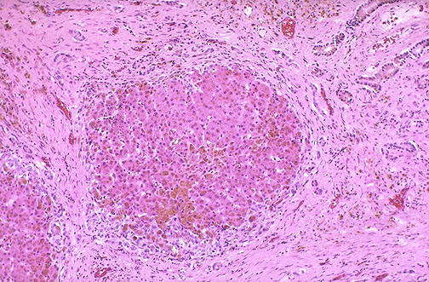
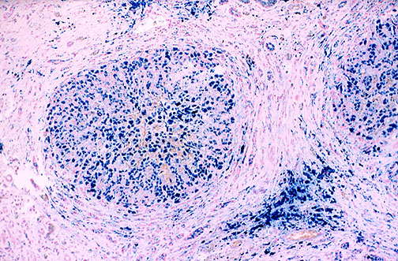
Liver
Cirrhosis
Liver Failure
Hepatocellular Carcinoma

Slide 41
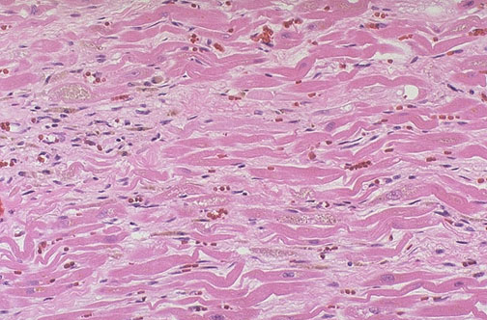
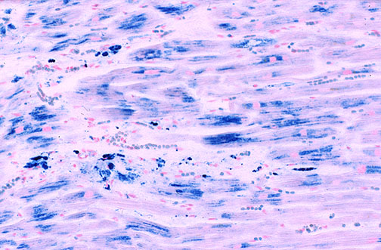
Heart
Heart Failure
Dysrhythmias
Sudden Death

Slide 42
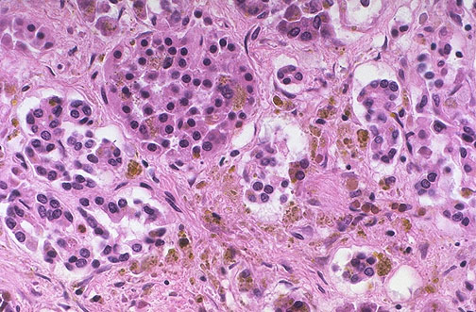
Pancreas
and other endocrine glands
Hypogonadism
Hypothyroidism
Diabetes Mellitus

Slide 43
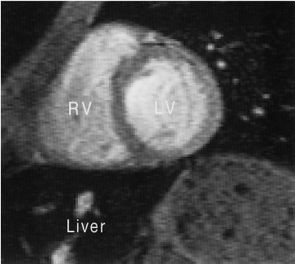
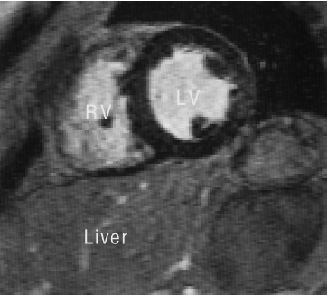
Appearance of Tissue Iron by MRI
and common methods of quantitation
T2*
Liver > Heart
Heart > Liver
R2, T2* → converted to Fe concentration
Serum ferritin may not accurately represent a patient’s risk (non-linear with iron load; confounded by inflammation and vitamin C deficiency; underestimates iron burden in thalassemia intermedia and Diamond-Blackfan anemia) and cannot substitute for more direct determinations of iron load in susceptible organs. Liver biopsy is invasive and susceptible to sampling errors, but may occasionally be necessary for histologic determination of fibrosis or cirrhosis.

Slide 44
Common Iron Chelators
Deferasirox
Tridentate iron chelator
Oral solution (dissolved tablet)
Once daily
30 - 40 mg/kg/dose
Main toxicity: GI, hepatic, renal
Monitoring: Monthly ferritin, LFTs, BUN/creatinine, urine prot:creat
Deferoxamine
Hexadentate iron chelator
SQ or IV infusion (short t_{1/2})
10-12 hrs, 5-7 nights weekly
30 - 50 mg/kg/day
Main toxicity: ocular, otic, bony
Monitoring: : Monthly ferritin, LFTs, BUN/creatinine, urine prot:creat; yearly eye exam and audiogram; consider yearly bone density
Chelation usually initiated when: 120-200 ml/kg of PRBCs have been transfused; LIC > 5-7 mg/g dry weight; and/or ferritin >1500-2000 ng/mL. Often wait until age > 2 years because of potential growth impairment and bony changes (especially for deferoxamine).

Slide 45
Ascorbic Acid (Vitamin C)
Vitamin C, iron, and iron overload
Vitamin C increases GI absorption of non-heme iron
Vitamin C increases availability of iron for chelation
Iron overload can cause vitamin C deficiency (iron-mediated oxidation of vitamin C)
Patients with severe chronic iron overload can have cardiac decompensation if deferoxamine and high doses of vitamin C (>500 mg daily) are used together
General recommendations
Vitamin C can be considered an adjunct to chelation.
Don’t give vitamin C without chelation (because of potential for increased GI absorption)
Vitamin C supplements should not be given to patients with cardiac failure
Do not exceed a daily vitamin C dose of 200 mg
Not formally studied for deferasirox (recommendations are extrapolated from experience with deferoxamine)

Slide 46
δβ-thalassemia
^{G}γ
^{A}γ
δ
β
Normal β-globin locus:
^{G}γ
^{A}γ
large deletion
High Hb F
Low Hb A₂
(δβ)⁰-thalassemia:
gene fusion
^{G}γ
^{A}γ
δ
β
High Hb F
Low Hb A₂
Hb Lepore (7-15%)
(δβ)⁺-thalassemia:
(Hb Lepore)

Slide 47
Hereditary Persistence of Fetal Hemoglobin (HPFH)
Deletion
Non-deletion
Linked to β-globin gene cluster
^{G}γ
^{A}γ
HPFH deletion
^{G}γ
HPFH deletion
pancellular
Linked to β-globin gene cluster
Not linked to β-globin gene cluster
BCL11A
HBS1L- MYB
heterocellular

Slide 48
Distribution of HbF in Erythrocytes
Kleihauer-Betke
heterocellular
25% Hb F
pancellular
25% Hb F

Slide 49
(δβ)⁰-HPFH and (δβ)⁰-thalassemia What’s the difference?
Related conditions
Defective δ- and β-globin synthesis (large gene deletions)
Increased Hb F (20-40%; higher than β-thalassemia trait)
Decreased Hb A₂ (unlike β-thalassemia trait)
Homozygotes: Hb F only (no A or A₂)
Gene-deletion HPFH also known as (δβ)⁰-HPFH
No thalassemic peripheral blood phenotype
Hb F (γ) synthesis fully compensates for defective δ and β synthesis
(δβ)⁰-thalassemia
Thalassemic peripheral blood phenotype (hypochromic, microcytic anemia)
Hb F (γ) synthesis does not fully compensate for defective δ and β synthesis
Notes:
A few words about hereditary persistence of fetal hemoglobin (HPFH) and delta beta thalassemia.
These are related conditions characterized by defective delta and beta globin synthesis with increased Hgb F production in adult life. Hgb A and A2 production is decreased or absent in these conditions.
The difference between HPFH and delta-beta thalassemia, essentially, is that HPFH produces no thalassemic phenotype, but delta-beta thalassemia does, because gamma chain synthesis completely compensates for defective d and b synthesis in HPFH but not in DBT.
A simple classification of HPFH and DBT is shown. Note the Hgb Lepore, a DB fusion gene, produces a DBT+ phenotype.

Slide 50
Gamma Thalassemia
In utero and transient neonatal microcytic hemolytic anemia.
May cause hemolytic disease of the newborn.
α
α
50
40
γ
β
% total hemoglobin
30
20
ζ, ε
β
10
γ
δ
6
18
30
birth
12
24
36
48
gestational age
(weeks)
postnatal age
(weeks)
Notes:
This graph shows the expression of the different globin genes during development. Age is shown on the x-axis, and the percent of total hemoglobin is shown on the y-axis.
The embryonic epsilon and zeta chains are expressed only in very early life. Zeta glonbin synthesis is replaced by alpha globins that persists for the remainder of life.
The beta like chains are a bit more complex. The embryonic epsilon gene is also transiently expressed in very early life. It is replaced by gamma globin chain synthesis. The combination of two alpha and two gamma chains is called fetal hemoglobin (or Hgb F).
As gamma chain synthesis decreases around the time of birth, it is replaced by beta chain synthesis. The combination of two alpha and two beta chains is called adult hemoglobin (or Hgb A). A small amount of delta chain synthesis begins around the time of birth, and the combination of two alpha and two delta chains forms a minor adult Hgb called Hgb A2.
So, Hgb F is the predominant Hgb in fetal life, and it is replaced by Hgb A and to a lesser extent A2 after birth.

Slide 51
Qualitative Disorders: Hemoglobinopathies
Notes:
Let’s transition now to the qualitative disorders of Hgb…the hemoglobinopathies.

Slide 52
Qualitative Abnormalities of Hemoglobin
Decreased solubility
Decreased oxygen affinity
Increased oxygen affinity
Abnormal heme iron oxidation state
Instability
Hb S, Hb C
Hb Kansas
Hb Syracuse, (Hb F)
Methemoglobin, Hb M
Hb Köln, Hb Hasharon
Notes:
Hgb can be qualitatively abnormal in several ways.
It could have decreased solubility, as with Hgbs S and C.
It’s oxygen affinity may be increased or decreased.
It’s ability to maintain iron in the ferrous state may be compromised, as with methemoglobin.
Finally, Hgb can be unstable leading to a hemolytic anemia.
The last 2 are covered in other lectures.

Slide 53
Common Structural Hb Variants
Hb | Mutation* | Distribution | Clinical Significance
S | β^{6 glu→val} | Africa, India, Mediterranean | Sickle cell disease (Hb SS, etc.)
E | β^{26 glu→lys} | Southeast Asia | Thalassemia (Hb E-β-thalassemia) Sickle cell disease (Hb SE)
C | β^{6 glu→lys} | Western Africa | Hemolytic anemia (Hb CC) Sickle cell disease (Hb SC)
D ^{Punjab/LA} | β^{121 glu→gln} | India, Pakistan, Iran | Sickle cell disease (Hb SD)
O ^{Arab} | β^{121 glu→lys} | Africa; Middle East | Sickle cell disease (Hb SO)
*Numbering of amino acids using the classical nomenclature based on mature globin chain after N-terminal methionine excision.
Notes:
You should be familiar with all the hemoglobinopthies summarized here.
[Read slide]

Slide 54
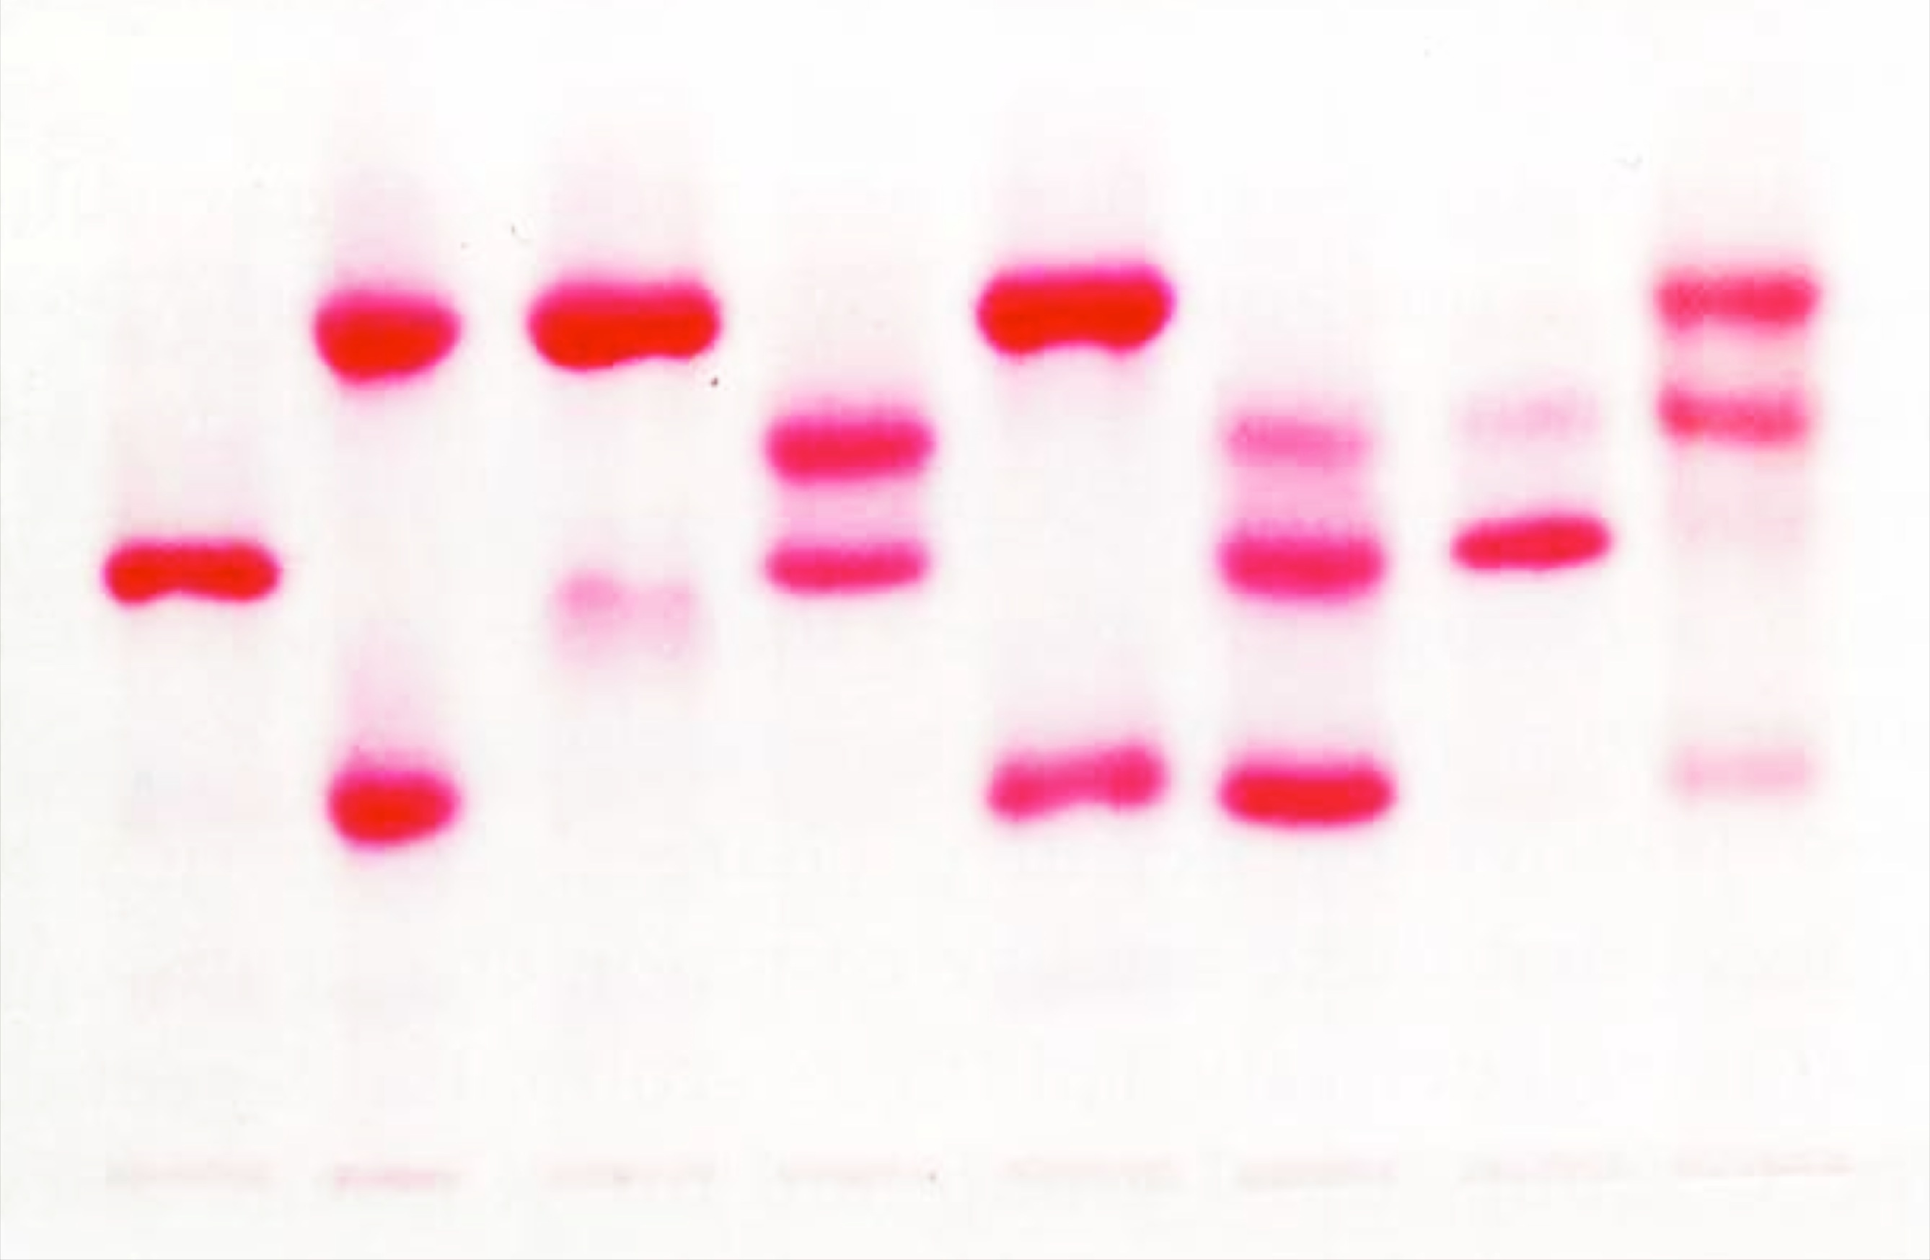
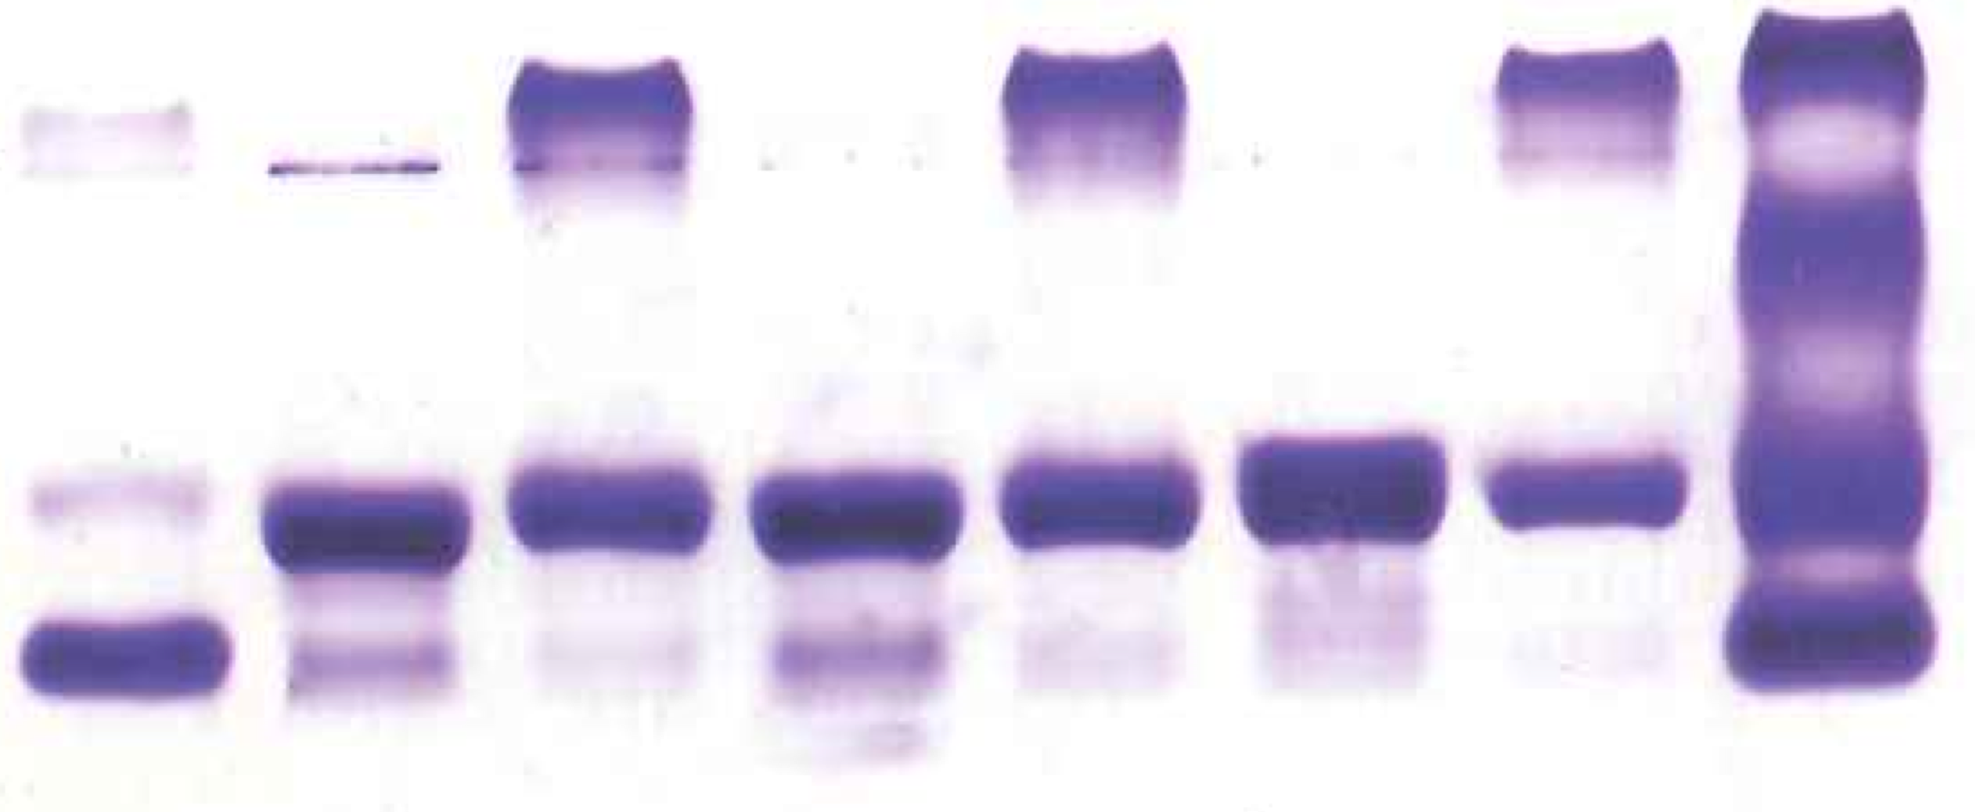
Hb Electrophoresis
Cellulose Acetate (pH 8.3)
Citrate or Acid Agarose (pH 6.2)
+
anode
+
anode
“fast”
A
C
F
S
S
DG
ADGOE
OE
C
F
“slow”
-
cathode
-
cathode
At least two methods are needed to identify a variant Hb. For example, Hbs S, D and G co-migrate on cellulose acetate, but in citrate D and G will migrate with A. Similarly, Hbs C, O and E co-migrate on cellulose acetate, but in citrate O and E will migrate near or with A. Thus, citrate is often used to confirm the presence of Hb S or Hb C. All Hb separation techniques do not conclusively establish the identity of a Hb, they only provide evidence for a particular Hb based on comparison with migration or elution characteristics of known Hbs.
indicates application point

Slide 55
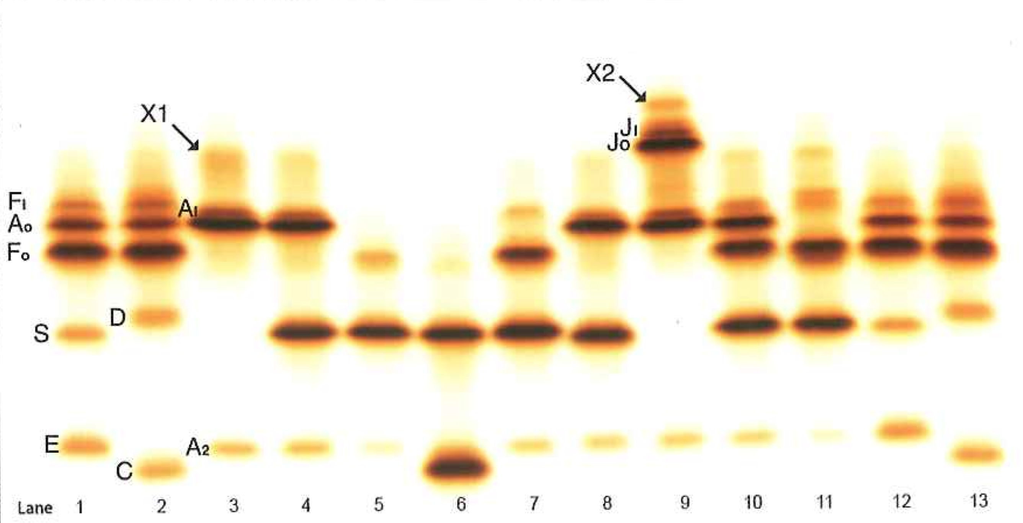
Isoelectric Focusing has replaced cellulose acetate electrophoresis in routine clinical use
Advantages over cellulose acetate: sharper bands, better separation of some variants, Hbs stop at isoelectric point. Also demonstrates post-translationally modified Hbs.

Slide 56
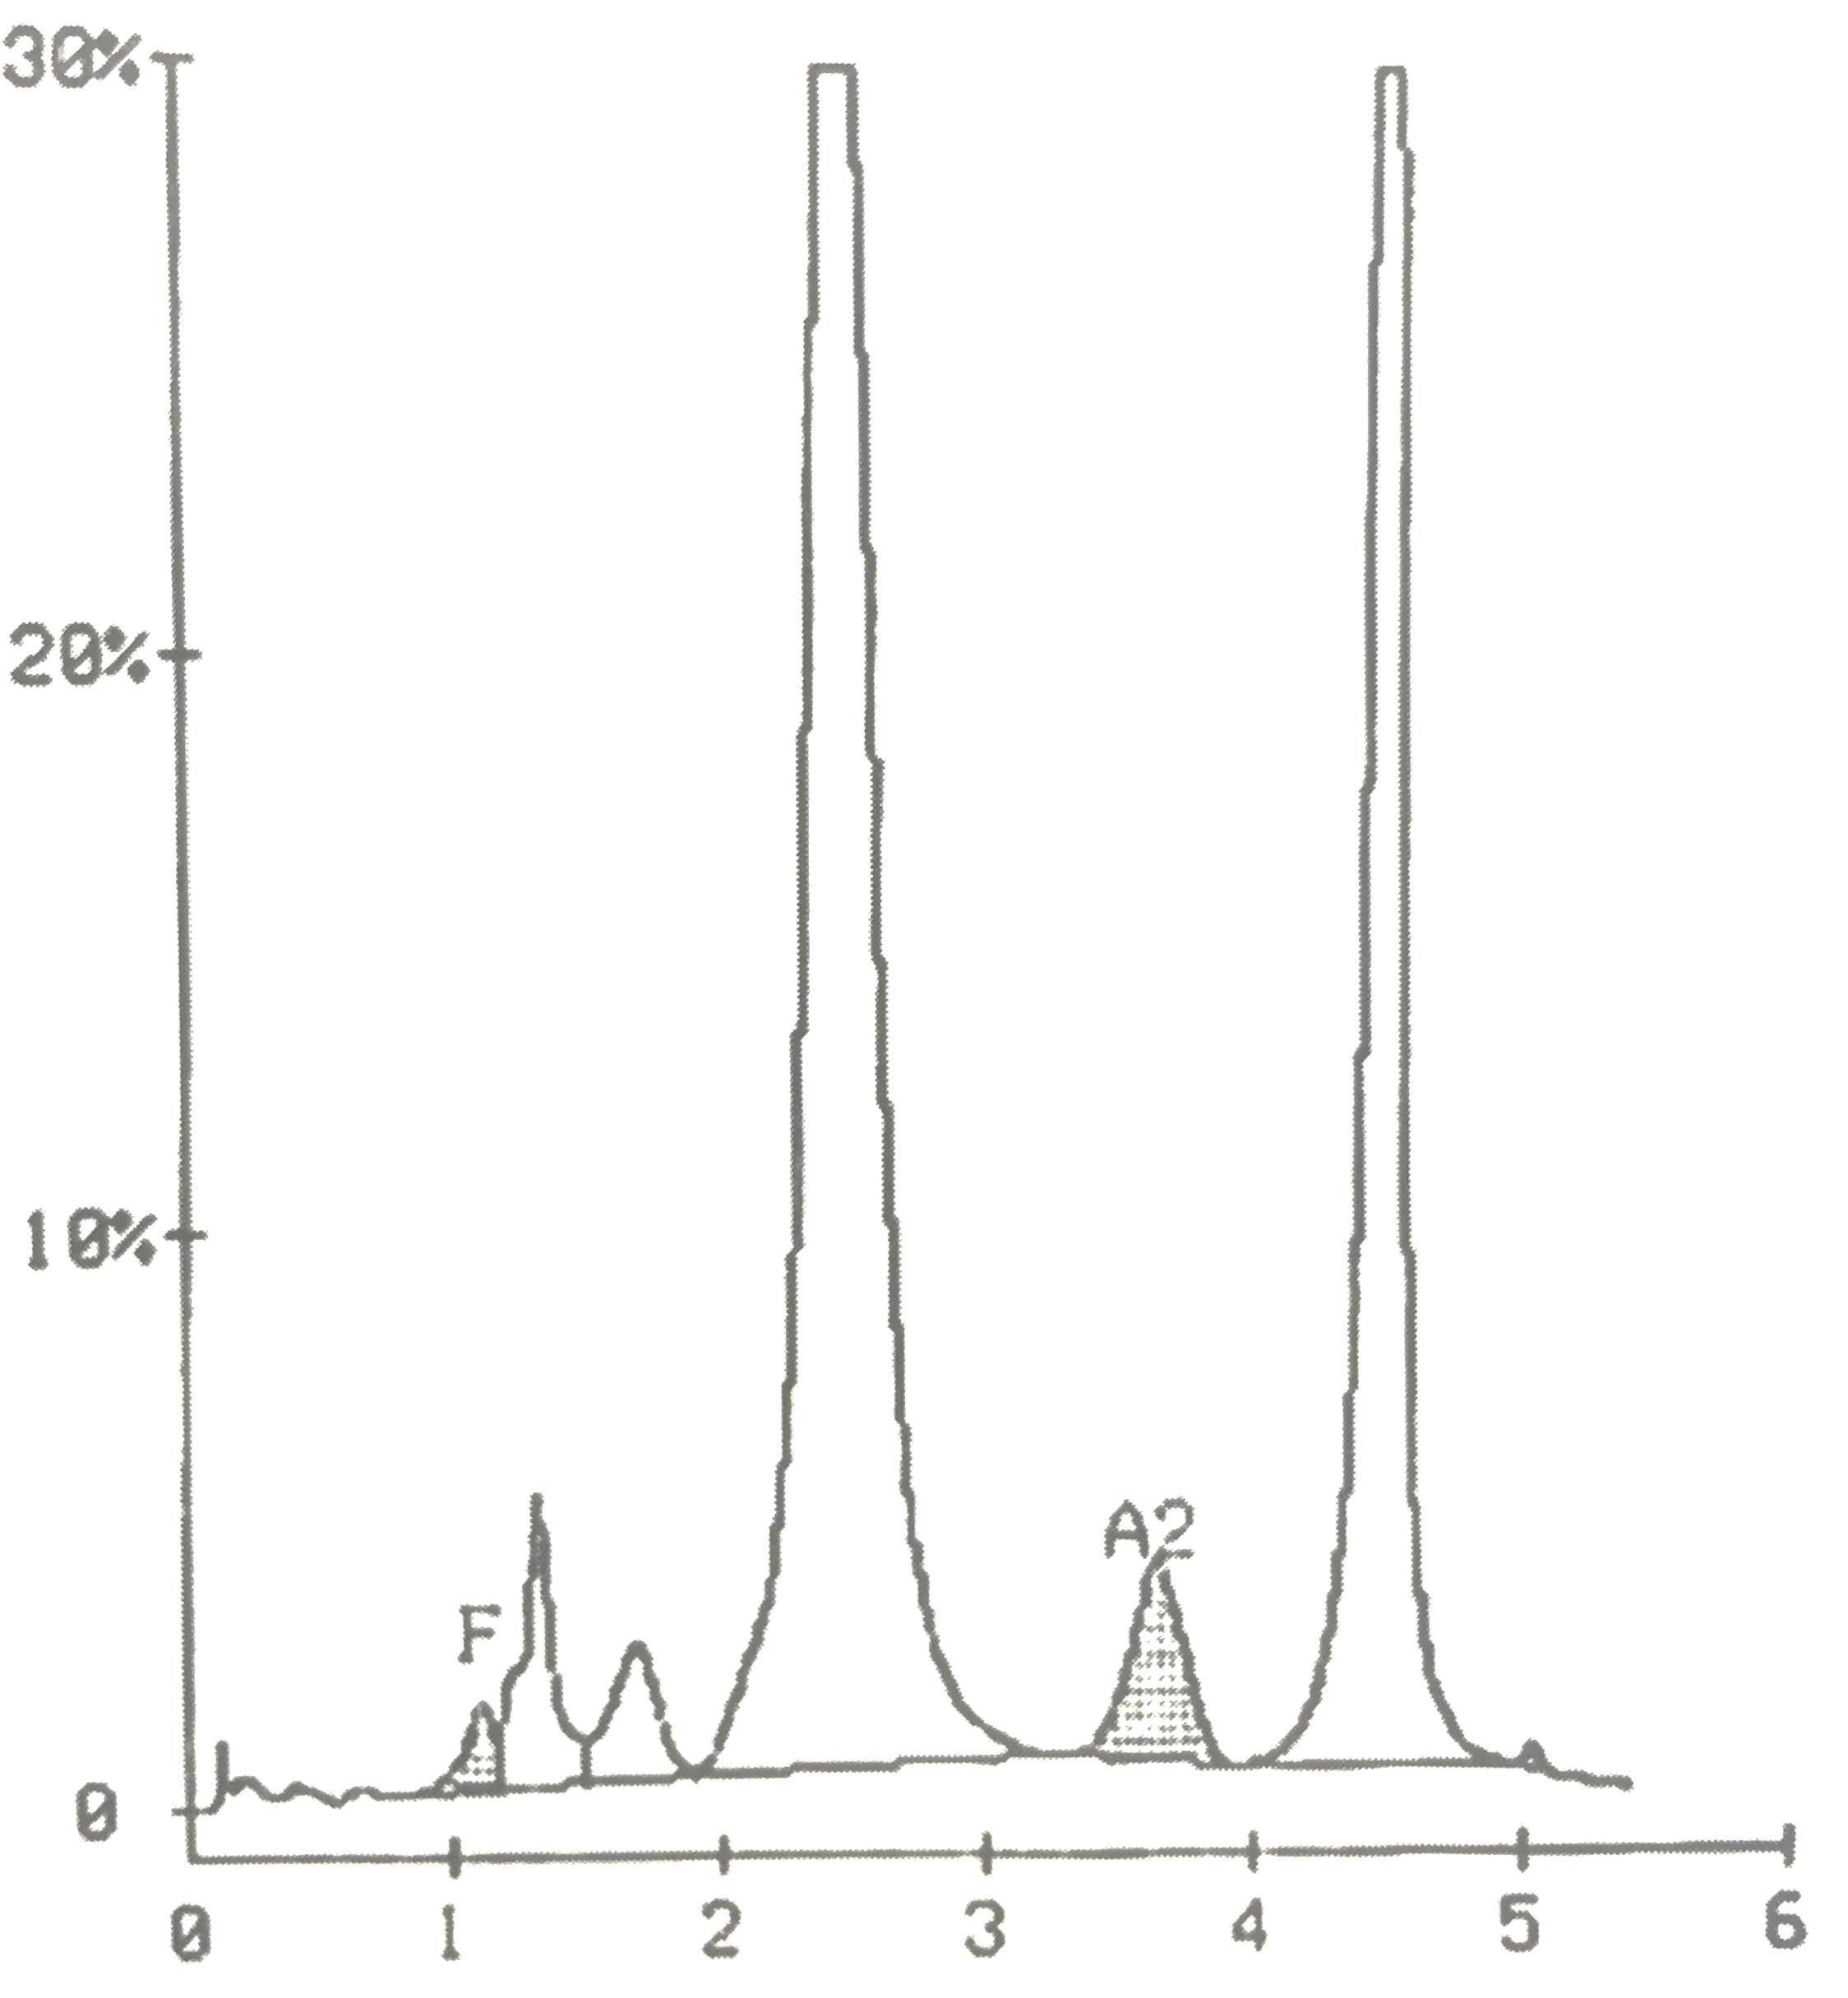
Common Current Screening (First-Line) Hb Separation Methods
HPLC
Capillary Zone Electrophoresis
F
A_{1c}
A₀
A₂
S
C
A
F
D
S
E
A₂
C
Advantages over IEF and gel-based electrophoresis: smaller sample volume, automation, higher throughput. Cautions: HPLC separates post-translationally modified Hbs (glycated, acetylated, degraded), which produces complex patterns that require specific expertise to interpret. A post-translational product of Hb S elutes with Hb A₂ on HPLC, so elevated Hb A₂ is not necessarily indicative of β-thalassemia when Hb S is present on HPLC (a common interpretive error).

Slide 57
Sometimes parental testing is needed to inform the diagnosis of a patient. For example, a child with microcytosis and predominantly Hb S (with only small amounts of Hb F and Hb A₂) by HPLC could have either Hb SS with coinherited α-thalassemia trait or Hb Sβ⁰. As noted before, the amount of HbA₂ detected on HPLC may not be a useful discriminator in the presence of Hb S. However, if one of the child’s parents has sickle trait (Hb AS) and the other is microcytic and has predominantly Hb A with elevated Hb A₂, then the child must have Hb Sβ⁰.
Genetic testing is increasingly used to make the initial diagnosis or confirm a diagnosis of SCD. Genetic testing actually includes a number of different techniques. For example, polymerase chain reaction-restriction fragment length polymorphism (PCR-RFLP) analysis, allele-specific oligonucleotide (ASO) probe hybridization, and sequencing of globin complementary DNA (cDNA) or genomic DNA are used to detect point mutations and small deletions or insertions. Large deletions or rearrangements, which cause the common forms of α-thalassemia and HPFH, as well as hybrid (fusion) genes like Hb Lepore, can be detected by multiplex gap PCR, Southern blotting analysis, or a newer technique called multiplex-ligation dependent probe amplification (MLPA). It is necessary to know which particular technique is being used for the genetic diagnosis of a patient, because each technique has limitations that affect the certainty of the findings. For example, a patient with Hb S-HPFH (specifically, gene-deletion HPFH) who has only direct genomic sequencing will appear to be homozygous for Hb S (Hb SS, sickle cell anemia), because only the β^{S} allele will amplify by PCR, as the HBB (β-globin) primers have no sites to anneal on the HPFH allele due to a deleted HBB gene. So, β-globin deletion analysis would be necessary in this case in addition to direct genomic sequencing. In the end, SCD is a genetic disease, and all patients deserve an accurate, specific genetic diagnosis.

Slide 58
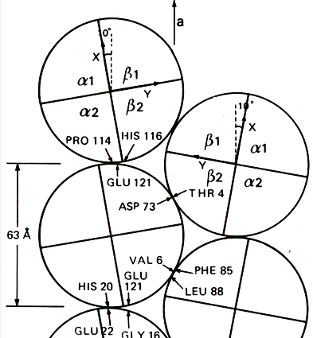
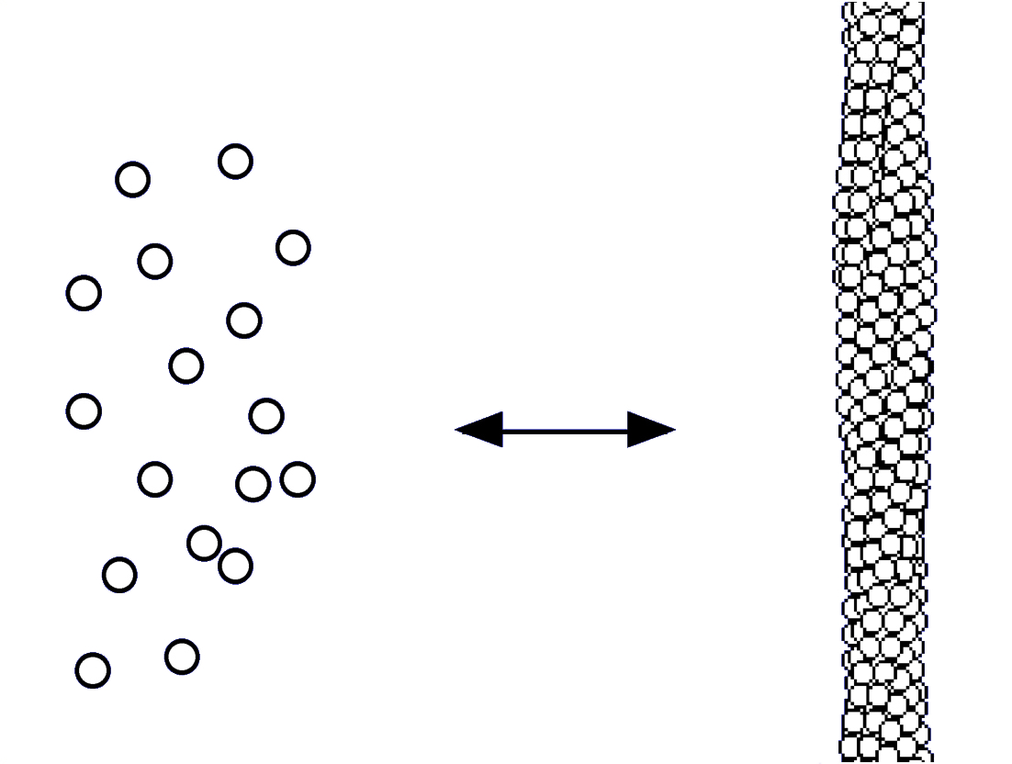
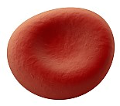
Sickle Hemoglobin (Hb S)
β^{6 glu→val} [HBB.c.20A>T(p.E7V)]
polymerization
upon de-oxygenation
mediated by β-β
intermolecular contacts
cyclic, reversible process damages membrane
-O₂
+O₂
oxygenated
deoxygenated
Polymerization is slowed or inhibited by non-S hemoglobins in the RBC.
Hb A is not incorporated into the fiber and slows polymerization due to “dilution” of Hb S.
Hb F is incorporated into the fiber and inhibits further polymerization.
Notes:
You absolutely need to know about sickle hemoglobin or Hgb S.
The mutation results in the substitution of glutamic acid by a valine in the 6th position. This allows inter-molecular interactions among Hgb molecules, such that polymerization of Hgb S occurs upon deoxygenation. Hgb S is soluble when oxygenated.
A filament of polymerized Hgb S is shown, and this process takes place inside RBCs, damaging the membrane to produce the characteristic sickle cells.

Slide 59
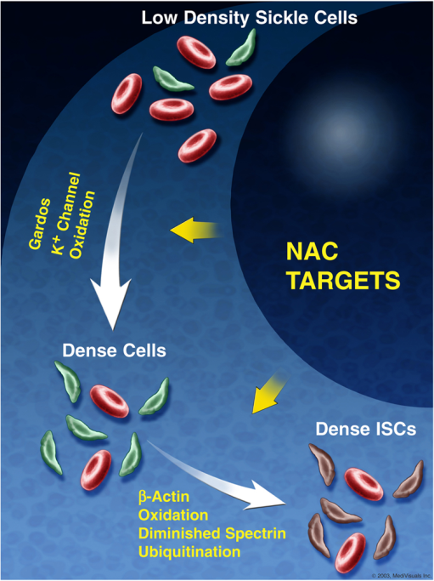
Irreversibly Sickle Cells (ISCs) Clinical and Laboratory Correlates
Positive correlations with %ISCs
MCHC
α-globin gene number
Inverse correlations with %ISCs
RBC lifespan
Total Hb
Hb F
α-thalassemia
Frequency of pain
An increase in the number of ISCs has been reported to portend VOC.

Slide 60
Common Forms of Sickle Cell Disease in order of decreasing relative frequency
Genotype |  | Name | Hb (g/dL)¹ | MCV (fL)^{1,2} | Retic (%)¹ | Severity³
β^{S}β^{S} | SS | sickle cell anemia | 6-9 | nl | 10-25 | 4+
β^{S}β^{C} | SC | sickle-Hb C disease | 9-12 | nl or ↓ | 5-10 | 2+
β^{S}β⁺ | Sβ⁺ | sickle-β⁺-thalassemia | 10-13 | ↓ | 5-10 | 1-2+
β^{S}β⁰ | Sβ⁰ | sickle-β⁰-thalassemia | 6-9 | ↓ | 10-25 | 4+
¹Common range of laboratory values in un-treated state (e.g., no hydroxyurea)
²Does not consider effect of co-inherited alpha thalassemia or therapeutic effect of hydroxyurea
³Population-based generalization
Inheritance: autosomal recessive (Hb SS) or autosomal co-dominant (Hb SC, Hb Sβ⁺, Hb Sβ⁰)
Notes:
The term sickle cell disease encompasses a number of related conditions, the most common forms of which are shown here in order of decreasing frequency.
Sickle cell anemia is the name for the homozygous state for the betaS gene. SCD also occurs from compound heterozygous states with Hgb S and Hgb C, beta-plus thalassemia, and beta-zero thalassemia. You should be familiar with the steady state hematologic parameters of the different sickle cell diseases.

Slide 61
Incidence of complications differs by genotype
All rates expressed per 100 patient-years.
Data from the Cooperative Study of Sickle Cell Disease (CSSCD).
Notes about Hb SC:
Retinopathy is more common in Hb SC than in Hb SS.
Detectable splenic involution is delayed (begins ~4 years of age)
Splenomegaly and splenic infarction are common features in older children and adults.
Avascular necrosis of the femoral head is a common problem.
Notes:
Shown here are the frequencies of pain, ACS, and stroke by genotype in the CSSCD.
Most complications are more common among patients with SS an Sbzero thalassemia than those with SC or Sbplus thalassemia.
You should know that certain complications, such as proliferative sickle retinopathy, are more common in SC than SS, however.

Slide 62
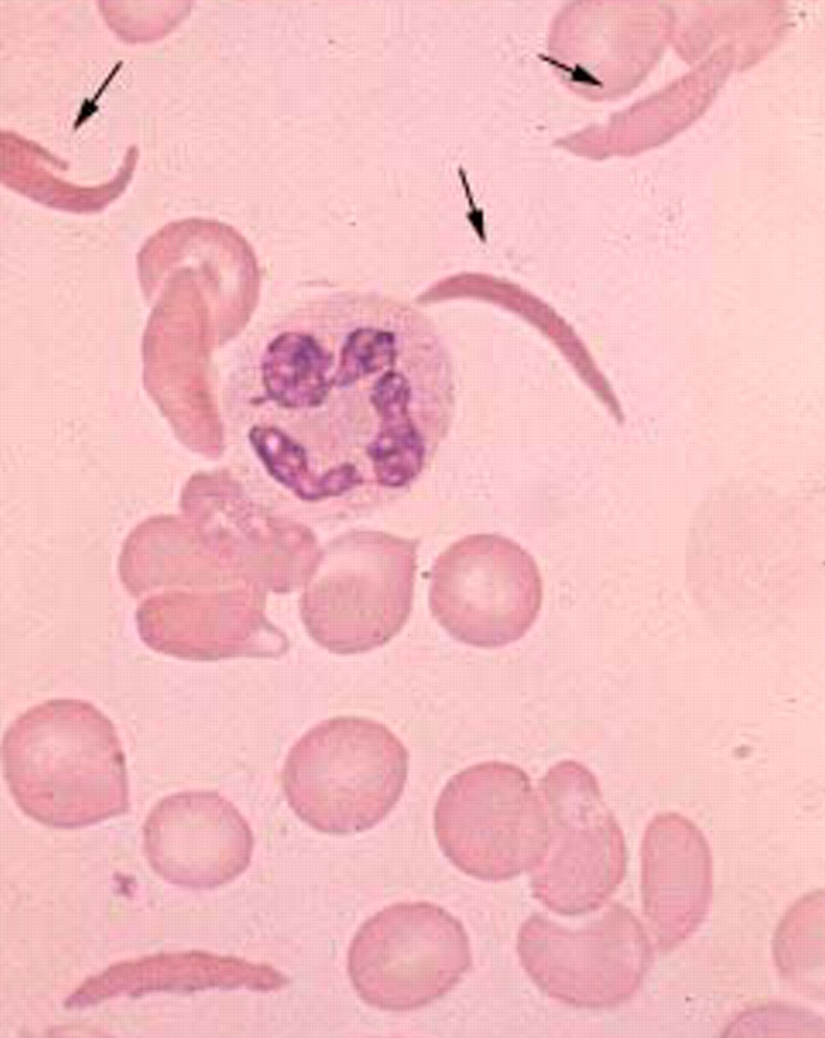
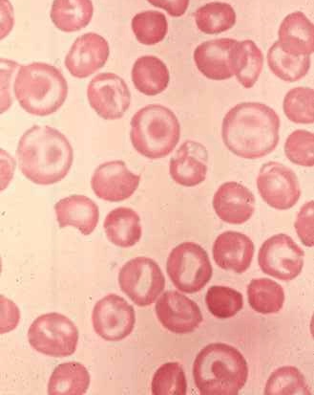
Light Microscopy
Many ISCs
Few or no ISCs
Hb SS
Hb SC
Notes:
The different forms of SCD have different findings on the peripheral smear.
Irreversibly sickled cells are characteristic of SS, but not SC, where target cells and dense irregular cells are typical.

Slide 63
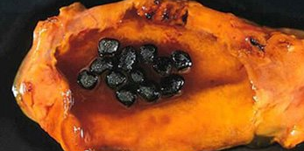
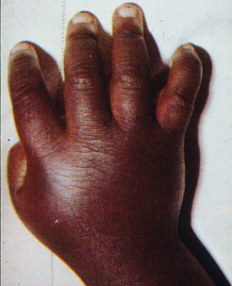
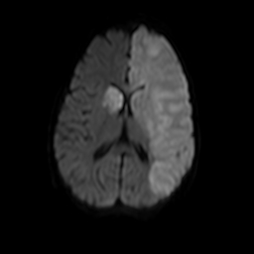
Manifestations of Sickle Cell Disease
Chronic hemolytic anemia
Jaundice, pallor, fatigue
Parvovirus aplastic crisis
Cholelithiasis (bilirubinate)
Endothelial dysfunction (NO)
Acute complications
Pain, dactylitis
Acute chest syndrome
Splenic sequestration
Aplastic crisis
Overt stroke
Chronic organ damage
Spleen
Brain
Kidneys, lung, bones, eyes
Susceptibility to infection
Notes:
The manifestations of SCD are summarized here.
Chronic anemia is the results of hemolysis and this produces jaundice, a tendency to form bilirubinate gall stones, and endothelial dysfunction.
There are a number of acute complications, such as pain, stroke, and ACS.
Then there is the consequent chronic organ damage, such as asplenia, nephropathy, and retinopathy.
You can think about the complications of SCD as being primarily due to hemolysis, vaso-occlusion, or a combination of both.
I have time to touch on only a few of these complications: pain, ACS, and the spleen.

Slide 64
Important Components of Management of Sickle Cell Disease
Early identification
Universal newborn screening
Ongoing (lifelong) education
Prevention and screening
Prophylactic penicillin
Immunizations
Screening TCD
Disease-modifying therapy
Hydroxyurea
Chronic transfusion
Stem cell transplantation
Management of acute complications
Notes:
The optimal management of SCD requires early identification by universal NBS and family education.
A number of of preventive and expectant measures are critical, such as prophylactic PCN, immunization, management of fever, and transcranial Doppler US or TCD to predict overt stroke.
There are three main treatments for sickle cell disease: transfusions, hydroxyurea, and the cure: SCT.
I’ll briefly expand on TCD and HU.

Slide 65
Splenic Complications
Involution / Hyposplenism
Splenic Sequestration
Begins ~3 mos. of age (Hb SS)
Lifelong risk of bacterial sepsis (esp. pneumococcal)
Reason for newborn screening
Reason for prophylactic PCN
Importance of immunizations
Empiric management of fever
Partially reversible entrapment of RBCs in splenic pulp
Mild to severe
May be recurrent
Teach parents/family to palpate the spleen (early identification)
Splenectomy may be needed for severe and/or recurrent episodes
Notes:
The spleen is affected by SCD. Autoinfarction of the spleen is illustrated here.
This leads to hyposplenism which predisposes to bacterial sepsis. This is why we use prophylactic PCN, immunizations, and detect the disease at birth by NBS.
Before the spleen is essentially gone, it can trap blood and cause episodes of severe anemia. This is why we teach parents to palpate the spleen. ASSC may require transfusion of splenectomy.

Slide 66
Acute Anemia Sequestration vs. Aplastic Crisis
Transient Aplastic Crisis¹
Anemia
Shock if severe
Spleen not enlarged
Reticulocytopenia²
NRBCs absent²
Normal platelets
Decreased jaundice
May need slow transfusion to prevent fluid overload and CHF
Acute Splenic Sequestration³
Anemia
Shock if severe
Splenomegaly
Reticulocytosis
NRBCs present
Thrombocytopenia
Jaundice (may be increased)
May need rapid transfusion because of hypovolemia⁴
¹Caused by human parvovirus. Ask if anyone else in the family has SCD or is pregnant because of risk to them.
²Reticulocytosis and NRBCs appear in recovery. Recognition of aplastic crisis during recovery phase can mimic hemolysis.
³ASSC can be triggered by parvovirus infection, so aplastic crisis and ASSC can be concurrent.
⁴Transfuse to a Hb of ~8 g/dL. Avoid over-transfusion, because it can release sequestered RBCs leading to hyperviscosity.
Notes:
Both aplastic and splenic sequestration crises can cause an acute anemia--the key is to differentiate between these.
Both present with anemia and shock,
However, in aplastic crisis the spleen is not enlarged; there is reticulocytopenia and NRBCs are absent; and the platelet count is normal.
With sequestration, the spleen is enlarged; retics and NRBCs are increased; and there may be thrombocytopenia.
For patients with aplastic crises, transfusion should be done with care, since the blood volume remains normal; blood should be given rapidly for shock due to sequestration, however.

Slide 67
Fever and Risk of Sepsis Empiric Management
Medical emergency
Functional hyposplenism
Risk of bacterial sepsis (>400x)
S. pneumoniae
Gram-negative enteric organisms
Prompt evaluation
Focused history and physical
CBC, retic, blood culture
IV antibiotic (e.g., ceftriaxone)
Inpatient vs. outpatient?
Inpatient: “toxic”, altered mental status
Others managed according to risk
Higher risk features
Temperature > 39.5ºC
Age < 1 year
Recent doses of PCN missed
Pulmonary infiltrate or respiratory distress
WBC > 30,000 (Hb < 6, plts < 150,000)
History of pneumococcal sepsis
Inadequate follow-up; non-adherence
Outpatient management
Observation (30 minutes) after ceftriaxone
Ensure follow-up (of patient and culture)

Slide 68
Prevention of Sepsis
Prophylactic penicillin (PCN)
< 3 years - 125mg po bid
> 3 years - 250mg po bid
Immunizations
Prevnar (PCV-13)
Pneumovax (2 and 5 years)
All usual childhood vaccinations (e.g., Hib)
Education of parent and patient
Significance of fever
What to do when you have a fever
Importance of immunizations and PCN
PCN: To whom and when?
SS and Sβ⁰
Begin 1-2 mos. of age
Continue until at least age 5y
Continue past 5y for pneumococcal sepsis or surgical splenectomy
SC and Sβ⁺
Hyposplenism occurs later
Practice varies
Consider at 4-5y
Notes:
It would be best to prevent, rather than treat, pneumococcal sepsis.
And the most effective, life-saving, preventive measure in SCA is the use of prophylactic oral PCN.
It should be started at the time of diagnosis (that is, when the NBS indicates SCA). The doses are shown here.
All patients should also be immunized against encapsulated organisms.
As you know the vaccine for H. Flu. is highly effective, unfortunately the vaccine against the pneumococcus does not offer a great deal of prevention; however it is give at 2 and 5 years of age.
The patient and parent must also be educated, such that they know to seek medical attention for any fever.

Slide 69
Acute Painful Episodes Features and Management
Triggers of pain
Often not identified
Infection/inflammation
Cooling of the skin
Stress
Sites of pain
Musculoskeletal
Abdominal
Physical signs present in 15%
Prevention
Avoid dehydration, cooling of skin, over-exertion, over-heating
Hydroxyurea
Crizanlizumab (NEJM 2016)
Management
NSAIDs and opiates (individualized)
Avoid over- and under-treatment of pain.
Non-pharmacological adjuncts (warm compresses, relaxation, massage).
Correct dehydration. Maintain normal hydration. Avoid over-hydration.
Incentive spirometry to prevent ACS
Vigilance for the fever and ACS.
Laxatives (opiate-related constipation)
Anti-pruritics (opiate-related pruritus)
Acute transfusion not indicated for uncomplicated pain.
Several anti-adhesive and rheologic agents in clinical trials now to abort/shorten or prevent painful events.
Notes:
Acute painful episodes are the hallmark of SCD.
Triggers of pain include
Pain is usually
Management includes
But it’s best to prevent pain by

Slide 70
Acute Chest Syndrome (ACS) Features and Management
Acute pulmonary illness
Radiographic pulmonary infiltrate
Respiratory signs and symptoms
Not apparent in 30-60% at time of hospitalization
Significance
May be mild and transient in the very young child with viral infection
Common cause of hospitalization
Can be fatal (teens, adults)
Inciting Causes
Infection (viruses, Mycoplasma, Chlamydia, S. pneumoniae)
Pulmonary vascular occlusion
Hypoventilation/atelectasis
Pulmonary edema
Bronchospasm
Empiric antibiotics
Cephalosporin (e.g., ceftriaxone)
Macrolide (e.g., azithromycin)
Transfusion
Often not needed for young children with mild disease
Simple (hypoxemia; exacerbation of anemia)
Exchange (severe disease)
Pre-op prevention (simple)
Supportive Care
Correction of hypoxemia
Maintenance of normal hydration
Adequate analgesia
Bronchodilators for wheezing
Support of ventilation

Slide 71
Common Types of CNS Injury in SCD
Overt stroke
Silent cerebral infarction
Transient ischemic attack
Occlusive cerebral vasculopathy
Cognitive impairment
Reversible posterior leukoencephalopathy

Slide 72
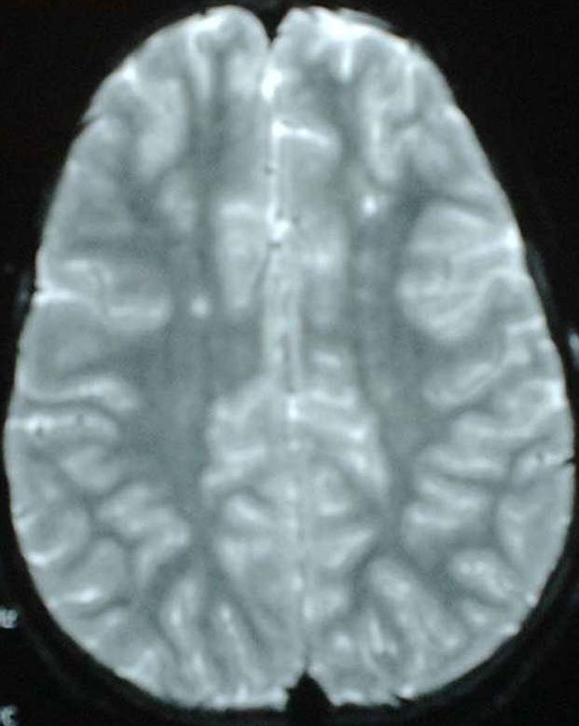
Overt Stroke
Silent Stroke
Historical frequency: 11%
Recurrence rate: 50-90%
2º prevention: CT (not HU¹)
1º prevention: CT² → HU³
Current frequency: 20-40%
Neurocognitive, academic impairment
2º prevention: CT⁴
1º prevention: unknown/unproven
¹SWiTCH trial ²STOP I and II trials ³TWiTCH trial ⁴SIT Trial

Slide 73
Screening and Prevention of Overt Stroke
Transcranial Doppler ultrasonography (TCD) screening
At least yearly between 2-16 years of age
Recommend chronic transfusions for abnormal velocities
TWiTCH trial
Hydroxyurea is non-inferior to chronic transfusion therapy
Inclusion criterion: abnormal TCD velocities (not MRI abnormalities or stroke)
Exclusion criterion: severe vasculopathy by MRA
Methodical transition to hydroxyurea after at least 12 months of chronic transfusions.
TAMMV (cm/s)² | STOP Classification | Yearly Risk of Stroke
<170 | Normal | <<1%
≥170 and <200 | Conditional | Intermediate (2-7%)³
≥200 | Abnormal | 10% (over subsequent 3 years)³
¹TAMMV = time averaged maximal mean velocity. Maximum or peak velocities are different.
²Cutoffs for non-imaging TCD; for imaging TCD, subtract 15 cm/s from cutoffs (e.g., abnormal is ≥185)
³Higher velocities give higher risks
Notes:
TCD is used to detect increased blood flow at sites of stenotic lesions in the large vessels of the circle of Willis. These are antecedents of overt stroke.
A TCD flow velocity of 200 cm/s or more indicates a 10% risk of stroke per year.

Slide 74
Management of Overt Stroke
Initial therapy
Rapid triage
Supplemental oxygen
Avoid delays to transfusion
Erythrocytapheresis likely better than simple transfusion
Simple transfusion can be given if Hb <9 g/dL as a temporizing measure for any delay in erythrocytapheresis
Secondary prevention
Chronic transfusion therapy
Stem cell transplantation
SWiTCH Trial: chronic transfusions and chelation better than hydroxyurea and phlebotomy

Slide 75
Management of Priapism
Home management
Oral analgesics
Oral hydration
Warm bath / shower
Urination
Oral pseudoephedrine
Prevention
Nightly pseudoephedrine
Leuprolide, bicalutamide
Prolonged (>4h)
IV analgesia
IV hydration
Oral pseudoephedrine
Rapid aspiration and irrigation
Avoid shunt procedures
Acute transfusion not shown to be helpful
Old reports that exchange transfusion may be harmful (ASPEN¹)—but is likely safe.
¹Association of sickle cell disease, priapism, exchange transfusion and neurological events.

Slide 76
Renal Complications of SCD by age of onset
reversible hyposthenuria
irreversible hyposthenuria
polyuria
albuminuria/proteinuria
renal tubular acidosis
gross hematuria
ESRD
10
20
30
Small studies suggest the ACE inhibition or ARB therapy may decrease albuminuria/proteinuria but the long-term effects are not known.
age (years)

Slide 77
Long-term Complications of SCD
Retinopathy
Avascular necrosis
Cardiomyopathy
Pulmonary hypertension
Chronic lung disease
Renal insufficiency / failure
Progressively severe anemia (adults)

Slide 78
Hydroxyurea: preventive therapy for all
Mechanism
Ribonucleotide reductase inhibitor
Induction of Hb F (main action)
Indication:
Hb SS (offer at ≥9 mos.)
Dosing
Once daily oral formulation
Begin at ~20 mg/kg
Increase incrementally over 2-3 months to DLT (usually neutropenia; ~30 mg/kg)
Toxicity
Transient, dose-related neutropenia or thrombocytopenia
Requires monitoring of CBCs
No apparent increased risk of malignancy
Efficacy
Decreases frequency of pain, ACS, hospitalizations, transfusions
Prevents organ damage
Prolongs life
*Not FDA-approved for children.
Notes:
HU is a medication that reduces the severity of SCD.
The MSH showed that it decreased the time to 1st and 2nd painful event.
It’s given by mouth once daily…
The toxicity is minor…

Slide 79
Transfusion Therapy
Episodic or Acute
Chronic Transfusions
Indications
Acute anemia
Arrest disease process (ACS)
Prevent complications (pre-op)
Simple transfusion (“top-up”)
Raise to baseline Hb or 8-10 g/dL
Avoid over-transfusion
Exchange transfusion
Acute stroke
Severe ACS, MOFS
Rapid clinical deterioration
“High” Hb concentration (>9 g/dL)
Main indications
Stroke (1º, 2º prevention)
Recurrent ACS
Frequent pain
Management
Monthly (every 4 - 6 weeks)
6 months to indefinitely
Pre-transfusion HbS < 30%
HbS-negative PRBCs
Extended antigen matching¹
Partial or automated exchange²
Main complications
Iron overload²
Alloimmunization¹
Infection
ACS = acute chest syndrome;
MOFS = multi-organ failure syndrome of SCD
¹Extended matching to decrease alloimmunization
²Phlebotomy or exchange to decrease iron loading

Slide 80
Avoid Over-Transfusion
90% Hgb S
60% Hgb S
30% Hgb S
Viscosity
O2 Delivery
0% Hgb S
Stroke
20
30
40
Hematocrit
Viscosity
Don’t transfuse higher than 10-11 g/dL in the un-transfused patient.

Slide 81
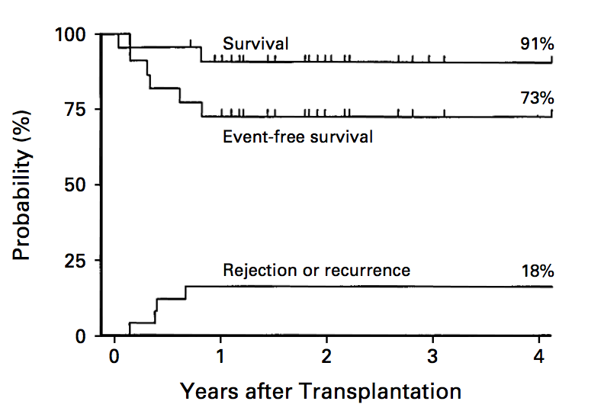
Stem Cell Transplantation for SCD or thalassemia
~95%
SCT is a cure for SCD and thalassemia
HLA-matched sibling donors are limited
Ongoing research to expand donor choices and reduce toxicity
70-80%
(including chronic severe GVHD)
5-10%

Slide 82
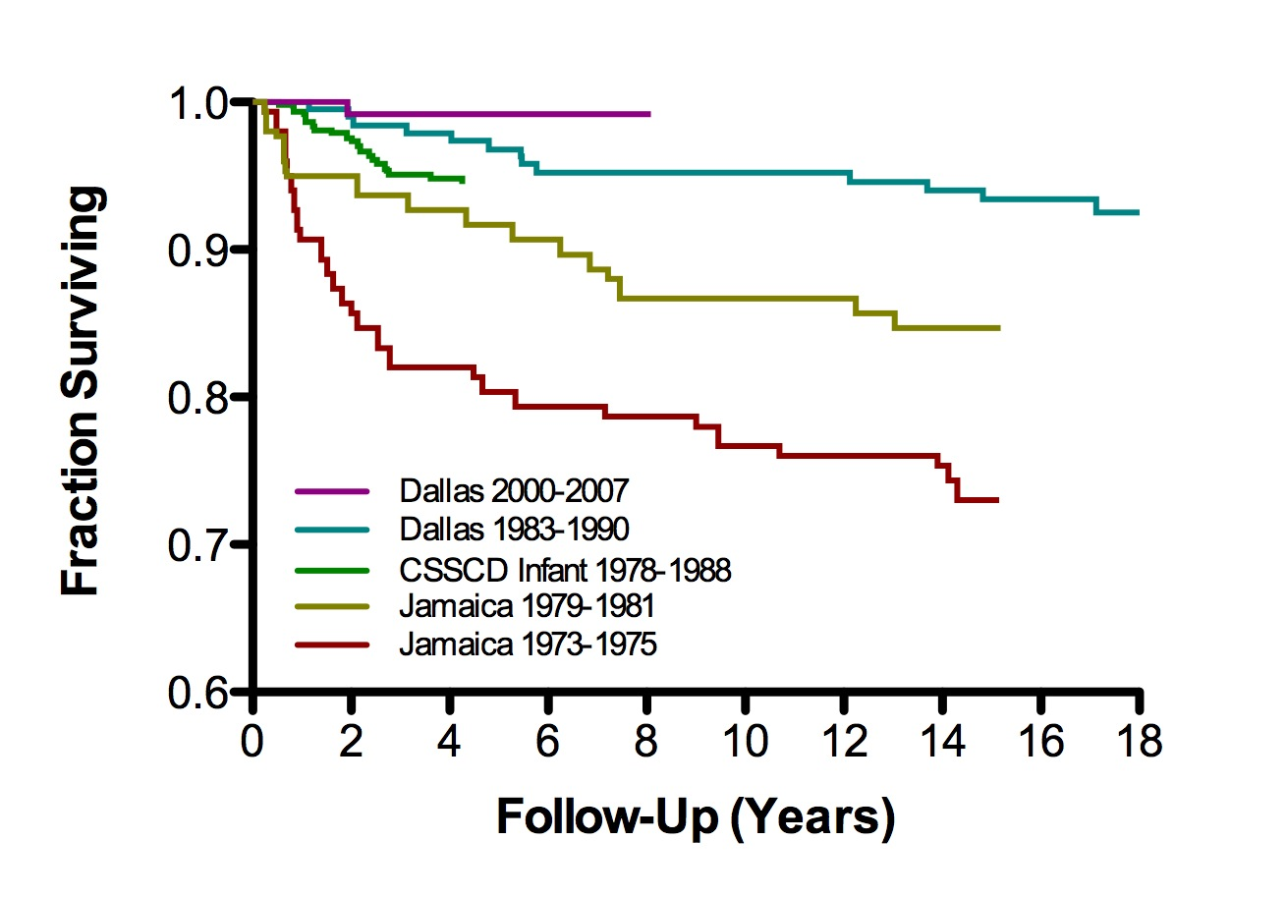
Survival in Sickle Cell Anemia
Current Estimated Life Expectancy
HbSS |  | HbSC | HbS trait
Male | Female | Male & Female | Male & Female
53 y | 58.5 y | Approaches normal | Normal
Notes:
Survival of children with SCD continues to improve, as it has with many malignancies.
Reasons for improved survival include…

Slide 83
Less Common Forms of SCD other compound heterozygous states
β-hemoglobinopathies:
D^{Punjab} (SD disease)
O^{Arab} (SO disease)
E (SE disease)
β^{S}
β-thalassemias:
(δβ)⁺-thalassemia (S/Lepore)
(δβ)⁰-HPFH (S/gene-deletion HPFH)
Do not conflate different forms of HPFH.
Compound heterozygosity for gene deletion HPFH is not the same as homozygosity for Hb S and co-inherited non-gene-deletion HPFH.
chromosomes 11
Notes:
There are also less common forms of sickle cell disease that occur when the Hgb S mutation is coinherited with other beta hemoglobinopathies or beta thalassemias.

Slide 84
Sickle Cell Trait Adverse Effects or Associations
Microscopic hematuria
Renal papillary necrosis (gross hematuria)
Isosthenuria (mild urinary concentrating defect)
Increased risk of chronic kidney disease
Increased risk of pulmonary embolism
Glaucoma after hyphema
Splenic infarction (altitude or depressurized flight)
Renal medullary carcinoma
Exertional heat illness / rhabdomyolysis / death
renal
rare

Slide 85
Key Diagnostic Differentiations specifically mentioned in the ABP content outline
Test or Characteristic | Hb SS | Hb S / HPFH*
Newborn screening pattern | FS | FS
Hbs present | S > F | S > F
Hb F % (>6 mos. old) | 0 - 30 | 20 - 40
Distribution of Hb F | heterocellular | pancellular
Blood counts | Anemia & reticulocytosis | No anemia or reticulocytosis
*Specifically referring to gene-deletion HPFH [(δβ)⁰-HPFH]
Test or Characteristic | Hb Sβ⁺-thalassemia | Sickle cell trait
Newborn screening pattern | FS(A) | FAS
Main Hbs present | S > A | A > S
Blood counts | Anemia, microcytosis & reticulocytosis | Normal

Slide 86
Hb C Disease
Homozygosity for β^{C} (Hb C)
Not a “sickling” disorder
Mild chronic hemolytic anemia
Intermittent jaundice
Splenomegaly (adolescents and adults)
No hyposplenism
No splenic sequestration
Microcytosis, targets, crystals
Hb C crystals
Notes:
Moving on, Hgb C disease is the homozygous state for the betaC mutation. It is not a sickling disorder.
This condition is characterized by a mild chronic hemolytic anemia. Individuals may have intermittent jaundice, and splenomegaly is common in adolescents and adults.
One sees microcytosis, target cells, and Hgb C crystals on the peripheral smear.

Slide 87
Charles Quinn, MD, MS
Medical Director, Pediatric Sickle Cell Program
Medical Director, Erythrocyte Diagnostic Laboratory
Cincinnati Children’s Hospital Medical Center
Professor of Pediatrics
University of Cincinnati College of Medicine

Slide 88
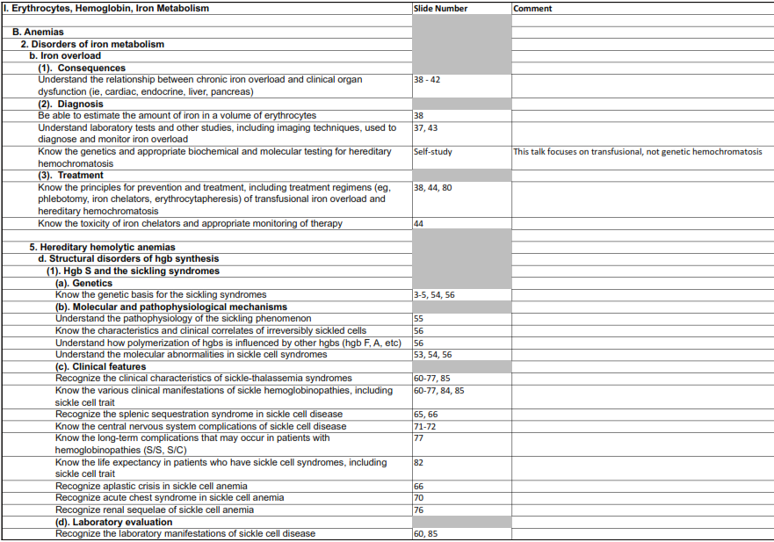
Assigned Content Outline Material

Slide 89
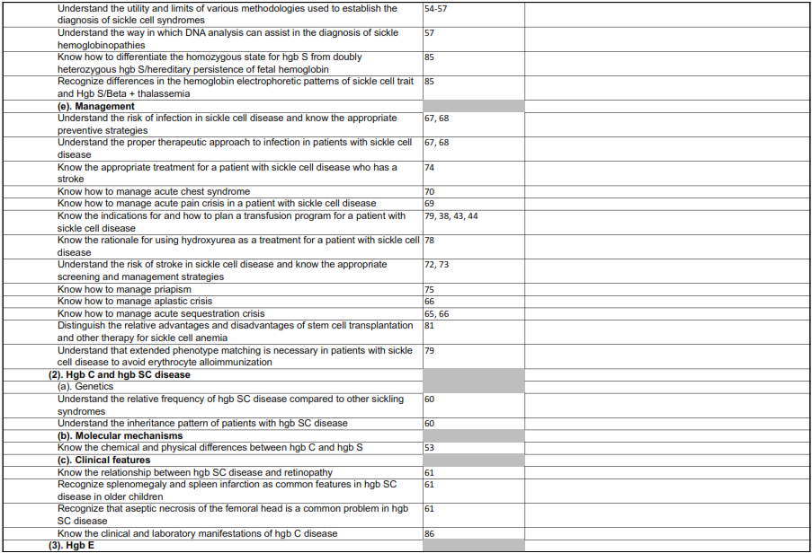
Assigned Content Outline Material

Slide 90
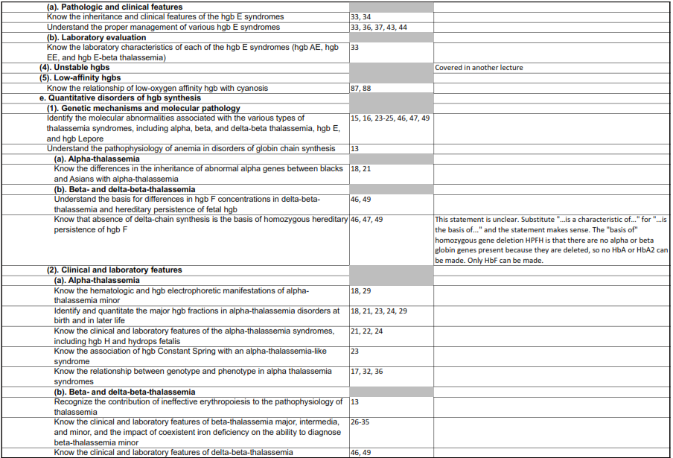
Assigned Content Outline Material

Slide 91
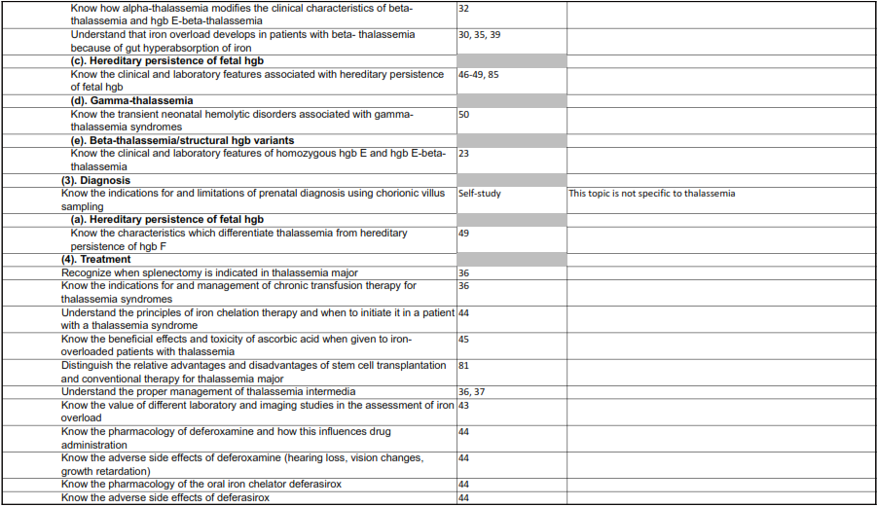
Assigned Content Outline Material

